Slide 1
Chapter 7: Understanding Application Software
Instructor: <Daw Khin Myat Thu>

Slide 2
Chapter 7: Understanding Application Software
Learning Objectives:
Identify the various types of application software
Understand the basics of business productivity applications
Explore graphics and photo editing programs
Understand system requirements and the uninstall process

Slide 3
introduction
Application software is software that enables you to perform a useful task on your computer.
Some programs are classified as productivity software because they allow you to get things done.
Other application software is designed to entertain you.

Slide 4
Word Processing
Most popular type of productivity software is the word processor
Designed for text-based documents
Contains advanced spelling and grammar correction, formatting tools
Microsoft Word is the most popular program in this category
Google Docs, Apple Pages

Slide 5
Word Processing

Slide 6
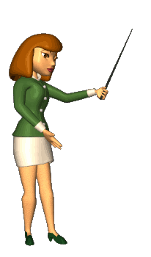
Desktop Publishing
Page layout software
Combines text with graphics
Content is frame-based for greater flexibility in the layout
Microsoft Publisher is popular for home users
Professional versions include QuarkXPress and Adobe InDesign
Main difference between word processing and desktop publishing is that word processing program enables to type directly on the page onscreen.
Desktop publishing uses movable and resizable frames for everything.

Slide 7
Desktop Publishing
Notes:
Desktop publishing software enables users to precisely position the text and other elements on a page or across a double-page spread (facing pages) to create an attractive design.
The text can be creatively wrapped around embedded images, and graphics can be made semi-transparent, or “ghosted,” behind text so the words aren't obscured.
The main difference operationally between word processing and desktop publishing is that a word-processing program typically enables you to type directly on the page onscreen, and it flows the text automatically based on the margins, indents, and number of columns you specify.
Desktop publishing, on the other hand, uses movable and resizable frames for everything, including text (see Figure 7.2). This gives you more control over the precise positioning of each element.

Slide 8
Spreadsheet Applications
Analyzes and presents numeric data
- Budgets
- Mortgages
- Sales data
- Inventory levels
Creates charts out of numeric data
Stores data in cells
Microsoft Excel (Apple Numbers)
Notes:
Spreadsheet data is entered into cells in rows and columns. You can enter text, numbers, or a combination of the two. If you enter numbers, you can apply number formatting that makes the numbers appear as currency, percentages, or any of several other number types.
Spreadsheet software does more than just record lists of text and data, however. It also supports formulas that calculate and manipulate the numeric data.
For example, in Figure 7.4, each of the expense figures in column B is summed in the formula in cell B9: =SUM(B3:B7). See Chapter 10 for detailed information on creating spreadsheets and working with formulas.

Slide 9
Spreadsheet Applications
Notes:
Spreadsheets can produce a range of charts and graphs based on the data they contain, like the one shown in Figure 7.3. These charts can then be exported and used in a report such as a word processing document or a presentation.

Slide 10
Spreadsheet Applications
Functions perform math calculations, such as SUM shown here

Slide 11
Database Software
Database: A structured collection of data, such as an inventory or address book
- Contains one or more tables
- Each table contains records and fields
Database Management System (DBMS) is the software that manages a database
Data mining: Extracting information from a database
Relational database: A database in which there are multiple tables with relationships to one another
Hierarchical Database: Tree structure in which elements consist of nodes such as parent node and child nodes.
Notes:
A database is a structured collection of data, such as the inventory of a store or a collection of personnel files.
A database contains one or more tables, each of which contains records.
For example, you might have a table called Employees that contains a record for each employee.
A record is information about one instance of the data being stored, such as one employee, one inventory item, or one sales transaction. Each record contains one or more individual pieces of information, called a field.
For example, in an Employees table, one of the fields might be Badge Number, and another might be Hire Date. The software used to create and control a database is a database management system (DBMS).
A database program makes calculations and extrapolates information using combinations of data and varying instruction sets. You might use it to see how one item or person compares to another. For example, your school uses a database to keep track of how well you're doing in comparison to your classmates across different subjects. Extracting information from a database is known as data mining. Web searches make use of data mining to provide search results based on the search query the user enters.

Slide 12
Primary Key
Fields
Record
Form

Slide 13
Relational database

Slide 14
Hierarchical Database

Slide 15
Personal Information Management software
Provides time-management and contact-management tools
- Calendars/scheduling
- Names and addresses of people and businesses
- To-do lists
- Notes
May also include email
Microsoft Outlook is the most popular
Notes:
It can be a challenge to keep track of where you need to be, what you need to do, and whom you need to contact. Personal information management (PIM) software helps people stay organized by providing a calendar, an address book, and a to-do list.
Some PIM software also functions as an email program, and allows you to send, receive, store, and organize email messages. Microsoft Outlook is a very popular email application that includes a full set of PIM capabilities. You can also get some of the individual PIM functions in other applications. For example, you can buy separate calendar, task list, and email applications, or use free versions online, such as Google Calendar and Gmail.

Slide 16
Software Suite
A collection of related applications sold as a group
Microsoft Office: Excel, Word, PowerPoint, Outlook, Access
Creative Suite: Photoshop, Dreamweaver, Illustrator, InDesign, Director
- provide photo-editing, web design, vector graphics, desktop publishing, video-editing capabilities
Adobe (professional graphics, publishing tools and creative cloud suite)

Slide 17
Accounting and Personal Finance software
Accounting software: simplifies the process of managing a business’s finances (invoices, purchase orders, processing payments and running reports)
- Quickbooks is one popular example for small businesses
- Larger businesses may have their own custom software
- online version available on a pay-as-you-go monthly fee plan
- FreshBooks and Outright are web-based.
Personal finance software: manages home and personal finances
- Quicken is one popular example
- Mint is a free online tool
- Your bank may have online banking services

Slide 18
Accounting and Personal Finance software
Tax software
- enables individuals and small businesses to calculate the taxes they owe and file the needed forms with the government
- TurboTax and H&R Block are two popular tax applications

Slide 19
Graphics software
Includes any application that enables you to create and manipulate visual images.
Includes drawing programs, photo manipulation programs, presentation creation programs, and video capture and editing software.
The products available include both professional-quality software used in entertainment and advertising, and consumer-quality software that the average computer hobbyist might experiment with.

Slide 20
Vector Image Drawing Programs
Vector art: art created with math formulas in a drawing program (rectangle, an oval a straight line)
- Adobe Illustrator (Professional quality program) for commercial uses such as technical drawings and architectural plans
- Drawing tools in Office applications
- Clip art line drawings
Vector images have many advantages.
- do not take up much disk space to store because the information needed to display them is very simple and compact.
- can be resized to any size without any loss of quality, because the math formulas behind them are simply recalculated and the shape redrawn.
The main disadvantage of a vector graphic is that even the best quality drawings don't look completely real.
- Most people would never mistake a character from a game like “Second Life” or “The Sims” for a video of a real person, for example.

Slide 21
Vector Graphic Tools in PowerPoint

Slide 22
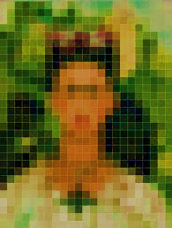
Raster (photo) editing Programs
Raster art also called a bitmap image: art created with a grid of colored dots
Scanned with scanners and digital cameras
Can also be created from scratch in Paint programs
Adobe Photoshop
Each graphic has a native resolution
Resolution is measured in pixels, as in 1024 x 768

Slide 23
Bitmap (Raster) Graphics
Color depth: number of bits used to describe the color of each pixel, such as 24-bit or 32-bit
A standard color depth is 24-bit, which uses 8 bits for red, 8 bits for green, and 8 bits for blue. There are $2^{24}$ (about 16 million) unique colors possible.
The human eye can only detect about 10 million different colors, so this is more than enough for full photorealism.
Notes:
A raster graphic, also called a bitmap image, is one that's composed of a grid of colored pixels. When you use a scanner or digital camera to capture an image or take a photo, the result is a raster graphic. Raster graphics can also be created from scratch using a program such as Paint (the free raster image-editing program that comes with Windows) or, on the higher end, Adobe Photoshop (or the consumer-level version, Photoshop Elements
A raster graphic has a native size, known as its resolution. Resolution is measured in number of pixels horizontally by number of pixels vertically, like this: 1024 × 768.
A raster image also has a color depth, which means the number of bits required to describe each pixel's color. A standard color depth is 24-bit, which uses 8 bits for red, 8 bits for green, and 8 bits for blue. There are 224 (that is, 2 to the 24th power, or about 16 million) unique colors possible in 24-bit color. The human eye can only detect about 10 million different colors, so this is more than enough for full photorealism.
One disadvantage of raster graphics is that they take up a lot of disk space. Each pixel requires 24 bits to describe it, at a minimum, so a 1024 × 768 image would take up at least 2,359,296 bytes (about 2.3 MB) in an uncompressed file—maybe more, depending on the file format. Because raster images can be so large, some file formats employ compression.

Slide 24
Photoshop Elements

Slide 25
Drawbacks of Bitmap Images
Large file size
- Example: 24-bits per pixel x 1024 x 768 = 2,359,296 bytes
- File compression can reduce the size
Lossless
Lossy
Loses quality when resized
- Resizing causes images to be pixelated
- Image quality loss is especially noticeable when resizing above original size
Notes:
Depending on the file format, compression can either be lossless (no loss of image quality) or lossy (some loss of image quality). The other major problem with raster graphics is that they tend to lose their quality when resized—especially when enlarged beyond their original dimensions. This happens because when you enlarge a raster image, the pixels don't change size, so the software must simulate a particular pixel's color, taking up more space than it originally did. The trouble is, it's not nearly as simple as just adding another pixel of the same color next to the original, because resizing is often done in odd multiples, like 15%.

Slide 26
Images Are Made of Pixels

Slide 27
Pixelation
Creating vector graphics with Microsoft PowerPoint at Page 244 Step by Step
Creating Raster Graphics with Paint at Page 246 Step by Step

Slide 28
Presentation Graphics Software
Creates groups of graphic slides to accompany presentations
Slides can be enhanced with graphics, sounds, videos, and animation effects
Microsoft PowerPoint from Microsoft office, Keynote for Apple computer
Presentations can be delivered in-person, on disc, on the Internet, or made into videos
Notes:
At various points in your working life, you're likely to be asked to give a presentation or make a speech. It's a daunting prospect. However, you can deflect some of the attention by giving your audience something else to look at. They will also find it easier to digest what you have to say if you provide a visual representation of key facts and figures you're discussing. Presentation graphics software is the ideal tool for this purpose. It enables you to create screen-sized slides containing a mixture of words and images that you can move through on demand as you deliver your presentation. You can incorporate audio and video clips, corporate branding such as company logos and color schemes, and other special elements and features.
Most presentations are created and delivered using the Microsoft PowerPoint Part of the Microsoft Office productivity suite. On an Apple computer, the equivalent program is Keynote; there is also a version of Microsoft Office available for Apple devices such as Macs and iPads.

Slide 29
PowerPoint
Bulleted summaries, bar and pie chart features
Most effective presentations have only a handful of slides and feature minimal details
Notes:
Presentation graphics generally distill what the speaker says into bulleted summaries, and bar and pie charts. Such presentations may accompany a detailed report or be used as part of a marketing pitch—for example, showing why a company is better to do business with than its rivals. The most effective presentations have only a handful of slides and feature minimal details, allowing the audience to focus on what the presenter says. To make your point effectively, avoid creating long and boring presentations crammed with far too much information.

Slide 30
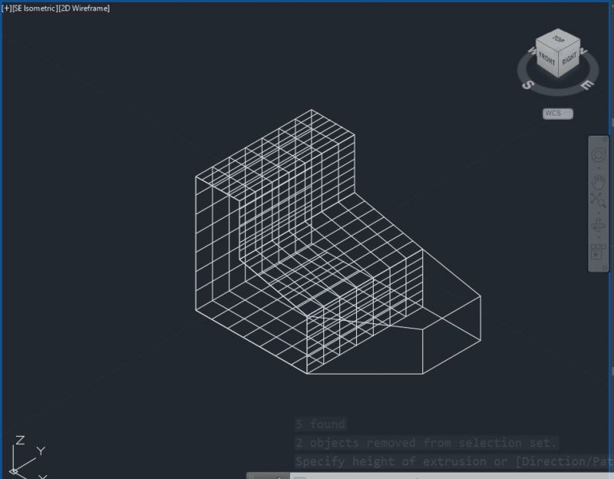
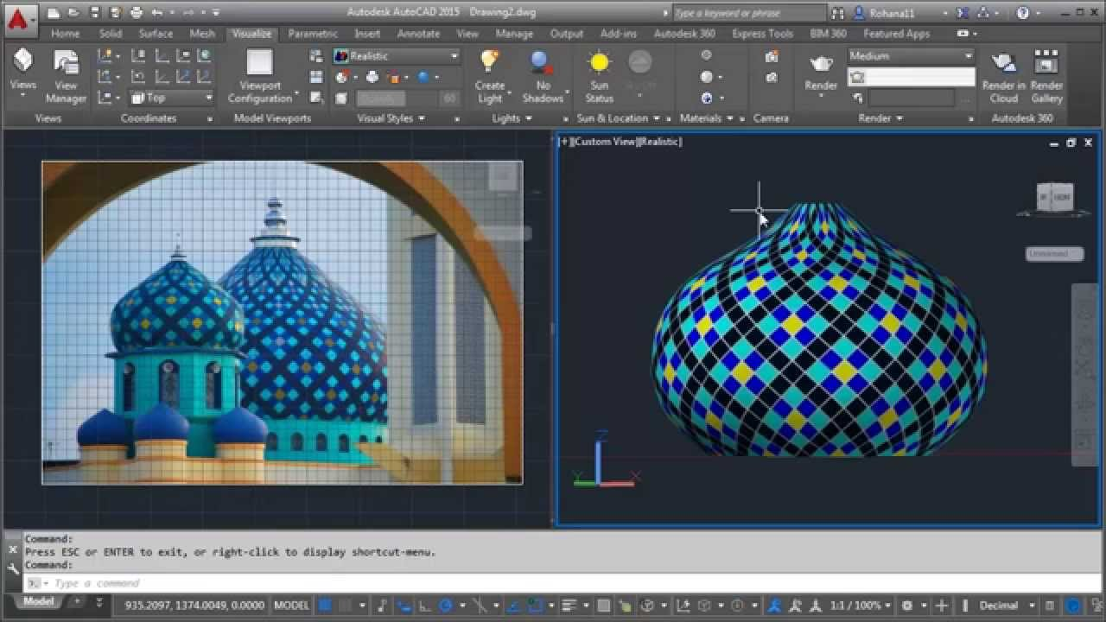
Computer-Aided Design (CAD)
Vector graphic drawing tool for 3D modeling
Creating a CAD drawing is a multi-step process
- Objects are created as a wireframe
- Wireframe is assigned properties such as mass
- Wireframe is assigned with a texture that resembles a certain type of surface, such as skin, hair, bones, or fabric
Notes:
Computer-aided design (CAD) software is used when designing any sort of item that has a physical form (rather than being flat like a photo).
It uses the same basic idea as the two-dimensional vector graphics that you learned about earlier in this chapter, but it models them to have height, width, and depth.
This is also known as 3D modeling. computer-aided design The process of using computer software to produce technical drawings that include the product's precise scale, simulate its textures, and show it in full three-dimensional detail. Three-dimensional drawings are built around a wireframe. This is a sort of skeleton on which details of the computerized object or character are overlaid. The wireframe is created by extruding the flat shape to give it volume and depth.
wireframe A 3D vector drawing that consists only of drawn lines, without any surface textures applied.
The object is also given mass and assigned textures and properties such as skin, hair, bones, or fabric. Each of these elements has a predefined (but separately editable) set of attributes. For instance, the attributes of a brick wall would include strength, inflexibility, and resistance to wind and people bumping into it. The wireframe can be rotated so the designer can check that all the design elements and perspective are correct. Once all the attributes have been added to an object created using a CAD program, the object is rendered to give it the appearance of a solid form by applying surface texture and color. For example, in Figure 7.9, which shows a rendered image in AutoCAD, notice how the image surface of the handheld vacuum includes two different surface textures: One looks like solid plastic, and the other looks semi-transparent. render To apply a surface texture and fill to a wireframe image to give it a solid appearance. Rendering can require huge amounts of computer power. Especially detailed designs can take many hours to render. If you want to design in 3D, you will need a powerful desktop computer with a multi-core CPU, lots of memory, and a high-quality graphics card.

Slide 31
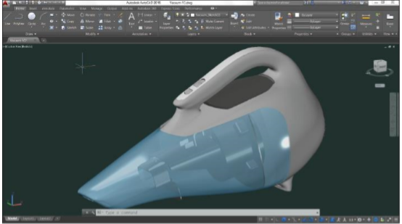
Computer-Aided Design (CAD)
- Rendering applies the properties and textures to the wireframe
- Rendering can require a lot of computing power and time

Slide 32
3D printer
Developments in CAD software and a new type of printer have made
A 3D printer uses plastic to build up three-dimensional objects.

Slide 33
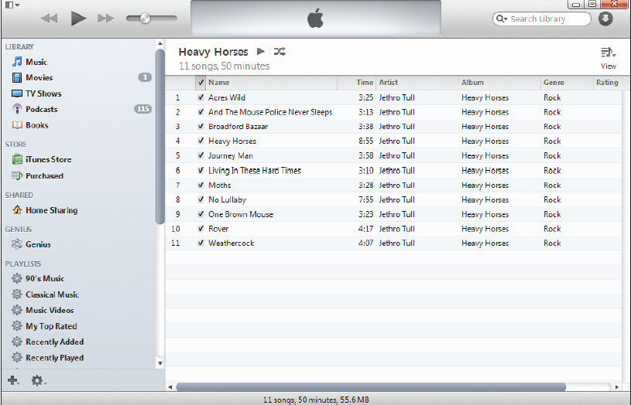
Music and Video Players
Multi-purpose players can play music, DVD movies, videos, podcasts, and audio
Movie player applications may require a codec
Codec is a translation file used to play back a audio or video format.
Notes:
If you have a Windows computer, you'll find that Windows Media Player can play music you've downloaded and any music CDs you insert.
It will also play some video clips and movies. As an alternative to Windows Media Player, you might use iTunes, which is a free download from Apple's website (see Figure 7.10). iTunes can play music, videos, podcasts, audio books, and more. You can also use online services, such as Pandora, to listen to music.

Slide 34
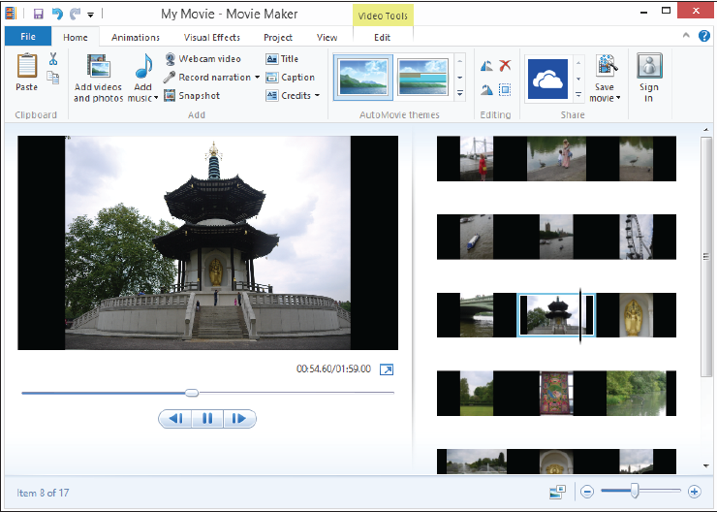
Audio and Video Editing software
Audio editing programs create and make changes to music and narration tracks
Audacity software lets you import multiple audio tracks, trim out the parts you don't require, and then splice everything together.
Video editing programs combine music, still images, and video clips to create movies
Windows Live Essentials for Window and iMovie for Mac.
Notes:
If you want to create your own videos and music, you'll need a camera and instruments to do so. You can easily capture video and record audio on a smartphone and then transfer them to your computer for editing.
Many applications are available for editing audio tracks. For example, the freeware program Audacity (audacity.sourceforge.net) lets you import multiple audio tracks, trim out the parts you don't require, and then splice everything together. Mac users can record and mix digital instruments such as piano, guitar, and drum tracks in the excellent GarageBand application. You can also buy more full-featured products, such as Adobe Audition.
Windows Live Essentials (windows.microsoft.com/en-gb/windowslive/essentials) contains a free Windows Movie Maker program that you can use to trim and combine video clips and photos and to add a sound track or commentary (see Figure 7.11).
On a Mac, iMovie offers slick tools to quickly create your own mini movie. Neither of these programs will tax your computer's processor, but if you want to create professional-looking movies you'll need to use a dedicated video-editing program such as Sony Vegas Pro or Adobe Director, or a full-featured consumer level program such as Adobe Premiere Elements.
As with the animation and 3D graphics programs described earlier, you need a powerful computer; a quadcore or eight-core processor and powerful graphics card are essential.

Slide 35
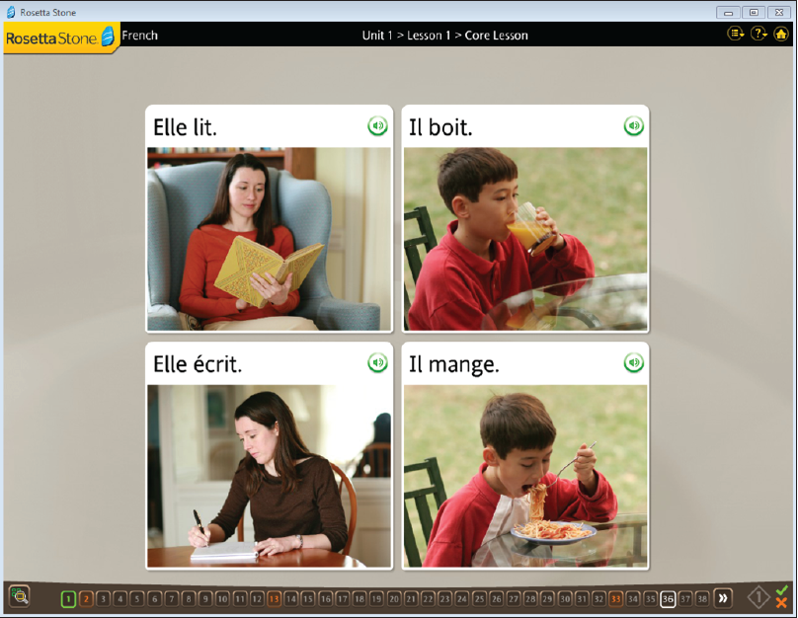
Personal Enrichment and Education software
Legal software (a will, a power of attorney statement, a lease and a loan agreement)
Reference software (dictionary and encyclopedia program)
Educational software that teaches or trains an individual in a particular type of knowledge or skill.

Slide 36
Communication Software
Email client (online web-based service like Outlook.com or Gmail)
Web browser (Safari, Google Chrome, Firefox, Explorer, and Opera)
Instant messaging (Yahoo!, Viber, Line, Messenger, Skype)
Videoconferencing (Zoom)
Groupware (Microsoft SharePoint)

Slide 37
Web Authoring Software
HTML Editors (plain text)
Most people (including most professionals) use web authoring software that provides a what-you-see-is-what-you-get (WYSIWYG, pronounced wizzy-wig) interface.
Web authoring software
Dreamweaver
Expression Web

Slide 38
Managing Your Applications
End User License Agreement (EULA)
System Requirements
Minimum and Recommended
Hardware requirements (CPU, RAM, disk space)
Operating system version

Slide 39
Installing Applications
What Installing Does
Expands and copies files to your hard drive
Creates a shortcut on the Start menu
Modifies the Windows Registry
How to Install an Application
Download a Setup file and run it to install
Insert CD or DVD disc and follow the prompts

Slide 40
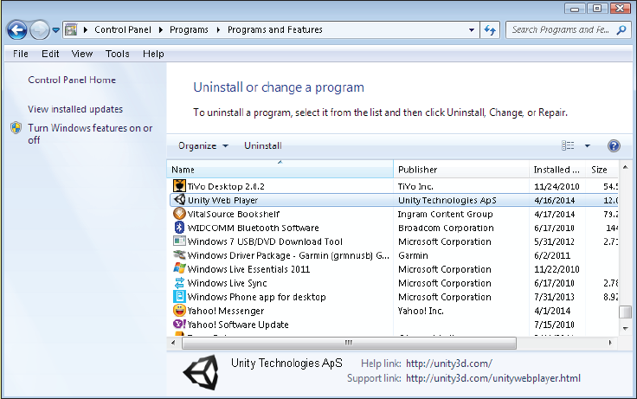
Removing Applications
Click Start and click Control Panel.
Under Programs, click Uninstall or Change a Program.
Click the program to uninstall.
Click the Uninstall button.
Follow the prompts.

Slide 41
Updating Applications
Updating fixes bugs and security flaws
Updates may be automatically installed for some applications

Slide 42
Key Terms
accounting software
application software
cell
codec
color depth
compression
computer-aided design
data mining
database
database management system
desktop publishing software
educational software
email application
End User License Agreement (EULA)
formula
graphics software
groupware
hierarchical database
instant messaging
legal software
node
personal finance software
pixel
pixilated
presentation graphics software
raster graphic
reference software
relational database
render
resolution
slide
spreadsheet
suite
system requirements
tax software
vector-based illustration
video chat
videoconferencing
web authoring software
what-you-see-is-what-you-get (WYSIWYG)
wireframe
word processor

Slide 43
Summary
1 . For each of the following, name two types of work you could accomplish: word processor,
spreadsheet, desktop publishing software, database.
2 . What are the advantages of a software suite?
3 . How is data stored in a relational database?
4 . If a raster graphic had a resolution of 800 × 600, how would you determine the number of
pixels in it?
5 . Explain the process of rendering in a CAD application.
6 . Explain the difference between instant messaging and video conferencing.

