Slide 1
Chapter 2: The System Unit
Instructor: <Daw Khin Myat Thu>

Slide 2
Chapter 2: The System Unit
Learning Objectives:
Recognize how data is processed
Understand processors
Understand memory types and functions
Identify and use ports and buses
Troubleshoot common system unit problems
2
Notes:
The heart of any computer is its system unit. As you learned in Chapter 1, “Computer Basics,” the system unit is the main body of the computer, containing the essential components it needs to function.
If you have ever shopped for a computer, you probably noticed that some models cost much more than others—many times more. The quality and features of the components inside the system unit are the primary reason why cost varies so widely.
Two computers can look identical from the outside but be very different in their capabilities and performance levels.
In this chapter, you will learn what happens inside the system unit, and what role each key component plays in making the computer fast and efficient at performing the tasks you ask of it.
When you understand these things, you will be able to decipher a computer's technical specifications with confidence and select the models that have the best balance of cost and features for your situation.

Slide 3
Careers in IT
Bench Repair Technician
- Diagnose system problems (hardware and software)
- Two years Degree in computer technology or CompTIA’s A+ certification
Notes:
A bench repair technician is like a mechanic for computers.
As the word bench implies, this technician works primarily at a workbench in a repair shop, although mobile repair technician positions are also available.
Bench repair technicians can diagnose system problems with computers that customers bring in for repairs, including both hardware problems like defective parts and software problems like virus infections.
This position requires either a two-year degree in Computer Technology or a professional certification such as CompTIA's A+ certification.
It is a good job for someone who prefers working mostly with the computers themselves rather than with their users.

Slide 4
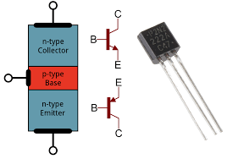
Understanding CPUs
Has at least one processor (CPU) which contains millions of tiny transistors
Pathways that take in data and instructions,
Process the data and output the result.
Notes:
The CPU contains millions of tiny transistors and
pathways that take in data and instructions,
process (calculate) the data according to the instructions, and
output the results of the calculations.
A computer may also have smaller processors used in specific subsystems, such as a graphics processor.
The control unit manages the flow of data through the CPU. It directs data to and from the other components within the CPU.
The arithmetic logic unit (ALU) component does the actual processing. It receives data and instructions and delivers a result. For example, if it received the numbers 3 and 5, and the instruction Sum, it would return 8.
Registers are holding areas for both data and instructions. There are many different registers, each with its own special purpose. For example, there are registers that hold data, registers that hold instructions, registers that store logical states (yes/no), temporary values that serve as increment counters, and so on.

Slide 5
Understanding CPUs
Central Processing Unit (CPU)
- Control Unit
Manages the flow of data through the CPU
- Arithmetic Logic Unit (ALU)
Does the actual processing
- Registers
Holding areas for data and instructions
Notes:
The CPU contains millions of tiny transistors and
pathways that take in data and instructions,
process (calculate) the data according to the instructions, and
output the results of the calculations.
A computer may also have smaller processors used in specific subsystems, such as a graphics processor.
The control unit manages the flow of data through the CPU. It directs data to and from the other components within the CPU.
The arithmetic logic unit (ALU) component does the actual processing. It receives data and instructions and delivers a result. For example, if it received the numbers 3 and 5, and the instruction Sum, it would return 8.
Registers are holding areas for both data and instructions. There are many different registers, each with its own special purpose. For example, there are registers that hold data, registers that hold instructions, registers that store logical states (yes/no), temporary values that serve as increment counters, and so on.

Slide 6
Understanding CPUs
Notes:
Registers are holding areas for both data and instructions. There are many different registers, each with its own special purpose. For example, there are registers that hold data, registers that hold instructions, registers that store logical states (yes/no), temporary values that serve as increment counters, and so on.

Slide 7
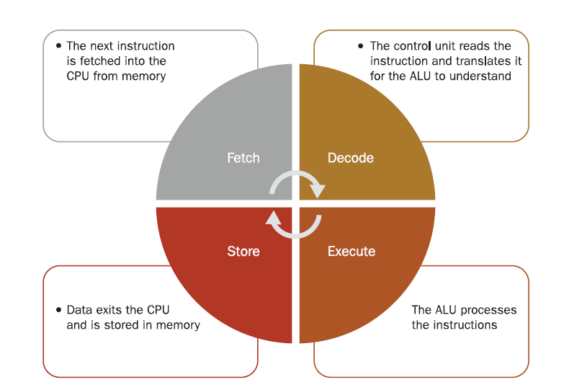
The Machine Cycle
The CPU performs billions of machine cycles per second, with the exact timing being determined by the system clock.
System clock is a crystal on the motherboard that sets the timing for data moving through the system, such as between memory and the CPU.
Notes:
You can also trace the same basic procedure in Figure 2.1 to understand how the parts of the CPU relate to the activities.
The CPU performs billions of machine cycles per second, with the exact timing being determined by the system clock (also called the system timer), a chip on the motherboard that provides the timing for all the system components to operate, as a metronome might do.
system clock A crystal on the motherboard that sets the timing for data moving through the system, such as between memory and the CPU.
This chip contains a crystal that oscillates at a certain frequency to produce the timing pulses.

Slide 8
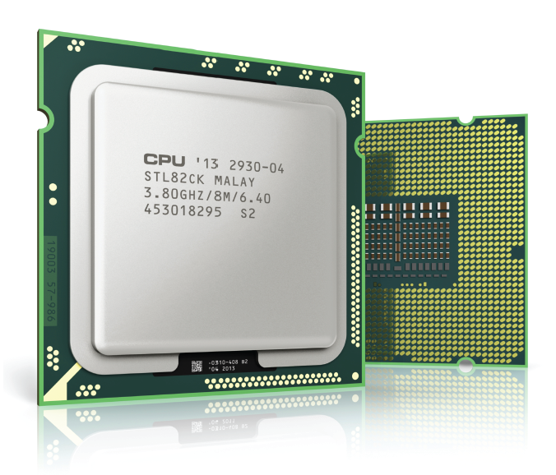
Physical Composition of a CPU
Semiconductor material (silicon)
Encased in a ceramic shell
Mounted on a small circuit board
Pins or contacts on the underside
Notes:
Physically, a CPU is a very small and thin sheet of semiconductor material (usually silicon) with a complex array of tiny transistors and pathways stamped into it with a die.
Semiconductor material is used for CPUs because it does not affect the flow of electricity one way or another: it neither conducts it nor impedes it.
The components inside the CPU are so small that you need a microscope to see them.
The CPU is fragile, so it is protected by a sturdy ceramic and metal casing; some models are mounted on miniature square circuit boards.
The underside of this casing contains either tiny pins or tiny metal dots, precisely spaced, that align with connectors on the CPU socket on the motherboard.
Each pin or each dot is a separate communication line, carrying a different piece of data.
CPUs come in different sizes and have to match the socket type on the corresponding motherboard.

Slide 9
Cores
Most modern PC, CPUs have multiple cores
Each core has its own control unit, ALU, and registers
Common numbers of cores are 2, 4, or 6
Intel i7 processor have four cores.
Multiple cores allows parallel processing for greater throughput
CPU
Notes:
Most modern CPUs have multiple cores, so they can complete multiple tasks simultaneously, as if they physically were more than one CPU.
A core consists of a separate set of the essential processor components (control unit, ALU, and registers).
Most models of the Intel i7 processor have four cores, for example. All of the CPU's cores are located on the same chip.

Slide 10
Caches
Cache is a small amount of fast memory located in or near the CPU
Stores recently used data or data soon to be used
Helps limit latency to improve performance
Multi-level cache system
- L1, L2, L3
- L1 is smallest, fastest, closest to core
- Fetching from L3 takes 10 times as long as from L1
- The cache sizes vary by CPU model.
- The Intel Core i7 CPU (L1 cache of 64KB per core, an L2 cache of 256KB per core, and a shared L3 cache of between 4 MB and 8 MB).
Notes:
In theory, the CPU is capable of executing a function with every tick of the system clock (called a clock cycle).
However, in practice, the CPU sometimes is idle because there is a delay between the request for data to be retrieved from memory and its delivery.
The bus (pathway) between memory and the CPU is not as fast as the CPU's internal speed, so several clock cycles may pass when the CPU is idle.
A delay caused by waiting for another component to deliver data is called latency.
To help minimize latency, CPUs have caches.
A cache is a small amount of very fast memory located near (or within) the CPU.
Data that the CPU has recently used, or is predicted to need soon, is placed in the cache for temporary holding.
That way, if the CPU calls for the data, it's more readily available and there is less delay. CPUs have a multi-level cache system.
Whenever the CPU needs some data, it first checks the Level 1 (L1) cache to see if it's there.
If the CPU does not find what it needs in the L1 cache, it checks the L2 cache.
This cache is also on the CPU itself. Finally, if the L2 cache does not have it, the CPU checks the L3 cache.

Slide 11
CPU Performance Factors
Maximum speed, measured in (GHz)
- CPU is pushed to run faster than its rating, it is said to be overclocked.
Word size
- 64 bit CPUs and 32 bit CPUs
- Speed and word size alone do not form a reliable benchmark of CPU’s capability.
Instruction per second
- Suppose two CPUs that both have a speed rating of 3.4 GHz.
- If each one processed one operation per clock cycle, each one able to output 3.4 billion operations per second.
Notes:
The most obvious performance factor for a CPU is its maximum speed, measured in billions of hertz, or gigahertz (GHz).
Although the actual speed is dictated by the motherboard's system clock, each CPU has an advertised maximum speed, which is the highest speed at which the CPU's manufacturer assures that it will reliably function.
If a CPU is pushed to run faster than its rating it is said to be overclocked.
An overclocked CPU is more prone to overheating, processing errors, and reliability issues.
word size The number of bits that the CPU can accept as input simultaneously. A CPU's word size also makes a difference. The word size is the number of bits that the CPU (or a single core of the CPU, if multi-core) can accept as input simultaneously. Most desktop and notebook PCs have 64-bit CPUs, but some tablets, netbooks, and smartphones have 32-bit CPUs
Instruction per second suppose you have two CPUs that both have a speed rating of 3.4 GHz.
If each one processed one operation per clock cycle, with no delays and with a single core, each one might be able to output 3.4 billion operations per second (usually expressed as Giga instructions per second, or GIPS).
However, one of them might have multiple cores, multiplying that theoretical maximum.
And, realistically, there is always going to be latency, no matter how efficient the processing technology becomes.
Each CPU will also have some advanced data handling technologies that reduce the average latency (the idle time waiting for data) by differing amounts.

Slide 12
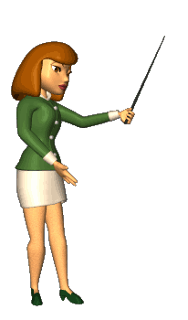
Understanding Memory
Static vs. Dynamic Memory
- Static = non-volatile
- Dynamic = volatile
Random Access Memory (RAM) vs. Read Only Memory (ROM)
- RAM = rewriteable (dynamic or static)
- ROM = not rewriteable (with exceptions) (Static)
- Electrically Erasable Programmable ROM (EEPROM), basis for solid- state drives and USB flash drives
Notes:
Memory like human memory, there is both short-term (temporary) and long-term (permanent) memory storage. Some memory is dynamic, in that it stores data only until the computer is turned off.
Dynamic memory (also called volatile memory) must be constantly refreshed.
Static memory (also called non-volatile memory) retains whatever you put in it indefinitely; the transistors do not require constant electrical power to retain their contents.
When is ROM not really read-only? Actually plenty of times.
Over the years, as technology has advanced, companies have figured out ways to make certain types of ROM chips rewritable.
The first generation used a special machine that reprogrammed the chips; this type of ROM was called Erasable Programmable ROM (EPROM).
Later ROM chips were erasable with strong electrical pulses; this was called Electrically Erasable Programmable ROM (EEPROM); this technology was used to allow the BIOS chip on a motherboard to be updated without having to remove it.
The early versions of EEPROM could only erase and rewrite the entire chip at once, but newer versions allow specific blocks to be rewritten while preserving the data in other blocks.
This advanced ROM-rewriting technology is used in USB flash drives and solid-state hard drives. Unlike RAM, which can be rewritten unlimited times, there is a limit to how many times an EEPROM can be rewritten, but the limit is very high (up to 100,000), so it is seldom an issue.

Slide 13
How Computers Use Memory
System memory (main memory)
* The main memory in a computer system, such as the RAM installed on the PC's motherboard, is dynamic RAM (DRAM).
Component memory (printers, display adapters)
* Many components have a small amount of memory built in for their own use. Component memory is typically DRAM unless the component's function requires it to be otherwise because that's the least expensive kind.
ROM-BIOS (EEPROM chip)
* A motherboard has an EEPROM chip that contains the low-level startup instructions for the hardware. To prevent corruption that would prevent the system from starting up, this chip is not rewritable except with a special utility program.
Notes:
• System memory: The main memory in a computer system, such as the RAM installed on the PC's motherboard, is dynamic RAM (DRAM).
• Component memory: Many components have a small amount of memory built in for their own use. For example, a printer might have RAM that holds the information about the page it is printing, and a display adapter might have memory to hold the data about the image it is displaying on the monitor. Component memory is typically DRAM unless the component's function requires it to be otherwise because that's the least expensive kind.
ROM-BIOS: A motherboard has an EEPROM chip that contains the low-level startup instructions for the hardware. To prevent corruption that would prevent the system from starting up, this chip is not rewritable except with a special utility program.
• Caches: The L1, L2, and L3 caches in a CPU are a type of static RAM (SRAM).

Slide 14
How Computers Use Memory
CPU caches
* The L1, L2, and L3 caches in a CPU are a type of static RAM (SRAM).
USB flash drives, Memory cards, Solid-state hard drives
* These devices use a type of EEPROM to store data. This type of EEPROM is also called flash memory; its enhanced technology allows data to be written and rewritten to it multiple times.
Notes:
• System memory: The main memory in a computer system, such as the RAM installed on the PC's motherboard, is dynamic RAM (DRAM).
• Component memory: Many components have a small amount of memory built in for their own use. For example, a printer might have RAM that holds the information about the page it is printing, and a display adapter might have memory to hold the data about the image it is displaying on the monitor. Component memory is typically DRAM unless the component's function requires it to be otherwise because that's the least expensive kind.
ROM-BIOS: A motherboard has an EEPROM chip that contains the low-level startup instructions for the hardware. To prevent corruption that would prevent the system from starting up, this chip is not rewritable except with a special utility program.
• Caches: The L1, L2, and L3 caches in a CPU are a type of static RAM (SRAM).

Slide 15
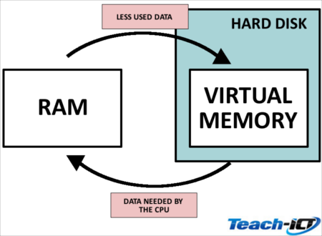
Understanding System Memory
Main memory is dynamic RAM (DRAM), loses its contents if it is not electrically refreshed.
Opened application is placed in system memory.
Virtual memory is simulated memory from data-swapping on/off the hard drive
Paging file is the area of the hard drive dedicated for virtual memory
Memory addresses
Any data can go into any area of the RAM, depending on what’s free at the moment.
Notes:
Each computer has a certain amount of system memory, also called RAM or main memory.
It is dynamic RAM (DRAM), so it loses its contents if it is not constantly being electrically refreshed.
System memory forms a workspace that the operating system uses.
When you open an application, that application is placed in system memory, and when you open a data file, it is placed there too.
When you make changes to a data file, those changes wait in memory until you write them to a more permanent storage area by saving your work.
The more system memory you have, the more applications and files you can have open at once.

Slide 16
Memory’s Physical Form
Dual inline memory modules (DIMMs)
Small-outline DIMMs (SO-DIMMs) for portables
Memory capacity per DIMM (2GB, 4GB, 16GB, etc)
Synchronous DRAM (SDRAM) synchronizes with the system bus speed
Single data rate SDRAM performs one action per clock tick.
Double data rate (DDR) SDRAM performs two actions per clock tick.
DDR2 (four actions), DDR3 (8 actions), DDR4 (technical improvements, 8 actions)
Notes:
System memory actions are synchronized with the system clock in modern PCs, just as the actions of the CPU are.
Therefore, the system memory used in today's systems is often referred to as synchronous dynamic RAM (SDRAM).
synchronous dynamic RAM (SDRAM) DRAM that operates at the speed of the system clock. The slowest and most basic type of SDRAM is single data rate (SDR).
This RAM moves one word of data per tick of the system clock.
SDR SDRAM is found only in older systems. single data rate SDRAM (SDR SDRAM) SDRAM that performs one action per clock tick.
Double data rate (DDR) SDRAM performs two actions per clock tick.
DDR2 SDRAM doubles that even further, and can perform four actions per clock tick, and DDR3 SDRAM doubles it again, to eight actions.
You might guess that DDR4 doubles it again, but it doesn't; DDR4 contains some technical improvements over DDR3 but keeps the same data rate.
Each type of DIMM has a different number of pins, so these DIMMs aren't physically interchangeable.
A motherboard typically supports only one type of DIMM. double data rate SDRAM (DDR SDRAM) SDRAM that performs two actions per clock tick.

Slide 17
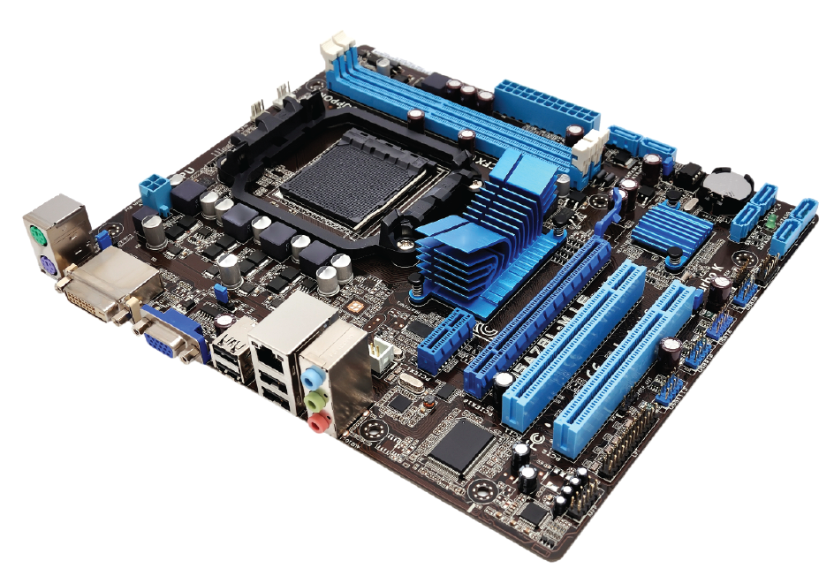
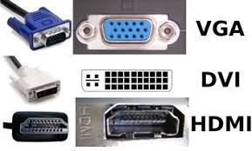
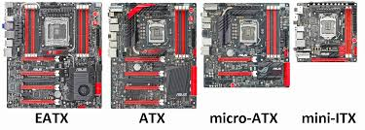
Understanding Motherboards
Motherboard: large circuit board inside the computer
Capabilities dictated by chipset
Chipset contains controllers (traffic, routed data)
Form factor: size and shape of motherboard
Notes:
Both the CPU and the memory plug into the motherboard.
Motherboards vary in many ways, including the CPUs and memory they support, the technology used in their chipset, the expansion slots they have, and the external ports they support.
The motherboard's capabilities are determined by its chipset.
The chipset contains the controllers that direct the traffic along the motherboard's buses, specify which memory and CPUs the motherboard can accept, and route data to expansion slots and ports as needed.
A motherboard typically supports only one brand of CPU, and only a limited array of specific CPU models (usually one or two models with allowances made for various speeds).
It also usually supports only one kind of RAM, in a few different capacities.

Slide 18
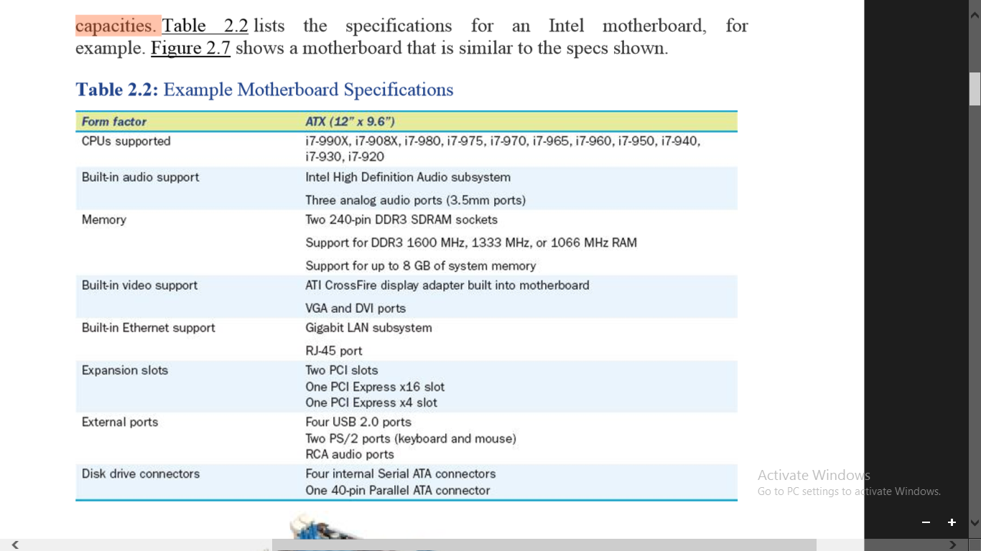
Understanding Motherboards

Slide 19
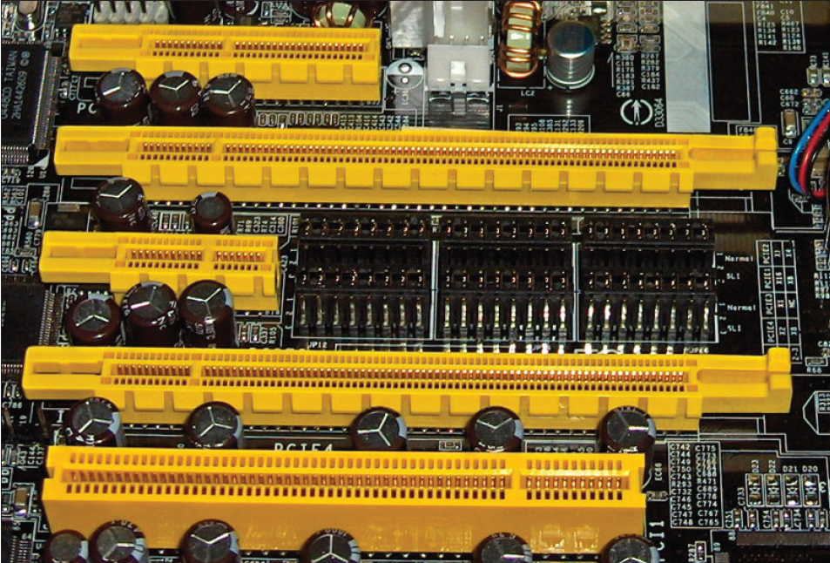
Expansion slots
Expansion slots plastic slots in desktop motherboard, for expansion cards
Adding capabilities that might not be built into the motherboard or adding more features in built-in device
Different motherboards have different numbers and types of slots.
Has its own separate bus, delivering its own combination of width and speed.
- PCI
- PCI Express (PCIe), x1, x4, x16
Notes:
Expansion slots are plastic slots on the motherboard. Inside the slots are metal contacts that connect with metal contacts on smaller circuit boards called expansion cards that fit into them.
There are many expansion devices you can buy, adding capabilities that might not be built into the motherboard, or adding a more feature-rich version of a built-in device.
For example, you might add a Wi-Fi adapter to a desktop PC with an expansion card, or a dial-up modem, or you might replace the on-board display adapter built into your motherboard with a model that has a faster graphics processor.
expansion slot A slot in the motherboard into which an expansion card (a small circuit board) can be installed.
expansion card A small circuit board that fits into a slot on the motherboard to add functionality.
Different motherboards have different numbers and types of slots. Each slot type has its own separate bus, delivering its own combination of width and speed. Recall from Chapter 1 that a bus is a data pathway within a circuit board.
Some buses are parallel, meaning they can carry multiple bits simultaneously.
For example, the system bus is usually 64-bit. Other buses are serial, meaning they are only one lane, and carry only one bit at a time.
The motherboard described in Table 2.2 has three expansion slots: one conventional Peripheral Component Interface (PCI) slot (an older type of slot, for backward compatibility with older devices) and two of a newer type, PCI Express (PCIe). PCIe slots come in different widths, such as x16 (16 channels, used mostly for display adapters) and x4 and x1 (used mostly for non-display components). Those numbers refer to the number of channels of data that can be carried simultaneously. Figure 2.8 shows some slots in a different motherboard; this one has one x1, one x4, and two x16 slots, as well as one regular PCI slot.
Peripheral Component Interface (PCI) A motherboard slot that accepts PCI expansion boards. PCI is considered a legacy interface (mostly obsolete).
PCI Express (PCIe) A new and updated version of the PCI motherboard slot. Different numbers of channels are used in different sized PCIe slots, such as 16, 4, or 1.

Slide 20
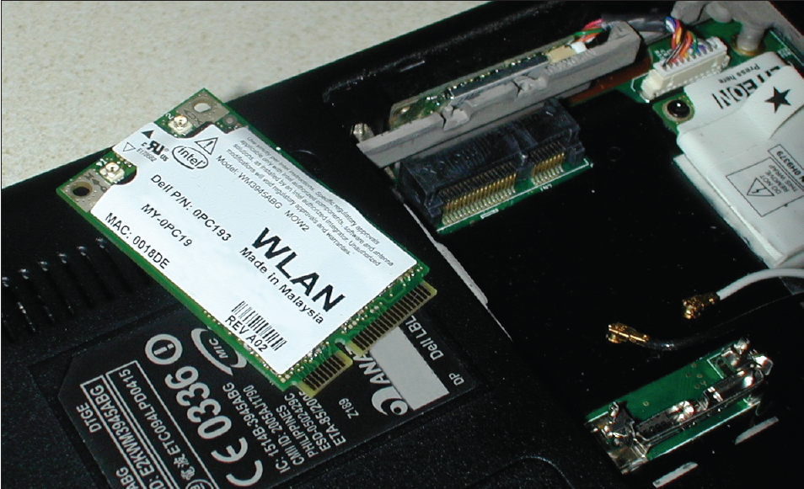
Express card
Notebook PCs are more likely than desktops to have a wide variety of built-in components, so there is less need for expansion slots.
Express Card slot in notebooks
PCI Express Mini Card socket in notebooks
Notes:
Notebook PCs are more likely than desktops to have a wide variety of built-in components, so there is less need for expansion slots.
That's good, because there's not much room for them.
On a notebook PC, there might be an externally accessible expansion slot called an ExpressCard slot.
ExpressCards are small circuit boards encased in a metal cartridge.
They add device capabilities to notebook PCs in much the same way that expansion slots do in desktop PCs.
Over the last two decades, there have been other versions of this same basic technology, called PC Card and CardBus, which accepted slightly different-sized cards.
ExpressCard slots are waning in popularity, and many new notebook computers do not have them.
ExpressCard A metal cartridge inserted into an externally accessible slot in a notebook PC that adds a capability to the system, such as wireless networking.
There also might be a removable panel on a notebook PC with a PCI Express Mini Card socket, into which you can install a small expansion board that uses the motherboard's internal PCIe bus.
One common use for this type of socket is to add a Wi-Fi adapter. Figure 2.9 shows a PCI Express Mini Card and its connector.
PCI Express Mini Card A small circuit board that can be installed in a notebook PC's PCI Express Mini expansion bay to add a capability to the computer, such as wireless networking.

Slide 21
Built-In Components
Graphics Ports:
Digital Visual Interface (DVI)
Video Graphics Array (VGA)

Slide 22
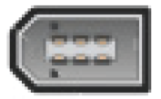
Built-In Components
Speakers/Headphones
3.5 mm
Ethernet networking
RJ-45 jack
Resembles a wide telephone plug
Universal Serial Bus (USB)
USB 1.1, 2.0, 3.0 speeds
FireWire (IEEE 1394)

Slide 23
Built-In Components (Legacy)
PS/2
Used for older keyboards and mouse
Parallel Port
Used for older printers
Serial Port
Used only for very old components

Slide 24
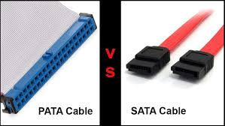
Drive Connectors
Parallel ATA
Older hard disk drives
Older CD and DVD drives
Serial ATA
Newer hard disk drives
Newer CD and DVD drives
Solid-state hard drives
Notes:
Most motherboards have two types of drive connectors.
The older type is Parallel ATA (PATA), and it is used with older hard drives and most CD and DVD drives.
This type of connector has 40 pins arranged in two rows, and uses a ribbon cable to connect the device to the motherboard.
ATA Short for AT Attachment. T
he IBM PC AT was an early type of computer (1984) that was among the first to support modern hard drive technology.
Parallel ATA (PATA) A type of connector used for older disk drives and optical drives such as CD and DVD drives.
The newer type is Serial ATA (SATA), a more compact connector that uses a thin round cable. SATA is used with newer hard drives.

Slide 25
Understanding Power Supplies
The power from your wall outlet is alternating current (AC), and is either 110 volt (v) or 220v, depending on the country in which you live.
Computer components require direct current (DC) and require much lower voltages.
Power supply has two functions:
- Converts AC to DC
- Decreases the voltage to the appropriate levels for the devices it powers
Notes:
The power from your wall outlet is alternating current (AC), and is either 110 volt (v) or 220v, depending on the country in which you live.
Computer components require direct current (DC) and require much lower voltages. A power supply has two jobs:
In a desktop PC, a power supply is a large silver metal box mounted in one corner of the system unit, with many bundles of colored wires and connectors emerging from it (see Figure 2.10).
The wire colors are significant; each wire color carries a different voltage.
Each connector has the appropriate wires running to it to deliver the exact voltage required for each connected device.
Table 2.4 summarizes the most common wire colors and their uses. Of these, the most common are the first three: red, yellow, and black.
The connector shown in Figure 2.11, for example, uses one red wire, one yellow wire, and two black wires.
The power comes in on the red and yellow wires, and the black wires are for grounding. A desktop PC's power supply has a fan in it, and when you start up the PC, the fan starts up too.
The fan pulls hot air out of the power supply, and has a side benefit of circulating air through the entire system unit too.

Slide 26
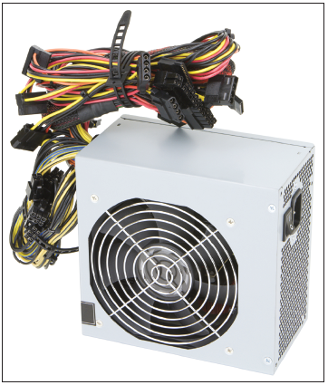
Understanding Power Supplies
In a desktop PC, a power supply is a large silver metal box mounted in one corner of the system unit.
Each wire color carries a different voltage.
Each connector has the appropriate wires running to it to deliver the exact voltage required for each connected device.
The most common are the first three: red, yellow, and black.
A desktop PC's power supply has a fan in it, and when you start up the PC, the fan starts up too.
The fan pulls hot air out of the power supply, and has a side benefit of circulating air through the entire system unit too.
Notes:
The power from your wall outlet is alternating current (AC), and is either 110 volt (v) or 220v, depending on the country in which you live.
Computer components require direct current (DC) and require much lower voltages. A power supply has two jobs:
In a desktop PC, a power supply is a large silver metal box mounted in one corner of the system unit, with many bundles of colored wires and connectors emerging from it (see Figure 2.10).
The wire colors are significant; each wire color carries a different voltage.
Each connector has the appropriate wires running to it to deliver the exact voltage required for each connected device.
Table 2.4 summarizes the most common wire colors and their uses. Of these, the most common are the first three: red, yellow, and black.
The connector shown in Figure 2.11, for example, uses one red wire, one yellow wire, and two black wires.
The power comes in on the red and yellow wires, and the black wires are for grounding. A desktop PC's power supply has a fan in it, and when you start up the PC, the fan starts up too.
The fan pulls hot air out of the power supply, and has a side benefit of circulating air through the entire system unit too.

Slide 27
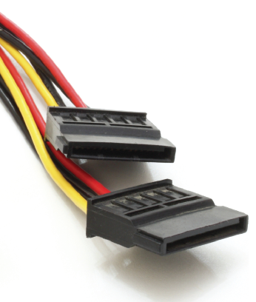
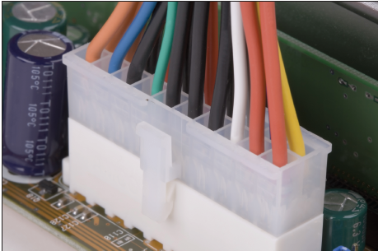
Wire Colors
Wire Color | Voltage
Black | Ground/neutral
Red | +5v
Yellow | +12v
White | -5v
Blue | -12v
Notes:
In addition to the several types of connectors that go to internal devices such as drives, the power supply also has one big connector, containing 20 or more wires arranged in two rows. This connector plugs directly into the motherboard, and powers all its components that do not have separate power connectors.

Slide 28
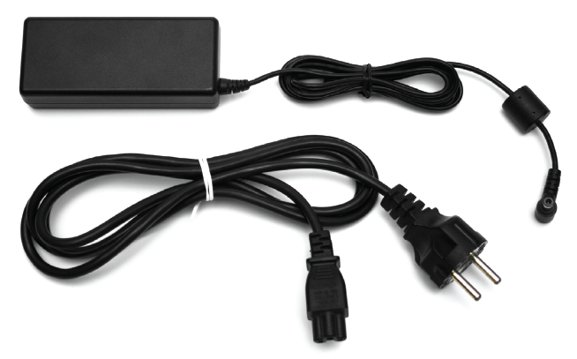
Notebook Power Supply
The power supply is built in.
Transformer block (brick) that steps down and converts the voltage.
When a notebook PC is plugged into AC power, its battery recharges.
The battery automatically provides DC power at the correct voltage
Notes:
On a notebook PC, the power supply is built in.
The power cord typically contains a transformer block(sometimes called a brick) that steps down and converts the voltage. Figure 2.13 shows an example.
When a notebook PC is plugged into AC power, its battery recharges.
The battery automatically provides DC power at the correct voltage, so no power conversion is needed when running on battery power.

Slide 29
Troubleshooting System Unit Problems
No Response
- Check for power
- Hold down Power button for 10 seconds, then press it again
- Do a soft reset (mobile device)
- Do a hard reset (mobile device)
Fan Noise but Nothing Onscreen
- Power-on Self Test (POST) card diagnostic
- Remove all non-essential hardware
- Remove newly installed hardware
Notes:
When your computer won't start up, it can be an annoying or even frightening experience.
It is not always obvious what is wrong with it.
By understanding some of the common symptoms of problems, however, you can make a more educated guess when problems occur, and you might even be able to fix the problem yourself.
If the computer doesn't show any signs of life when you press its Power button (no lights and no fan noises), it is most likely not receiving electricity.
Check the outlet, the power cord, and the power strip (if you are using one) to make sure there is no break in the connection. Some power strips have on/off switches.
After you have confirmed that electricity is not the issue, try holding down the PC's Power button for 10 seconds and then releasing it.
Then press the Power button again normally to try again to turn the computer on.
If the PC has placed itself into a lowpower mode such as Sleep and gotten stuck there, holding down the Power button will turn off the computer completely, releasing it from that mode.
When you turn the computer on, if you see lights flas.h on its buttons or hear its fans spinning but you see nothing onscreen, check to make sure the monitor is connected properly and powered on.
If the monitor is okay, then the device is receiving power but it is unable to complete its power-on self test (POST). The POST is a software procedure built into the BIOS; the device must pass this basic internal testing before the operating system can load.
power-on self test (POST) A low-level hardware test that occurs at startup, before the operating system loads. If you have this problem after installing new hardware, the new hardware is probably at fault.
Try removing it and then restarting to see if the system boots correctly without the device. Then try reinstalling the device.
If the problem starts again, the device may be defective or incompatible with your computer. As the computer starts up, it is normal for it to beep once.
If you hear multiple beeps, you may have a problem with memory. You may have recently installed some memory that is incompatible with your motherboard, or you may have installed it incorrectly.
Because there is no error message, this is a difficult type of error to troubleshoot on your own. A computer professional may want to use a POST card, which is an expansion board that fits into one of the motherboard's empty expansion slots.
The card monitors the start-up process and displays a two-digit code that describes the point at which the startup process has stalled. The POST card comes with a manual that deciphers the codes. For example, the code may indicate that the memory is at fault, or the CPU, or the motherboard itself.

Slide 30
Troubleshooting System Unit Problems
Error Message on Black Screen
- Troubleshoot according to the message received
- Research error message online
- Use CMOS Setup (BIOS Setup) to adjust settings or check device status
Error Message on Bright Blue Screen
- This error reports a serious hardware or memory problem.
- “Blue Screen of Death” (BSOD)
- Turn computer off and back on again
- If error persists, there may be a hardware incompatibility or failure
Notes:
If you see some gray or white text on a black background, that's good—it means that your system passed its POST. If the start-up stalls in this mode, and displays an error message, it means that either your system is having a problem with a specific component or it can't find and start the operating system.
You might see a Keyboard Stuck message, for example, if you have something sitting on your keyboard that is making one or more of the keys seem pressed.
A No Operating System or Non-System Disk Error message could mean that your hard drive does not contain an operating system, or it could mean that the start-up process could not find your hard drive. Perhaps it is defective, or perhaps its connector has come loose.
A common reason for the Non-System Disk error is that you may have left a USB flash drive or external drive connected and the system is trying to load the operating system from this device. Remove the device and then restart the system
If you see an error message at start-up, research it online. You can usually find advice on the web that will help you troubleshoot. Some of the solutions you may find online may suggest that you view or change settings in your CMOS Setupprogram (sometimes called BIOS Setup). This utility is built into your motherboard. You can access it at start-up by pressing the key that activates it. There should be a message onscreen at start-up telling you what key that is. (It might be F1, for example.) If you press this key quickly when you see that message, the BIOS Setup program starts.

Slide 31
Troubleshooting System Unit Problems
Windows Hangs at Startup
- Restart in Safe Mode
- Prevent non-essential drivers and programs from loading
PC Shuts Down or Freezes
- Most likely overheating
Notes:
If your system frequently shuts down or locks up after it has been operating for about 10 to 15 minutes, overheating is the most common cause.
Many of the components in the system unit get hot as they operate, especially the CPU, the graphics processor, and the larger chips involved in the motherboard's chipset. Some chips that get especially hot have aluminum or copper blocks on top of them with baffles (ridges or wings) to increase the amount of surface that air touches.
These blocks are called heat sink; they work by channeling heat away from the hot component; the air around the heat sink picks up the heat. In an active heat sink, a fan then blows that hot air away.
In a passive heat sink, there is no fan; passive heat sinks rely on other fans nearby that are cooling the system unit in general to carry the heat away. If a component is overheating, you may have a defective fan in one of your active heat sinks. Try looking inside the system unit when the PC is running to see if you can identify a fan that isn't spinning.
Another thing to check is to make sure the fan is not blocked with dust. The fans are designed to pull air in from the outside to cool the components. They also import dirt and dust, which can block the fans.

Slide 32
Summary
1 . What are the three basic components inside a CPU?
2 . What are the four steps of the machine cycle, and how do the parts you named in #1 fit into it?
3 . How do the L1, L2, and L3 caches improve CPU performance?
4 . What is the difference between static and dynamic memory?
5 . What are four ways in which one motherboard may differ from another?
6 . Why does a power supply have different colored wires?

Slide 33
Test yourself
Please kindly answer the FACT CHECK and MATCHING.

