Slide 1
Chapter 1 Computer basics
Daw khin myat thu

Slide 2
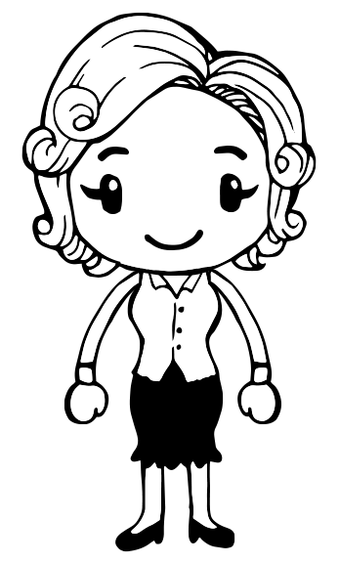
Chapter 1: Computer Basics
Learning Objectives:
Understand the purpose and elements of information systems
Recognize the different types of computers
Distinguish the main software types
Identify the components of a computer system
Understand how computers communicate

Slide 3
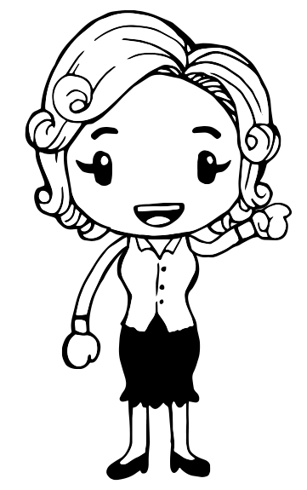
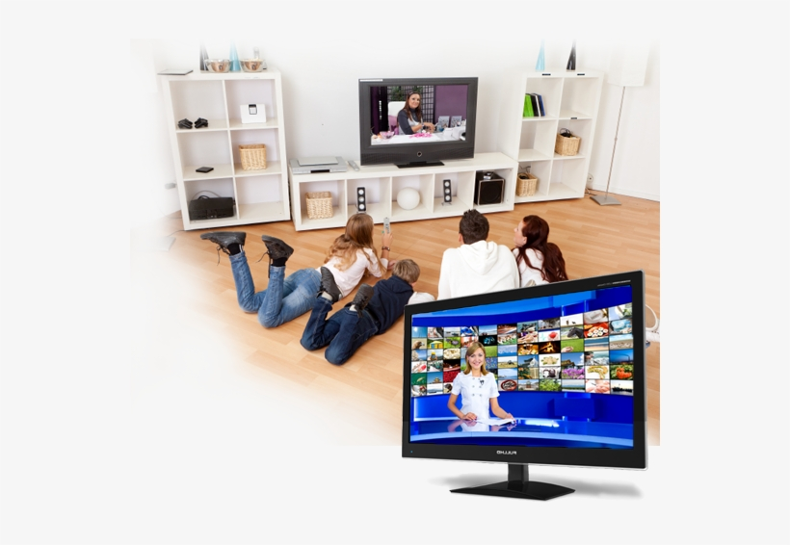
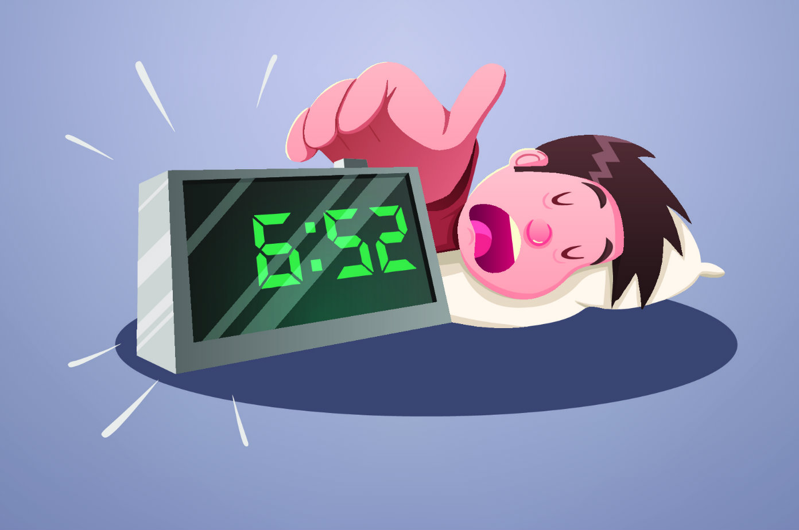
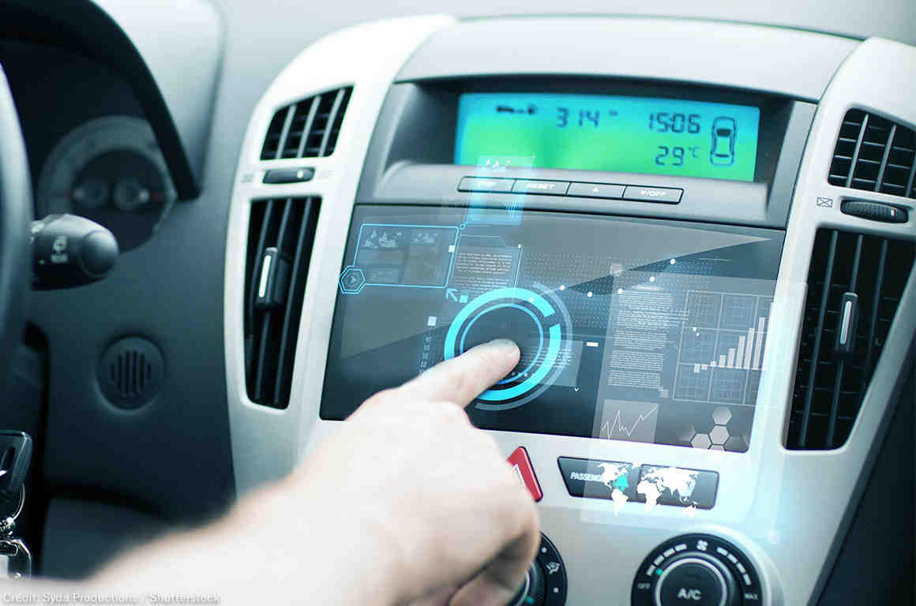
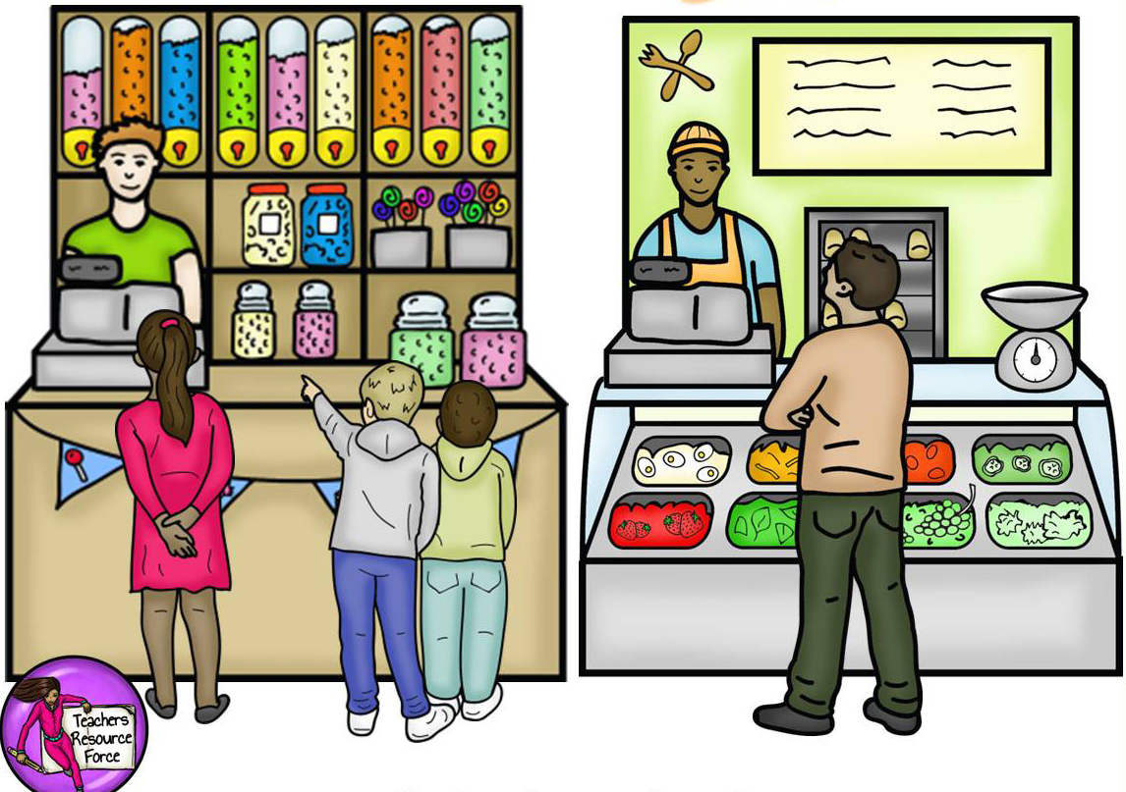
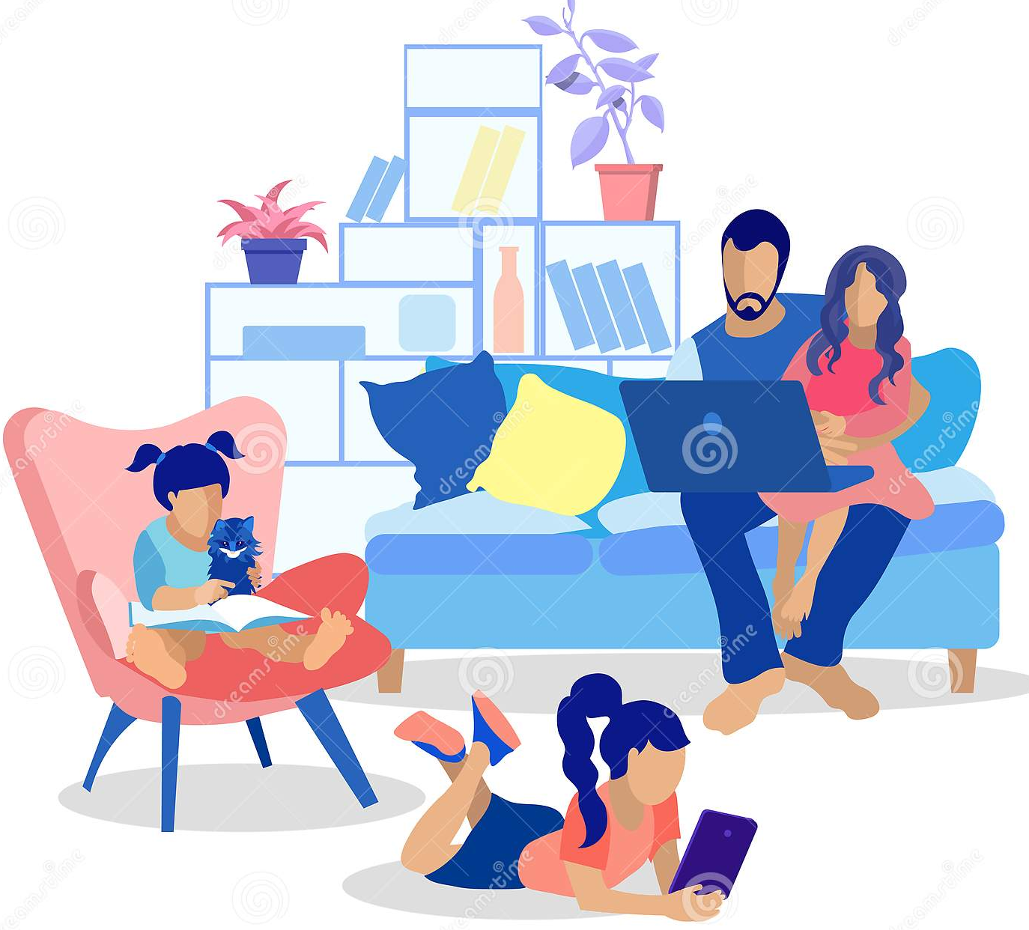
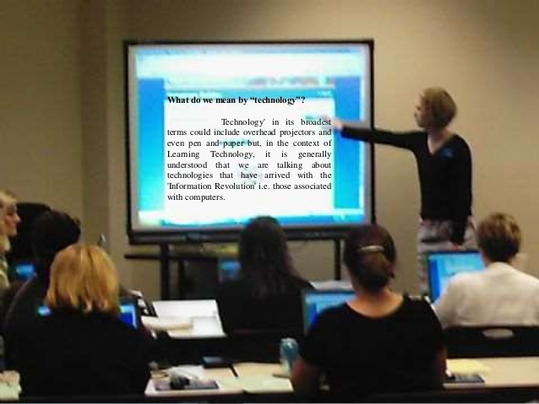
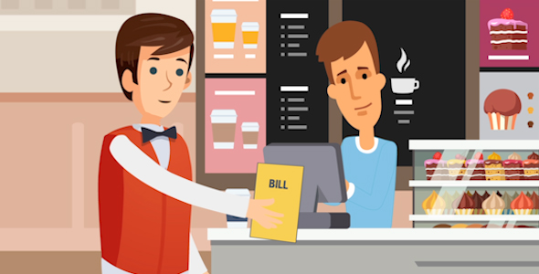
Introduction

Slide 4
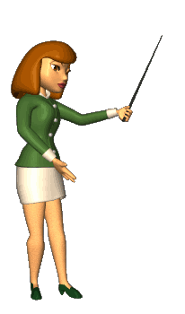
Understanding Information Systems
Information system: An interconnected environment for managing and processing data using a computer
Parts of an information system:
- People
- Hardware
- Software
- Procedures
- Data

Slide 5
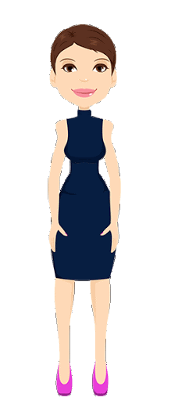
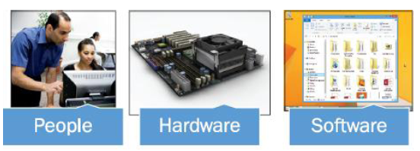
Understanding Information Systems
People: The only reason computers exist is to help people accomplish their goals. The first step in planning an information system is to analyze the requirements of the people.
Hardware: The hardware includes circuit boards with silicon chips and transistors mounted on them, input devices like keyboard and mouse, and output devices like printers and monitors.
Software: A program that tells the hardware what to do. There are many different levels of software, including the operating system (like Windows or Mac OS) and applications (like a word processing or accounting programs).

Slide 6
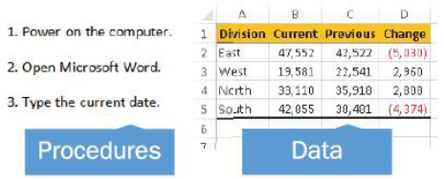
Understanding Information Systems
Procedures: The software doesn't run itself (usually). People must interact with the computer to tell it what software to run.
Data: Computer programs operate upon the data they receive. For example, in your accounting software, you enter data about the checks you are writing—the date, the amount, the recipient—and the program stores that data so you can recall it later.

Slide 7
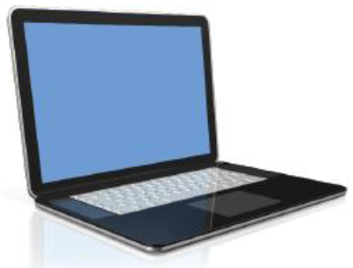
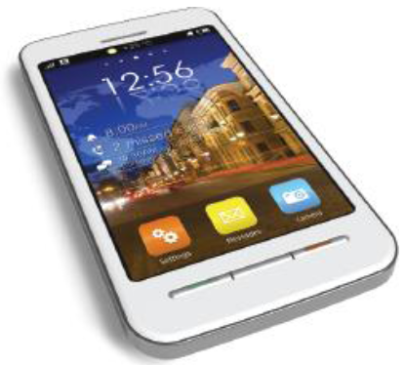
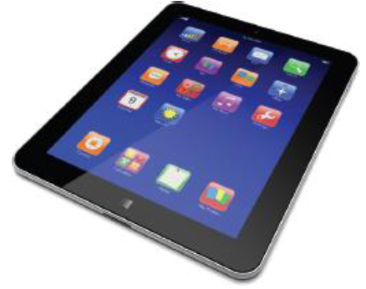
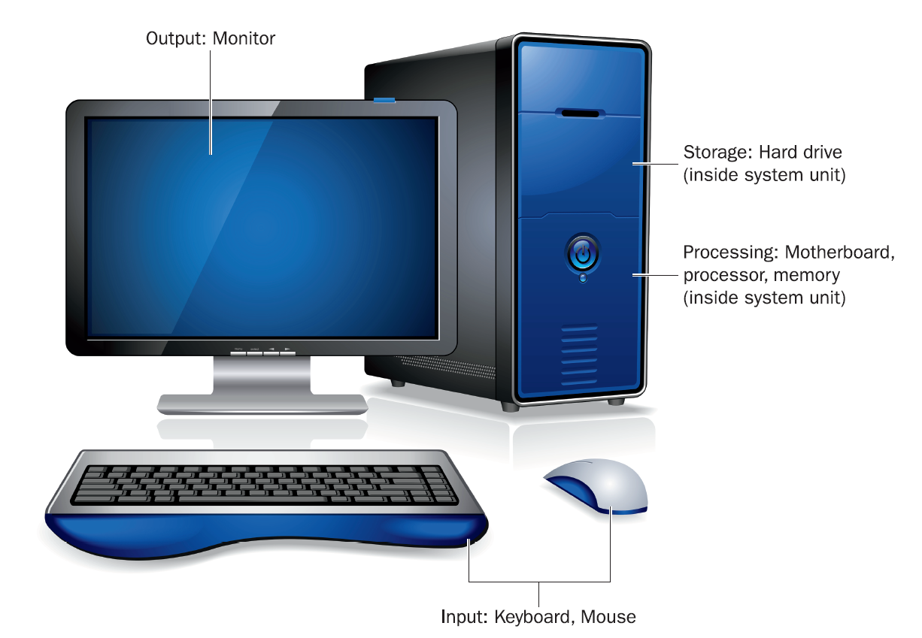
Computer Types
Personal Computers
Desktop PC
- Design to be used at a desk, seldom moved
- System unit, separate monitor, keyboard, mouse
Notebook PC (Laptop)
- Fold-up design, built-in keyboard, screen and pointing device
- Netbook (smaller version of notebook)
Tablet PC
- Slate design, touch screen, no separate keyboard and mouse, software-based keyboards
Smartphone
- Hand-held, computer application, internet access capability, touch screen, GPS

Slide 8
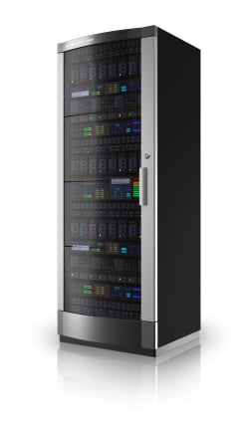
Computer Types
Multi-User Computers
Server
- Serves and supports a network, a group of network users
- Provides centrally accessible storage space and shares printers
- A small network server look similar to a desktop PC, but different OS, such as Window Server or Linux
- Does not directly provide processing power to clients
- A group of servers located together in a single room or facility is called a server farm, or server cluster.
- Large Internet service provider (ISP) companies maintain extensive server farms.

Slide 9
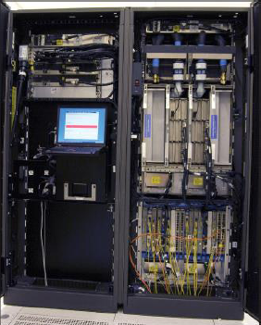
Computer Types
Multi-User Computers
Mainframe
- Capable of processing and storing large amounts of business data
- Provides processing support to terminals
- Large cabinet, or a series of cabinets, each about the size of refrigerator.

Slide 10
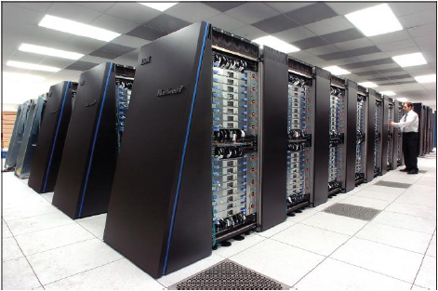
Computer Types
Multi-User Computers
Supercomputer
- Largest and most powerful computer available
- Cryptanalysis (code breaking), weather forecasting, scientific research, government

Slide 11
Software Types
Basic Input Output System (BIOS)
- Most basic software
- Read-only chip on motherboard
- Startup instructions and performs some basic testing on the hardware for computer
Operating System (OS)
- OS manages all the computer’s activities after startup
- User interface: humans use to communicate commands and receive feedback.
- Runs application and enables humans to interact with them.
- Control and manages the file storage system
- Communication with hardware
- Microsoft Windows is the most popular
- Other OS include Mac OS and Linux for desktop and notebook, UNIX for mainframes and servers, Android, IOS and Windows phone for tablets and smartphones

Slide 12
Software Types
Utilities
- Useful service to the operating system
- A wide range of system maintenance and security functions: checking storage disks for error, blocking security and privacy threats and backing up
Application Software
- User can purchase additional software, software may be provided on a CD or DVD or may be downloaded and installed over the Internet.
- Productivity software helps to accomplish practical tasks (Eg. Microsoft Office)
- Graphics, games, multimedia
- Software as a Service (SaaS)
- without buying software product once, installing it on computer
- Pay a usage fee for the software, associated data are stored online.

Slide 13
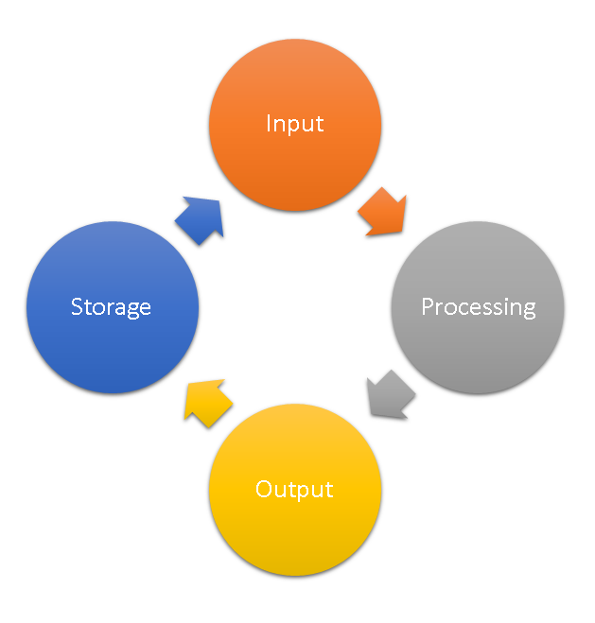
Computer System Components
Four broad categories (information processing cycle)
Keyboard, mouse, touch screen
Hard drives, USB, DVD
Motherboard, processor, memory chips
Monitor, printers, speakers

Slide 14
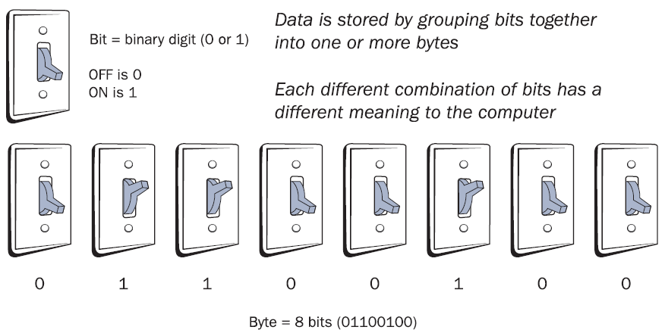
How Data is Represented
The smallest unit of data is bit. Bit = binary digit (0 or 1)
8 bits = 1 byte
8 4 2 1
$2^{3}$ ${ 2}^{2}$ ${ 2}^{1}$ ${ 2}^{0}$
0 0 0 0 0
0 0 0 1 1
0 0 1 0 2
0 0 1 1 3
0 1 0 0 4
0 1 0 1 5
0 1 1 0 6
0 1 1 1 7
1 0 0 0 8

Slide 15
Common Quantities of Bytes

Slide 16
Information Processing devices
Input
- Provides a way to get data into the computer
- Keyboard (oldest and most common input)
- External keyboard (desktop PC), built-in (notebook)
- Software based keyboard (tablets, smartphones)
- Graphical interface (Pointing devices such as mouse), trackballs, touchpads, touch-sensitive screen, digital cameras, scanners, bar code readers
Processing
- Motherboard (large circuit board) includes Central Processing Unit (CPU), memory
- Electrically conductive ways called buses that carry the data from place to place
- Chipset which is a controller that directs the bus traffic

Slide 17
Figure 1.13 A motherboard

Slide 18
Information Processing devices
Output
- Monitor; helps to communicate with the operating system, without monitor user wouldn’t know if the OS had received and understood the instructions
- Printers (for producing hard-copy), speakers (audio feedback)
Storage
- Removable or non-removable
- Hard drive; external and internal
- USB flash drive, CD, DVD

Slide 19
How computer communicate
Early computers didn’t communicate easily with one another.
Carried between computers on floppy disks and other low-capacity removable disks
Network connections were difficult to set up and transferred data very slowly.

Slide 20
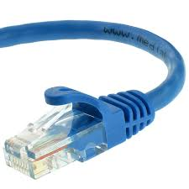
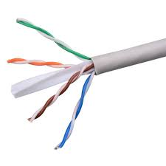
Ethernet Networking
Ethernet networking
- Network: Two or more computers connected to share data and resources.
- Wired Ethernet (use twisted pairs cable and an RJ-45 connector)
- Wi-Fi (IEEE 802.11)
- Ethernet :The current dominant standard for local area networking devices.
- Network adapter: A hardware component that enables a computer to connect to a network.

Slide 21
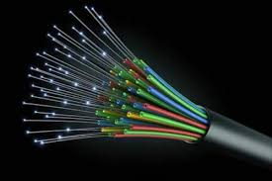
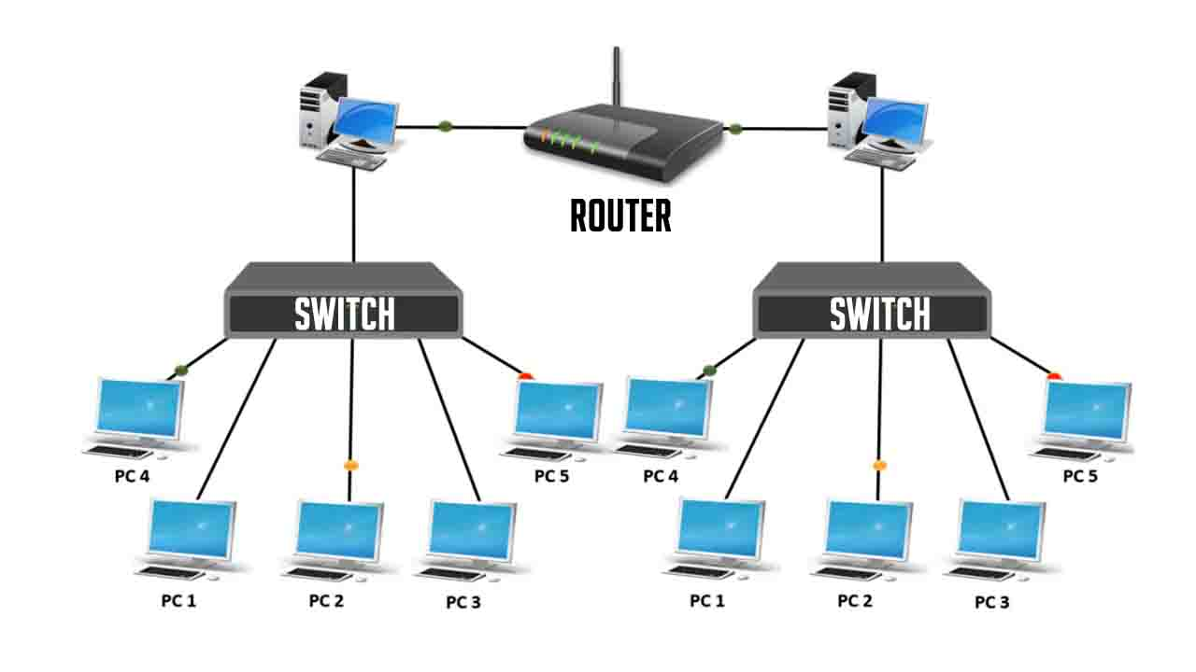
Ethernet Networking
Hardware
- Network interface card (NIC), a.k.a. network adapter
- Switch
- Router
- Cable (copper, fiber optic)
Types of Networks
Client/server
Peer to Peer

Slide 22
Other Ways Computers Communicate
Bluetooth
- Short-range personal networking (limited range 10 meters )
- Device connectivity (computer-to-printer or phone-to headset)
Internet
- A global packet-switched network created cooperatively by multiple companies, governments, and standards organizations.
- Internet service provider
- TCP/IP (Transmission Control Protocol/Internet Protocol)

Slide 23
Summary
What are the five parts of an information system?
What is the difference between a server and a mainframe?
What distinguishes an operating system from an application?
What are the four parts of the information processing cycle?
What is Wi-Fi and what equipment does it require?

Slide 24
Chapter 1: Computer Basics
Learning Objectives:
Understand the purpose and elements of information systems
Recognize the different types of computers
Distinguish the main software types
Identify the components of a computer system
Understand how computers communicate

Slide 25
Test yourself
Please kindly answer the FACT CHECK and MATCHING.

