Slide 1
Chapter 3: Input, Output, and Storage
Instructor: <Daw Khin Myat Thu>

Slide 2
Chapter 3: Input, Output, and Storage
Learning Objectives:
Define input and describe the available types of keyboards and pointing devices
Describe scanning and image-capturing device types and features
Define output and explain the types of output devices available
Differentiate between types of monitors and explain their features
Differentiate between types of printers and identify the best printer for a task

Slide 3
Chapter 3: Input, Output, and Storage
Learning Objectives (continued):
Classify storage devices according to their capacities, interface, and media
Explain cloud and network storage and identify online and network-based storage technologies

Slide 4
input Devices

Slide 5
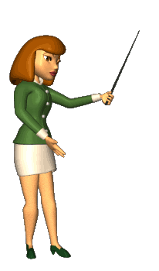
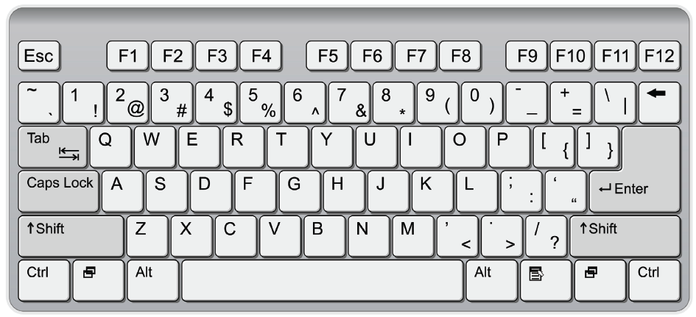
Keyboards
QWERTY layout
Function keys
Toggle keys
Modifier keys
Positional keys
Notes:
A keyboard enables you to enter typed data—letters, numbers, and symbols. A keyboard can be a separate device that plugs into the system unit (as with a desktop PC) or a built-in keyboard (as with a notebook PC).
There are many sizes and types of keyboards, but most English-language keyboards use the same key arrangement, called QWERTY.
The name comes from the first six letter keys on the top row of letters, from left to right. QWERTY The standard layout for English-language keyboards. This type of keyboard has a number of specialty keys as well as the numbers, letters, and symbols. Specialty keys include:
• Function keys (F1 through F12) perform special actions when pressed. The action assigned to each key depends on the operating system or application you are using.
Toggle keys turn a feature on or off each time they are pressed. For example, the Caps Lock key toggles between upper- and lower-case letter typing mode, and the Num Lock key toggles between the numeric keypad on the keyboard (if it has one) providing number entry or functioning as a set of directional arrows.
• Modifier keys change the meaning of other keys when they are pressed in combination with them. For example, the Shift key, when pressed in combination with a letter, makes that letter uppercase. Other keys, such as Ctrl and Alt, can be used with other keys to issue special command shortcuts. For example, a common keyboard shortcut in Windows is Ctrl+C (press both keys simultaneously) for copying selected content.
Positional keys such as the Home, End, Page Up, and Page Down keys, as well as the directional arrow keys, scroll the display or move the insertion point in applications.
insertion point The flashing vertical line that indicates where typed text will appear

Slide 6
Specialty Keyboards
Wireless
Bluetooth
Infrared
Ergonomic
Bilingual
Virtual
Notes:
A wireless keyboard does not require a cable connection to the computer, allowing for greater ease of use. An ergonomic keyboard is a keyboard that is designed to minimize the stress on the user's body. It may have a built-in palm or wrist support, for example.
A bilingual keyboard has characters in more than one language on its keys, so when you switch to a different keyboard layout in the operating system, the characters on the keyboard match what you are typing.
wireless keyboard A keyboard that connects to the computer wirelessly rather than with a cable.
ergonomic keyboard A keyboard that is designed with features that help reduce stress on the user's hands and wrists.

Slide 7
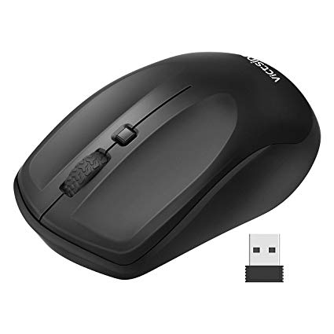
Pointing Devices
Mouse
Mechanical (ball) or optical
Corded or cordless
Trackball
Touchpad
Touch screen
Joystick
Notes:
A pointing device is a piece of hardware that enables you to move an onscreen pointer in a graphical user interface like Microsoft Windows.
A mouse is the most common pointing device. It is a palm-sized object that you move across a flat surface to move the pointer on the display.
A mouse has one or more buttons on it; you press the buttons to act upon whatever the pointer is pointing at.
A mouse can be either mechanical or optical. A mechanical mouse has a chamber on its underside with a rubber ball in it.
As you roll the mouse across a flat surface, the ball turns, activating sensors inside the chamber that translate the ball's movement to onscreen pointer activity.
An optical mouse has a light-emitting diode (LED) and a sensor on its underside, as shown in Figure 3.3. The light bounces off the surface and the sensor measures it, and those measurements are reported back to the computer to tell the pointer how to move. Mechanical mice need frequent cleaning; optical mice are maintenance-free and have virtually replaced the mechanical type.
Like a keyboard, a mouse can have a wire (cord) connecting it to the computer, or it can be wireless.
A wireless mouse communicates with a transceiver connected to a USB port to exchange data with the computer, or uses a technology called Bluetooth to communicate via radio waves. A wireless mouse requires a battery, whereas a wired mouse draws the small amount of power it needs from the computer via its cord.

Slide 8
Pointing Devices

Slide 9
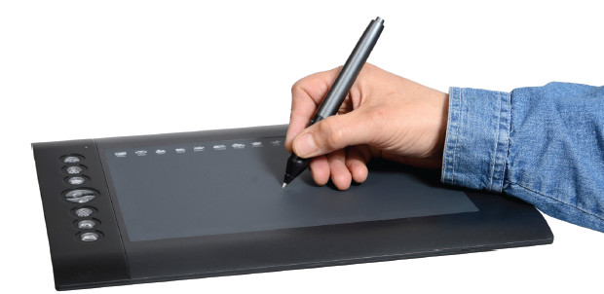
Drawing Tablet
Inkless pen called a stylus
Used for creating digital artwork
Notes:
A drawing table, also called a digitizing tablet, is a specialized type of touchpad designed for drawing.
The user draws on the tablet with a pen-shaped pointer called a stylus, and the drawing shows up onscreen.
Professional graphic artists use drawing tablets to draw directly into a computer program to create both technical and artistic drawings. Figure 3.7 shows a drawing tablet.
drawing table A flat rectangular touch-sensitive surface on which a user can draw with a stylus to create onscreen artwork.
stylus A pen-shaped pointer used to drag across the surface of a touchsensitive screen.

Slide 10
Sensory Input Devices
Global Positioning System (GPS)
Accelerometer
Compass
Gyroscope

Slide 11
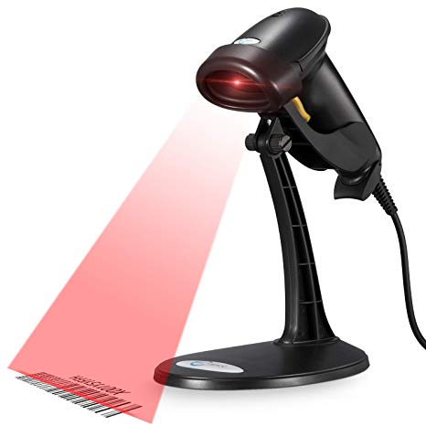
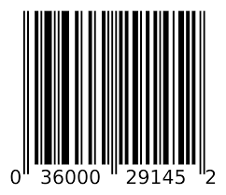
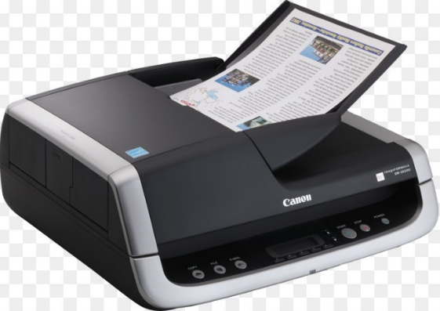
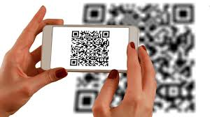
Scanning Devices
Digitizes hard copy
Shining a bright light on the surface of the page
Measuring the amount of light that bounces back form it
Uses a photosensitive charge-coupled device (CCD)
Types of scanners
Flatbed
Document feeder
Bar code reader
QR code reader
Flatbed
Automatic Document Feeder
Notes:
A scanner digitizes hard-copy photos and documents and stores them electronically.
Scanners work by shining a bright light on the surface of the page and measuring the amount of light that bounces back from it using a photosensitive charge-coupled device (CCD).
Lighter areas bounce back more light than darker areas. For color scanning, multiple sensors are used, each one picking up a different color: red, green, and blue.
digitize To convert something from hard-copy to digital (computerized) form.
charge-coupled device (CCD) The light-sensitive sensor in a scanner that records the amount of light bounced back from the image.
multi-function device (MFD) A device that combines the functions of a printer, a copier, and a scanner into one unit, and also a fax in some models.
flatbed scanner A scanner that has a large flat glass surface on which the page to be scanned is placed.
document feeder A mechanical feature of some scanners that enables multiple pages to be scanned consecutively without user intervention.
Most scanners are flatbed models, as in Figure 3.8, where you place the image on a flat piece of glass and then a sensor and light bar moves beneath it to capture the image. A flatbed scanner may optionally have a document feeder on it so multiple pages can be queued for scanning. There are also smaller portable scanners that either feed in one sheet at a time past a stationary sensor and light bar, or that you hold in your hand and manually move across the image to be scanned.

Slide 12
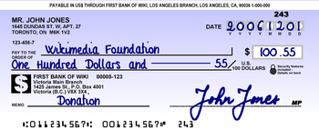
Other Input Devices
Magnetic card reader
Radio frequency (RF) ID chip
Optical mark recognition (OMR)
Magnetic character recognition (MICR)
Biometric authentication devices
Fingerprint scanner
Facial recognition software and camera
Retina scanner
Notes:
magnetic card reader A scanner that reads and deciphers the information on the magnetic strip on a credit card or other ID card. Another type of scanner used in many businesses is a magnetic card reader, shown in Figure 3.11. You use one of these every time you swipe a credit card to pay for a purchase, for example. Magnetic card readers read the encoded data on the magnetic strip on the back of your credit card or ID card and transfer that data into a computer. Some credit cards have a radio frequency identification (RFID) chip in them that enables you to pass them in front of a radio frequency card reader to read the card's data without it physically touching a reader. RFID chips are also used in security systems to allow employees access to secure areas of a building if they are wearing an RFID-equipped ID badge.
Fingerprint Readers A fingerprint reader is a type of biometric scanner—that is, a scanner that scans something about a human body that is used to identify that person. Many computer systems use fingerprint readers as a form of user authentication. The fingerprint of the person logging in is compared to a database of pictures of the fingerprints of authorized users. Other types of biometric scanners include facial recognition, voice recognition, and retina scanners.
Certain industries use specialized scanners to simplify data entry. For example, companies that grade standardized testing use an optical mark recognition (OMR) system that detects the presence of a pencil or ink mark on certain spots on a standardized form. Banking institutions save time and cut down on entry errors by using a magnetic-ink character recognition (MICR) system to read the routing and account numbers on checks and deposit slips

Slide 13
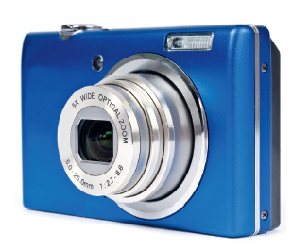
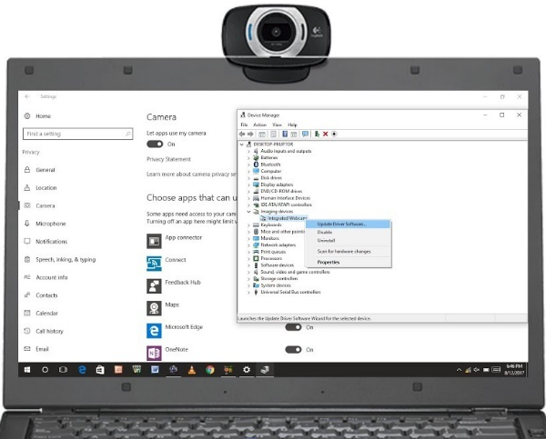
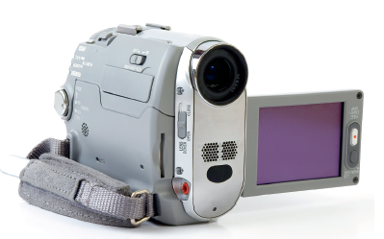
Capture Devices
Digital camera
Digital video camera
Web cam
Notes:
The scanners you have learned about so far read existing data and scan existing photographs and documents. Image capture devices, on the other hand, capture new content. A capture device can capture either still images or motion video. Some devices do both, but most are designed primarily for one type or another. A digital camera is designed primarily for still photos, and looks much like a film camera; a digital video camerais designed primarily for motion video. See Figure 3.13. Both work using the same basic technology; the digital video camera captures many frame (individual still images) per second and stores them in a single file. When you play back the still images in chronological order, the image appears to be moving. Digital video cameras can also capture sound to accompany the video clips, which can be played back synchronously with the images. Many modern smartphones have built-in cameras that can take still photos and record video clips.
Some digital video cameras are stand-alone; you can take them out into the world and capture video, and then connect the video camera to a computer to transfer, edit, and save the video clips. Other cameras are webcams, as in Figure 3.14, which are simple video cameras that lack their own storage and capture controls. They remain permanently attached to the computer, and store their video clips or still images directly on the computer's storage drives. They rely on video capture software on the computer to start and stop the capture process. Webcams are often used for online video chatting through services such as Skype.

Slide 14
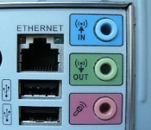
Audio Input Devices
Audio adapter (sound card)
Microphone
Voice recognition software
Speech recognition software
Notes:
AUDIO INPUT DEVICES Most personal computers support audio input, either through a built-in audio adapter on the motherboard or through an add-on sound card. A computer's audio ports may support speakers, headphones, micro-phones, and both analog and digital external audio device input. An example of an external audio input device is a home stereo system; an external digital audio device might be a digital piano keyboard. audio adapter Also called a sound card. A component of a computer system that accepts and processes audio input and delivers audio output. If you have a microphone and voice input software, you can speak into the microphone to issue commands to the computer and to input text into a word processing program. Some people with disabilities use voice input to control the computer as a substitute for a keyboard or mouse, and some people who have a lot of text to enter but don't type very quickly may find voice input more efficient than trying to type all the text. People who use audio input frequently find that it is worthwhile to buy a high-quality microphone headset, as in Figure 3.15, because it provides more accurate voice pickup. voice recognition software Software that recognizes spoken words that match words in its database to digitize spoken language. speech recognition software Software that can learn an individual's pronunciation and vocal inflection and translate it into digitized text. There are two kinds of voice input software: voice recognition and speech recognition. Voice recognition software recognizes spoken words that match words in its database. It does not pay attention to the tone or inflection of the speaker's voice. People who speak with a heavy accent may have difficulty with such software. Voice recognition is included with Microsoft Windows and Microsoft Office. Speech recognition software is teachable software that learns an individual's pronunciation and vocal inflection. Each user trains the software by reading long passages of text into the microphone; the software records what each word sounds like when that person pronounces it, and can also learn new words.

Slide 15
Output Devices

Slide 16
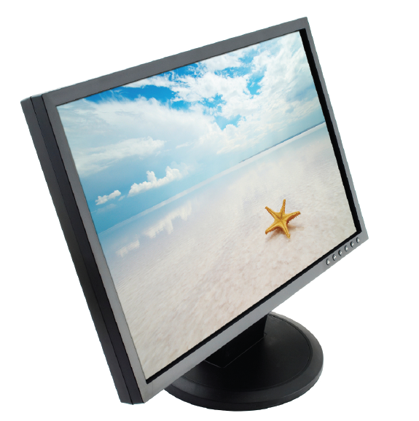
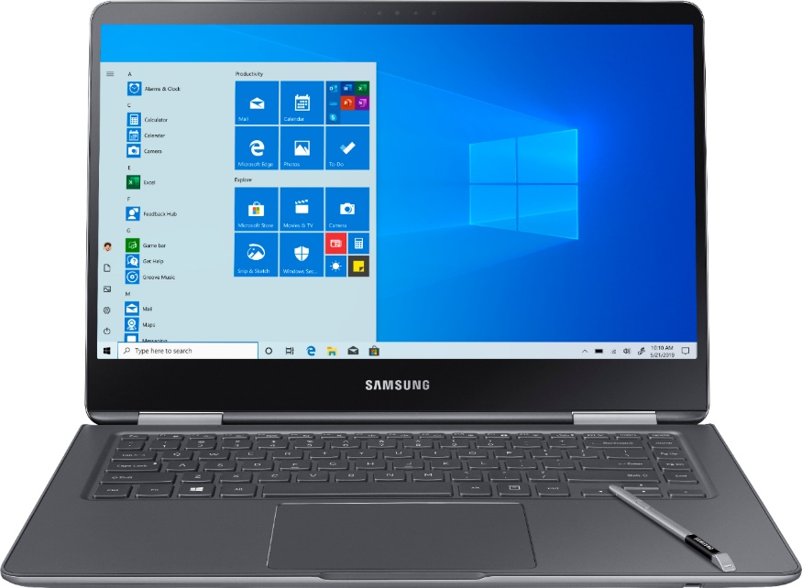
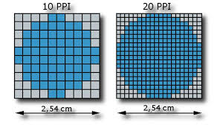
Display Screens
Video screen the computer uses to provide information to a human user
Display is made up of individual dots called pixels
Notes:
A display screen is a video screen that the computer uses to provide information to a human user. A display screen can be built into a device, as it is with smartphones, tablets, and notebook PCs, or it can be a separate unit (a monitor), as it is with the majority of desktop PCs. display screen A video screen that a computer uses to provide output to a human user. pixel An individual colored dot in a graphic or on a display screen. Display screens create their images by filling in tiny dots called pixels with different colors. The pixels are so small and so close together that the human eye sees them as continuous color gradients rather than individual blocks. Monitors differ in the technology they use to illuminate those pixels. liquid crystal display (LCD) A flat-screen display technology that passes electricity through liquid crystals to create a display image. Built-in display screens are thin and flat, and most of them use liquid crystal display (LCD) technology. Most modern stand-alone monitors are also LCD, like the one shown in Figure 3.16. This technology has two polarized filters, with a liquid crystal substance between them. One filter is at an angle, so light doesn't pass through it automatically. When electricity hits a crystal, it twists, refracting the light so that it passes through the second filter and lights up the display in a certain spot. Color displays have separate filters for red, green, and blue. Some new mobile devices use organic light-emitting diode (OLED) technology, which used organic matter that lights up in response to an electrical current.

Slide 17
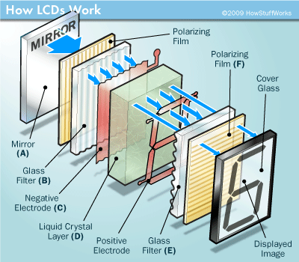
Current Monitor Technologies
Liquid Crystal Display (LCD)
Active vs. Passive Matrix
Organic Light-Emitting Diode (OLED)
Notes:
Flat-screen displays vary in the number of transistors used to create the display image. In an active matrix, each individual pixel in the display is actively maintained by a separate transistor. Almost all LED screens today are an improved variant of an active matrix called thin-film transistor (TFT). In a passive matrix (which is cheaper to manufacture), each pixel maintains its state on its own until it decays or is refreshed. An OLED screen may be active matrix or passive matrix depending on the model.
A high-definition TV (HDTV) can also be used as a computer monitor by connecting the computer to one of its high-definition multimedia interface (HDMI) input ports.

Slide 18
Cathode Ray Tube (CRT)
Older technology, mostly obsolete
Large vacuum tube with electron guns that strike phosphors to light up the screen
Triads of red, green, and blue phosphors

Slide 19
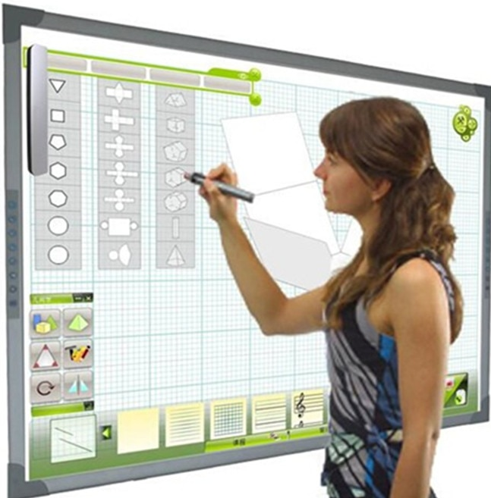
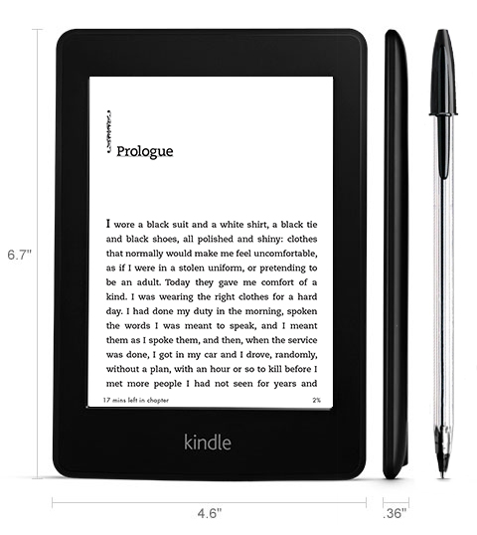
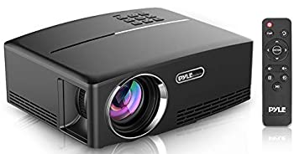
Current Monitor Technologies
E-paper
Digital/smart whiteboard
Digital projector
Notes:
You also may encounter a few specialized monitor types. For example, some e-book readers have a special type of screen called electronic paper (e-paper). This type of screen retains its image but is unpowered except when the display changes, so it uses much less power than a device with an LCD screen. A digital or smart whiteboard is a large writing board in a conference room or other meeting area that is connected to a computer, so that whatever is written on the board is also saved on the computer. Digital tools and buttons also appear on the screen for interacting with the data collected, as shown in Figure 3.19. A digital projector (see Figure 3.20) accepts display data like a monitor does, but instead of showing the image on its own screen, it projects an image in large format on a nearby screen or wall.
Digital projectors differ from one another in their brightness, measured in lumens. The brighter the projector, the better it will display when the image is projected at a large size in a well-lit room. An inexpensive projector having 1,500 lumens would be okay for a small, dark room; a more expensive projector might have 4,000 lumens.

Slide 20
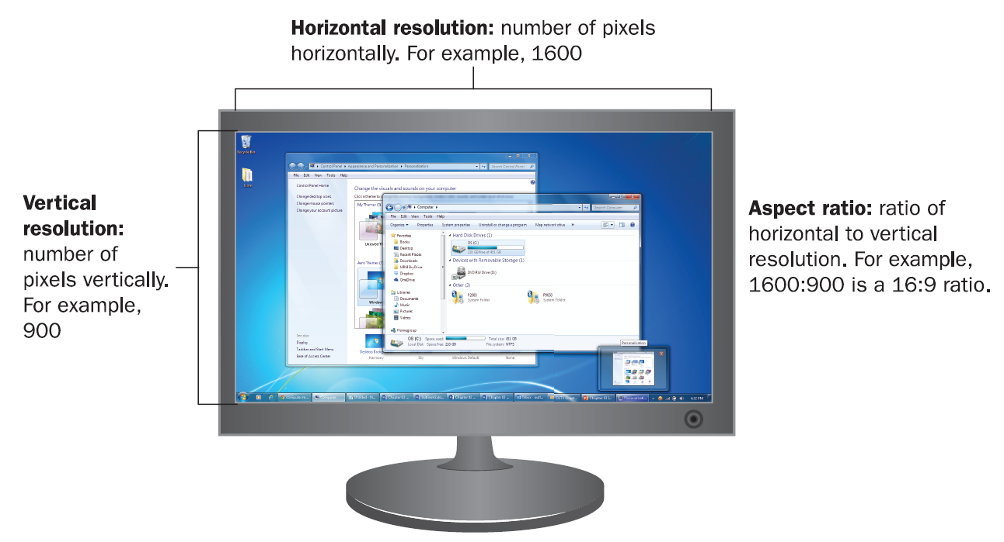
Resolution
Measured in horizontal and vertical pixels, such as 1024 x 768
Each display has a maximum (native) resolution
LCD and LED displays look best at their native resolution
Aspect ratio is ratio of width to height, such as 4:3 or 16:9
Notes:
One quirk of LCD monitors is that if you use any resolution that is lower than the native one, the display may not appear as sharp and crisp. Therefore, you should run an LCD in its native resolution whenever possible. If the icons and text are too small to read, adjust the text and icon size in the operating system's settings.
When selecting a display mode in the operating system, you should choose one that matches the aspect ratio of the display screen. The aspect ratio is the ratio of width to height—in other words, the relative dimensions of the screen. Some monitors have a traditional 4:3 aspect ratio, but many LCD screens use a wide-screen 16:9 aspect ratio instead. aspect ratio The ratio of width to height on a display screen, such as 4:3 (standard) or 16:9 (wide).

Slide 21
Other Measures of Monitor Performance
Refresh rate
Number of times per second each pixel is refreshed
Mostly an issue on CRTs; insufficient refresh rate can cause flickering
Color depth
Number of bits required to describe the color of each pixel
32-bit or 16-bit is the norm for most operating systems
Notes:
All display screens have a maximum refresh rate, the number of times each pixel is refreshed per second. The operating system's display mode determines the actual refresh rate that is used. On a CRT, using a high refresh rate (greater than 80 Hz) makes the monitor flicker less, resulting in less eyestrain for the user. On an LCD monitor, the refresh rate is somewhere around 60 Hz but is not as important because an LCD monitor is not prone to flickering.
A display mode specifies a color depth, which is the number of binary digits needed to uniquely describe the color of each pixel. For example, an 8-digit binary number has 256 possible combinations of 0 and 1 (2 to the 8th power), so 8-bit color would allow for 256 different colors. Windows defaults to 32-bit color that would allow for over four billion colors (also called True Color); an alternative is 16-bit color (also called High Color).

Slide 22
Display Adapter
The hardware that helps the operating system communicate to the monitor what should be displayed
May be built into the motherboard or may be a separate circuit board installed on the motherboard
If separate, has its own memory
Notes:
A display screen relies on the computer's display adapter to tell it what to do. The display adapter, in turn, takes its orders from the operating system to specify the display mode (resolution, refresh rate, and color depth). The display adapter requires its own memory, which it uses to hold the color information for each pixel as it operates, and which it uses to render 3D objects and control special video effects in certain applications. If the display adapter is built into the motherboard, the display adapter may reserve some of the motherboard's memory for its own use. If the display adapter is a separate circuit board, it has its own memory mounted directly on the circuit board. display

Slide 23
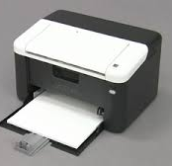
Printers
Factors to Consider:
Initial cost
Per-page cost (consumables)
Resolution (dots per inch)
Speed
Color
Paper handling
Interface
Multiple functions
Notes:
Initial cost: How much does the printer cost? • Per-page cost: How much does it cost to print a page, taking into account the price of the consumables? How much does the ink, toner, or ribbon cost, and how many pages will it print before you have to replace it? Are there other parts in the printer that wear out and have to be replaced after a certain number of pages?
consumables Printing supplies that must be replaced with use, such as paper and ink.
• Resolution: How many individual dots per inch (dpi)does the printed image consist of? A higher resolution results in a sharper image, as shown in dots per inch (dpi) A measurement of printed image quality, the number of individually colored dots in one row (or column) of one inch of the printed file. A printout can have a different horizontal and vertical dpi, although this is not common.
• Speed: How many pages per minute can the printer output? A typical printer might output at somewhere between 10 and 20 pages per minute for black-and-white, and slightly less than that for color.
Keep in mind when comparing speeds that a printer's advertised speed refers to its maximum output after it has started printing; this speed doesn't take into account the time it takes for the computer to send the job to the printer and for the printer to process that data internally and start the printing process. If you print one or two pages at a time, you will not achieve the advertised speeds; it will likely take the printer 30 seconds or so to eject the first page of a print job.
• Color: Does the printer print in color, or just in black-and-white? If it prints in color, can it print photos well? Some printers are designed specifically for photos, and have special inks for them and/or use special glossy paper for photos. • Paper handling: Does it have multiple paper trays, so you can have two sizes of paper loaded at once? How much paper can it hold at once? How well does it print on heavy cardstock or envelopes without bending or creasing them? Does the printer have any special paperhandling features, such as the capability to print on both sides of the paper (duplexing) without the user manually flipping the paper over? What is the largest size paper it can accept? duplexing To print on both sides of the paper.
• Interface: Most printers use the USB interface to connect directly to a computer. Can the printer also connect to a network? Does it require a cable to connect it to the network, or can it connect wirelessly? • Multi-function: Is it just a printer, or can it perform other tasks too, like scanning, copying, and/or faxing? A multi-function device (MFD) can save you money and space if you would otherwise have to buy separate machines for those functions.

Slide 24
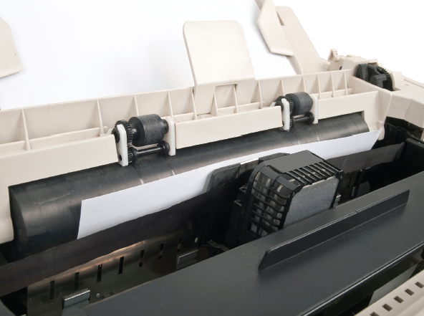
Impact vs. Non-Impact
Impact printers strike an inked ribbon to make a mark on the paper
Dot matrix printers are still used in industrial settings
They print on multi-part carbon copy forms

Slide 25
Impact vs. Non-Impact
Non-impact printers lay the ink or toner down on the paper without striking it (Dot Matrix)
Inkjet
Thermal
Laser

Slide 27
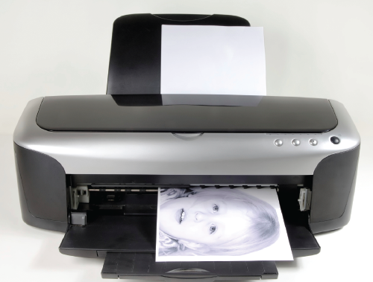
Inkjet Printer
Sprays liquid ink onto the page
Separate ink cartridges: black, cyan, magenta, yellow
Some printers can print photos very realistically
Initial cost of the printer can be very low
Ink is expensive

Slide 28
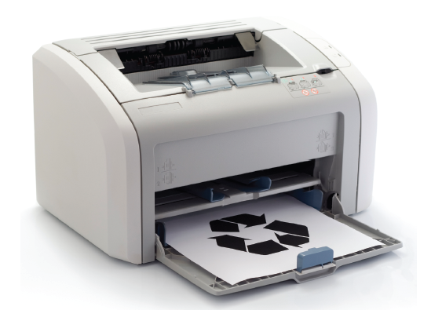
Laser Printer
Uses powdered toner
Can be color or black-and-white
Initial cost is higher than inkjet
Cost per page of toner is low

Slide 29
Laser Printer Printing Process
Drum inside printer is negatively charged
A laser partly neutralizes the charge in certain areas
Toner clings to the neutralized areas
Paper is charged so that toner jumps off onto paper
Fuser heats the paper, melting the toner into the paper

Slide 30
Comparing Printer Types
 | Dot Matrix | Inkjet | Laser
Initial Cost | Medium | Inexpensive | Expensive
Per-page Cost | Inexpensive | Expensive | Inexpensive
Resolution | Poor | Good | Good
Speed | Slow | Medium | Fast
Color | No | Yes | Some models
Paper handling | Continuous feed | Single low-capacity tray | Multiple high-capacity trays (some models)
Suitable for | Multi-part forms, text-only printouts | Photo printing, home use | Business printing, high-volume printing

Slide 31
Audio Output Devices
Speakers
Speaker systems designed for computers are somewhat different from speaker systems designed for home stereo and home theater systems
Another difference in computer speaker systems is that the speakers have magnetic shielding to protect nearby computer devices from electromagnetic interference (EMI).
Powered speakers : Speakers that contain their own amplification, powered by either AC current or batteries.
Headphones
Notes:
The audio adapter in a computer handles both input and output. You learned earlier in this chapter how audio input comes in from microphones and digital musical instruments. The most common audio output devices are speakers and headphones. Speaker systems designed for computers are somewhat different from speaker systems designed for home stereo and home theater systems. Typically, a single 3.5mm plug connects to an output port on the computer; you don't plug in the speakers separately to the computer. On a two-speaker system, one speaker connects to the computer and the other speaker connects to the first speaker. A system with more speakers than that usually has a central gathering point, such as a subwoofer into which all the speakers connect.
Another difference in computer speaker systems is that the speakers have magnetic shielding to protect nearby computer devices from electromagnetic interference (EMI). Most speakers are powered speakers, meaning they require an AC adapter or batteries to function. The power boosts the amplification of the sound, and is necessary because most computers don't have a built-in amplifier the way most home stereo systems do.

Slide 32
Storage Devices
Instructor: <Daw Khin Myat Thu>

Slide 33
Storage Devices
Primary storage: memory
Secondary storage: disks and solid-state drives
Evaluations of storage:
Capacity
Cost
Access speed
Interface
Media type
Portability
Removability
Notes:
As you learned in Chapter 2, “The System Unit,” when a computer processes data, RAM (Random Access Memory) holds that data temporarily. RAM is known as primary storage because it's where the data must be in order to interact with the CPU. Data waits for the CPU's attention in memory, and then it waits again in memory when the CPU has finished processing it.
For data to be safely and permanently stored, however, it must be placed in secondary storage. Secondary storage devices are nonvolatile, so they don't lose their contents when the computer's power is turned off. Secondary storage can include hard disk drives, solid state drives, CDs, DVDs, and network and cloud-based storage.
Capacity: How much can it hold? • Cost: How much does the storage cost per megabyte or gigabyte? • Access speed: How quickly can the data be written and retrieved? • Interface: How does it connect to the computer, and how fast is that connection? • Media type: Is it magnetic, optical, or solid-state? • Portability: Is the storage inside the system unit, or connected to it externally? • Removability: Is the disc removable from the drive that reads and writes it, or are they one inseparable unit?

Slide 34
File Storage Vocabulary
File: a named collection of bits that represent a single object
Folder: A logical organizing unit for files
Volume: A physical storage device or a portion of one that is assigned an identifying letter
Notes:
A file is a named collection of bits that work together to represent a single object, such as an executable program, a spreadsheet, a picture, or a system file. Folders are logical organizing units for files. For example, a Windows-based computer has a Windows folder containing the system files needed to run Windows, a Users folder containing the data files and settings for each user account, and a Program Files folder containing the files needed for each installed application. A folder within a folder is called a subfolder; each of the aforementioned folders contains multiple subfolders. Files and folders are stored on volumes. Each volume has a letter followed by a colon, such as C: or D:
Some people use the terms disk (or disc), drive, and volume interchangeably, but they have different meanings. The term diskrefers to a platter or set of platters on which data is stored. Examples include a hard disk drive (HDD) and a DVD. When referring to a CD, DVD, or Blu-ray, it is customary to spell the term disc. The term drive refers to the mechanical components that read and write the data on a disk. In some cases, such as with an HDD, the drive and its platters are physically inseparable, so the terms disk and drive have come to be synonymous; hard diskand hard drive refer to the same thing. When the disc is removable from the drive, however, as with a CD or DVD, the terms are separate. See Figure 3.28. Solid-state storage devices such as USB flash drives are technically neither discs nor drives, because they have no platters and no moving parts. However, they are commonly referred to as drives anyway, as in the term solid-state drive (SSD).

Slide 35
File Storage Vocabulary
Drive: A physical storage device, or the mechanical parts that spin a disk so that data can be written and read on it
Disk: A spinning platter that holds data

Slide 36
Hard Disk Drive (HDD)
A mechanical storage drive
Consists of a stack of metal platters (usually 4 to 6) coated with iron dust
Read-write heads access the stored data
Data is stored in binary form in changes between positive and negative magnetic polarity
Notes:
An HDD consists of a stack of metal platters (usually 4 to 6) that are coated with iron dust. These platters spin on a common spindle inside a sealed metal casing. A set of read/write heads inside the HDD casing reads and writes data on the platters; there are heads on each side of each platter. The arms move in and out to reach different spots on the platters, and the disks move past the heads as they spin. The most common platter sizes are 3.5” in diameter on HDDs for desktop systems and 2.5” on HDDs for notebooks.
The data is stored on the platters in patterns of magnetic polarity. The iron dust on the surface is very sensitive to magnetic polarity and can be easily magnetized. As the disk surface moves past a read/write head, the write head switches its polarity between positive and negative to change the polarity on the surface, creating a pattern of polarity changes. Each polarity change represents a 1 bit, and each area where there could have been a polarity change but there isn't one represents a 0 bit. An HDD has an internal controller that manages the physical reading and writing operations.

Slide 37
Hard Disk Drive (HDD)
Notes:
A precise system exists for describing the physical locations on an HDD. The platters are divided into concentric circles, like the rings on a tree trunk cross-section, called tracks. Each platter's first track is track 0, the next one track 1, and so on. The track number tells the drive where to position the actuator arm that controls the position of the read/write heads. All the heads move together, so if one head is reading track 1 on one side of one platter, all the other heads are also reading track 1 on their side of their platter too. For this reason, tracks are not referred to individually, but as cylinders. A cylinder is the group of all the tracks at a single arm position. Figure 3.30 illustrates the relationship between these parts.

Slide 38
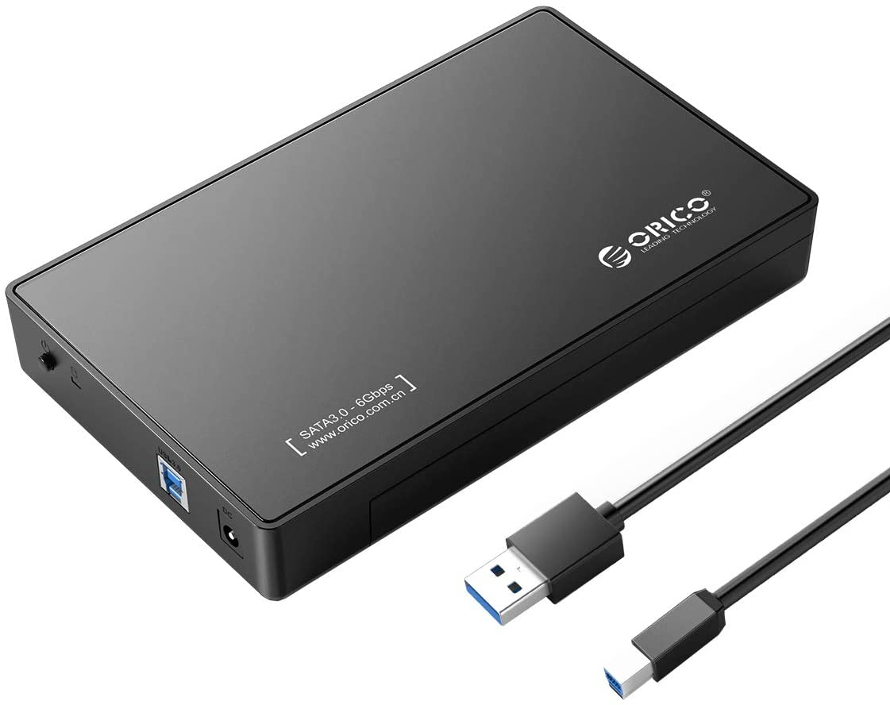
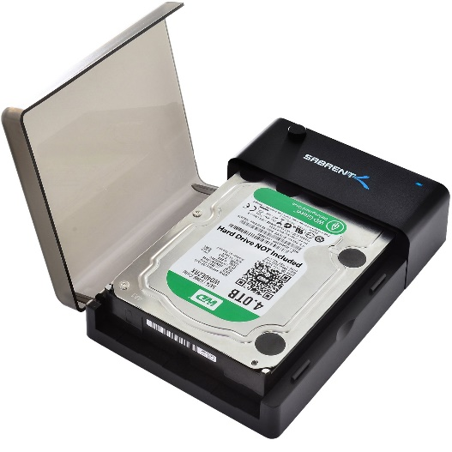
Hard Disk Drive (HDD)
HDD can be internal or external
Internal HDD connects to the motherboard using Parallel ATA (PATA) or serial ATA (SATA) cable.
External HDD connects to a port on the outside of the system unit, and depending on the model may use a USB port, a FireWire port or an external SATA port.
You can buy enclosures that will convert an internal HDD to an external one.

Slide 39
Optical Drives
CDs, DVDs, Blu-ray
An optical drive uses a light beam and sensor to read the data.
The surface of a blank optical disc is shiny and reflects light strongly.
When data is written to an optical disc, certain areas are burned with a laser so they are less reflective.
The shiny areas are called land, and the less-shiny areas are called pits
Reads and writes in patterns of greater or lesser reflectivity
Notes:
An optical drive uses a light beam and sensor to read the data. The surface of a blank optical disc is shiny and reflects light strongly. When data is written to an optical disc, certain areas are burned with a laser so they are less reflective. The shiny areas are called land, and the less-shiny areas are called pits. Recall from the preceding section that on an HDD, transitions between positive and negative magnetic polarity indicate a 1 bit, and lack of transition indicates a 0 bit. On an optical disc, transitions between areas of greater and lesser reflectivity indicate a 1, and a consistent level of reflectivity indicates a 0

Slide 40
Types of Discs
CD, which holds up to 900MB of data.
DVD, which holds up to 4.7GB per disc (single-sided, single layer). DVDs can also be doublesided, with recordings on both sides, can hold up to 17GB of data.
Blu-ray can store up to 128GB
Read-only, write-once, or rewriteable
Come in two competing recordable and rewriteable standards, plus and minus sign, like this: DVD+R and DVD-R
Notes:
There are several types of optical drives and discs. The oldest and most basic type is a compact disc (CD), which holds up to 900MB of data. CDs are used for small amounts of data and also for audio recordings. A digital versatile disc (DVD) can store up to 4.7GB per disc (single-sided, single layer). DVDs can also be doublesided, with recordings on both sides rather than recording on one and a label on the other. DVDs can also be dual-layer, where the top layer is semitransparent and read using a laser and sensor at a different angle than the lower layer. A double-sided, dual-layer DVD can hold up to 17GB of data. DVDs are used to distribute large applications, large amounts of data, and standard-definition movies. Blu-ray discs (BD) can store up to 128GB in up to four layers. They are used to distribute even larger amounts of data, or high-definition movies.

Slide 41
Types of Discs

Slide 42
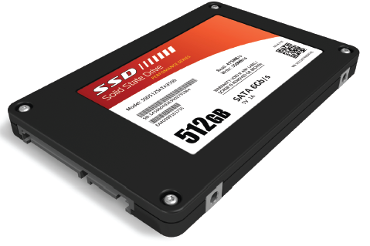
Solid-State Drives
Use a form of EEPROM (memory) to store data
Small, removable drives like USB flash drives are portable
Large solid state drives designed to replace the hard disk drive are solid-state hard drives (SSHD)
They don't have any moving parts, the access time is very fast
Notes:
A solid-state drive (SSD) uses a type of EEPROM to store data in tiny transistors. As you learned in Chapter 2, electrically erasable programmable read-only memory (EEPROM) is a type of memory that stores its contents permanently; it is nonvolatile. Because it is electrically erasable, the computer can erase what's written there and rewrite it. The type of EEPROM used in solid-state drives can be erased and rewritten in small blocks, making it suitable for use as a storage device. When a solid-state drive is a large-capacity replacement for an HDD, it's sometimes called a solid-state hard drive (SSHD) to distinguish it from lower-capacity portable solid-state storage such as USB flash drives. Figure 3.32 shows a solid-state hard drive.
Solid-state drives are silent because they don't have any moving parts, and the access time is very fast because there are no read/write heads that have to move anywhere to get to the data. SSDs are more expensive than HDDs, though; you get much less capacity for the money. For this reason, SSHDs are found mostly in high-end desktop and notebook computers. Solid-state storage is common in tablets and smartphones, where high-capacity storage is not needed and being lightweight is a primary concern. To balance between performance and cost, some systems have both a small SSD and a larger HDD. The SSD contains the start-up files and the operating system, and the HDD holds everything else. Hybrid drives are also available that combine the two technologies in a single physical unit

Slide 43
Solid-State Drives
SSDs are more expensive than HDDs
SSHDs are found mostly in high-end desktop and notebook computers.
Solid-state storage is common in tablets and smartphones, where high-capacity storage is not needed and being lightweight is a primary concern.
To balance between performance and cost, some systems have both a small SSD and a larger HDD.
Hybrid drives are also available that combine the two technologies in a single physical unit
Notes:
A solid-state drive (SSD) uses a type of EEPROM to store data in tiny transistors. As you learned in Chapter 2, electrically erasable programmable read-only memory (EEPROM) is a type of memory that stores its contents permanently; it is nonvolatile. Because it is electrically erasable, the computer can erase what's written there and rewrite it. The type of EEPROM used in solid-state drives can be erased and rewritten in small blocks, making it suitable for use as a storage device. When a solid-state drive is a large-capacity replacement for an HDD, it's sometimes called a solid-state hard drive (SSHD) to distinguish it from lower-capacity portable solid-state storage such as USB flash drives. Figure 3.32 shows a solid-state hard drive.
Solid-state drives are silent because they don't have any moving parts, and the access time is very fast because there are no read/write heads that have to move anywhere to get to the data. SSDs are more expensive than HDDs, though; you get much less capacity for the money. For this reason, SSHDs are found mostly in high-end desktop and notebook computers. Solid-state storage is common in tablets and smartphones, where high-capacity storage is not needed and being lightweight is a primary concern. To balance between performance and cost, some systems have both a small SSD and a larger HDD. The SSD contains the start-up files and the operating system, and the HDD holds everything else. Hybrid drives are also available that combine the two technologies in a single physical unit

Slide 44
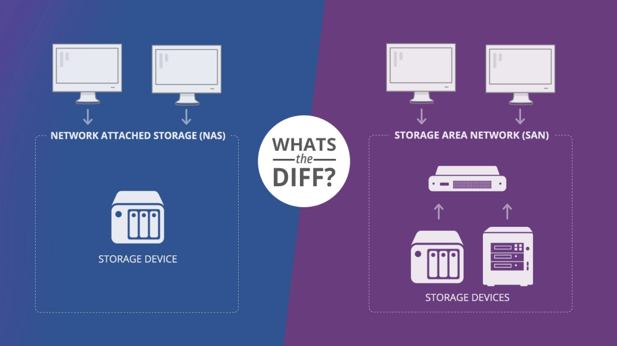
Network Storage Vocabulary
Direct-attached storage: Local storage, connected directly to the computer
Network-attached storage: Storage accessed via a network
NAS appliance: A specialize device that provides storage space to network users
Storage-area network: Network-accessed storage that appears to the user as local storage
Notes:
Network storage can enable multiple users to access the same up-to-the-minute information simultaneously.
For example, in a retail business with multiple checkout areas, all the checkout computers access a common database containing the item prices so that when the price of an item changes, all cashiers immediately have that information available.
On a smaller scale, a family could store its movie and music collection on one computer, which then can share the collection with all the other computers in the household via the family's wireless network. Storage that is available via a network is called network-attached storage (NAS).
Generically speaking, network-attached storage can be a volume on a file server in a business network or a shared folder on an individual's personal computer.
However, the term is most often applied to a NAS appliance, which is a specialized computing device built specifically for network file sharing.
The appliance connects directly into the network and can be remotely configured from any computer, so it doesn't need its own input or output devices.
NAS appliances are available for consumers as well as businesses; for example, you could connect an inexpensive NAS appliance to your home network to provide everyone in your family with always-on access to shared files
Some large companies employ storage-area networks (SANs) to make central access to large amounts of data simple. A SAN logically combines the contents of multiple remote storage devices so that each individual computer connected to the SAN sees that storage pool as a single local drive.

Slide 45
RAID
Redundant Array of Independent Disks
RAID0: Striping for performance
Notes:
When it is essential that data be kept safe and readily available, some companies store that data on a redundant array of independent disks (RAID).
There are several types of RAID systems, and each type offers improvements over a single disk drive in performance, in data safety, or in both.
Usually, when you store data on a disk, you write to one disk at a time. RAID systems have the ability to spread the data across multiple drives so each physical disk contains part of the data; this is called striping.
For example, RAID0 stripes data across multiple physical disks to improve the speed at which data is accessed, and RAID1 mirrors the contents of a physical disk on another identical disk so that the data is always available even if the original disk fails.
RAID5 combines the striping from RAID0 with a data storage method that enables the RAID unit to reconstruct lost data on any of the physical disks in the event of a disk failure.

Slide 46
RAID
Redundant Array of Independent Disks
RAID1: Mirroring for data security
Notes:
When it is essential that data be kept safe and readily available, some companies store that data on a redundant array of independent disks (RAID).
There are several types of RAID systems, and each type offers improvements over a single disk drive in performance, in data safety, or in both.
Usually, when you store data on a disk, you write to one disk at a time. RAID systems have the ability to spread the data across multiple drives so each physical disk contains part of the data; this is called striping.
For example, RAID0 stripes data across multiple physical disks to improve the speed at which data is accessed, and RAID1 mirrors the contents of a physical disk on another identical disk so that the data is always available even if the original disk fails.
RAID5 combines the striping from RAID0 with a data storage method that enables the RAID unit to reconstruct lost data on any of the physical disks in the event of a disk failure.

Slide 47
RAID
Redundant Array of Independent Disks
RAID5: Striping with parity, for both performance and data security
Notes:
When it is essential that data be kept safe and readily available, some companies store that data on a redundant array of independent disks (RAID).
There are several types of RAID systems, and each type offers improvements over a single disk drive in performance, in data safety, or in both.
Usually, when you store data on a disk, you write to one disk at a time. RAID systems have the ability to spread the data across multiple drives so each physical disk contains part of the data; this is called striping.
For example, RAID0 stripes data across multiple physical disks to improve the speed at which data is accessed, and RAID1 mirrors the contents of a physical disk on another identical disk so that the data is always available even if the original disk fails.
RAID5 combines the striping from RAID0 with a data storage method that enables the RAID unit to reconstruct lost data on any of the physical disks in the event of a disk failure.

Slide 48
Cloud Storage
Cloud: A secure computing environment accessed online
One of the most popular individual cloud storage systems is Microsoft OneDrive.
It is a secure storage environment, and you can optionally choose to share certain folders or files with specific other people or with the public.
Cloud storage: Storage that is accessed from a cloud environment
Notes:
A cloud is a secure computing environment consisting of a set of remote servers that users access via the Internet. A cloud can include applications, communication with other users, and storage space (cloud storage).
One of the most popular individual cloud storage systems is Microsoft OneDrive.
If you have a Microsoft account (which is free), you automatically get several gigabytes of OneDrive storage online.
It is a secure storage environment, and you can optionally choose to share certain folders or files with specific other people or with the public.
Google also offers free cloud-based storage to users, as do many other online companies. Businesses of all sizes also employ cloud storage.
For example, a business with many locations might create a cloud-based information system for all employees to access, regardless of where they are. This information system might include customer and product information, order information, access to human resources data such as vacation schedules, and company-wide announcements and memos.
A large company might maintain its own online server for implementing its cloud environment, or might contract with a third-party company to host its cloud.

Slide 49
Troubleshooting

Slide 50
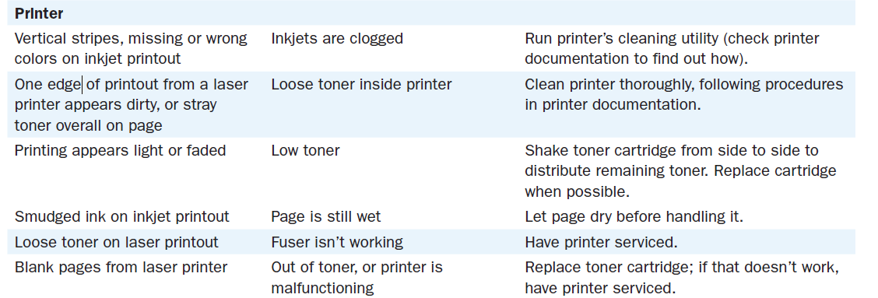
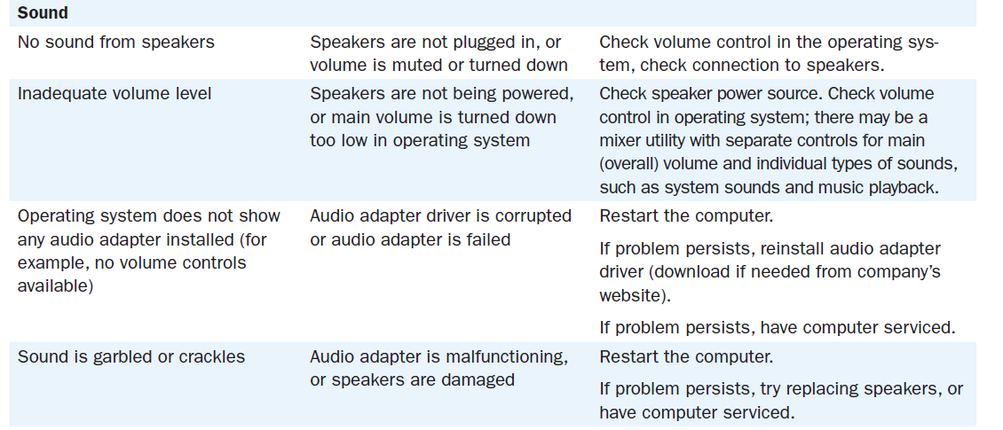
Troubleshooting

Slide 51
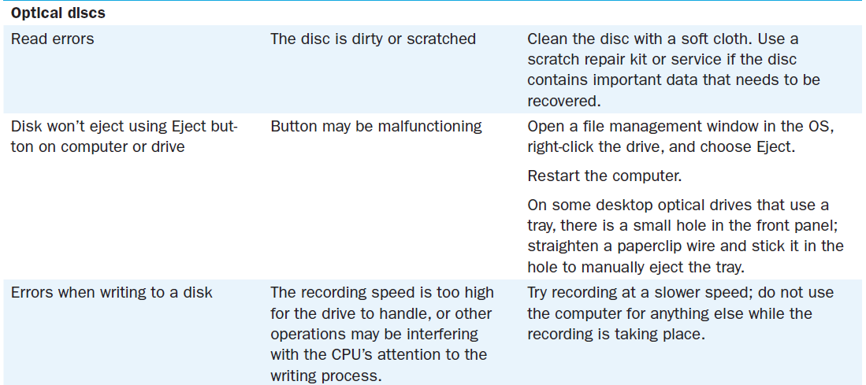
Troubleshooting

Slide 52
Chapter 3: Input, Output, and Storage
Learning Objectives:
Define input and describe the available types of keyboards and pointing devices
Describe scanning and image-capturing device types and features
Define output and explain the types of output devices available
Differentiate between types of monitors and explain their features
Differentiate between types of printers and identify the best printer for a task

Slide 53
Chapter 3: Input, Output, and Storage
Learning Objectives (continued):
Classify storage devices according to their capacities, interface, and media
Explain cloud and network storage and identify online and network-based storage technologies

Slide 54
Summary
1 . List three input devices and three output devices.
2 . How do wireless input devices communicate with the computer?
3 . Explain briefly how LCD and CRT technologies form screen images.
4 . List three types of printers and give an example of an appropriate use for each one.
5 . Explain how HDD and SSHD differ internally.
6 . Differentiate between DAS, NAS, SAN, and cloud storage.

