Slide 1
Chapter 4: Operating System Basics
Instructor: <Daw Khin Myat Thu>

Slide 2
Chapter 4: Operating System Basics
Learning Objectives:
Understand the types of operating systems available
Differentiate among the major desktop operating systems
Explain how device drivers work
Explain computer file storage concepts

Slide 3
System Software
System BIOS
- Stored on a ROM BIOS chip on the motherboard
- Performs a power-on self-test (POST) at start- up, ensures that all the critical hardware devices are functioning properly.
- If the hardware passes the tests, the BIOS looks for an operating system.
- “Firmware” – both hardware and software
Operating System
Utilities
Notes:
the Basic Input/Output System (BIOS) is the built-in software on the motherboard that starts the computer.
It performs a power-on self-test (POST) at start-up, which ensures that all the critical hardware devices are functioning properly, including the CPU, the RAM, and the motherboard.
If the hardware passes the tests, the BIOS looks for an operating system on one of the available drives, and then passes off control to the operating system to complete the boot process. The BIOS has a list of default settings it uses for managing memory and devices, but those settings can be overridden by user settings that you specify.

Slide 4
Operating System
Notes:
Operating system
It provides the user interface that humans use to communicate commands and receive feedback.
It communicates with the hardware, instructing it to take action to accomplish tasks. For example, it communicates with the keyboard and mouse to accept input, and it communicates with the display screen to show output.
It controls and manages the file storage system.
It runs applications, and enables humans to interact with them.

Slide 5
Operating System
Platform: the hardware required to run a particular operating system
A platform that was originally based on CPUs made by Intel.
- Intel platform (IBM-compatible)
- Windows
- UNIX
- Linux
- x86 The 32-bit version , x64 The 64-bit version
- Macintosh platform
- Mac OS X
- iPad and iPhone platform
- iOS
Notes:
There are many kinds of operating systems, suited for a wide range of devices, from supercomputers to smartphones. Each operating system is optimized for the hardware it runs on and the tasks the user is likely to want to perform. For example, the operating system on a tablet computer is designed to be compact (because there is limited storage space in the tablet), easy to operate (because most users are not computer professionals), and fast to respond to simple commands, whereas the operating system in a server is designed to give computer professionals many options for managing and configuring the server and supporting users and databases.
Some operating systems are designed to run on just one specific platform. A platform is a type of hardware.
For example, the type of hardware used in most Windows-based computers is called the Intel platform or the IBM-compatible platform. Those names originate from the makers of the early CPUs (Intel) and personal desktop computers (IBM). Several different operating systems run on the Intel platform, including Microsoft Windows, UNIX, and Linux. Most tablets and smartphones, on the other hand, support only one operating system. For example, devices built on the Macintosh platform such as the Apple iPad and iPhone support only the Apple iOS operating system.

Slide 6
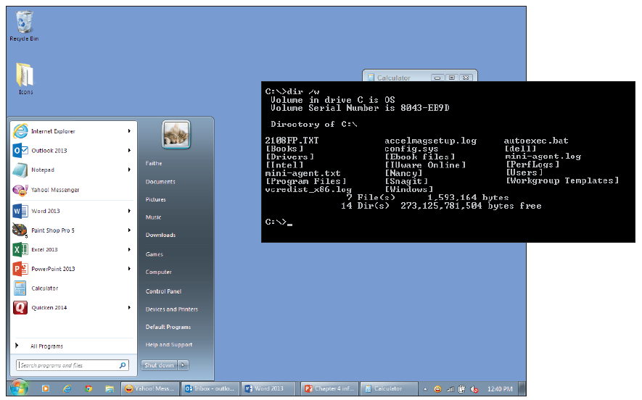
Interface Types
Graphical User Interface (GUI)
Command-line interface
Notes:
An operating system can have either a graphical user interface (GUI) or a commandline interface.
GUI interfaces are the norm in operating systems designed for most personal computing devices, such as desktops, notebooks, tablets, and smartphones.
Users interact with the graphics they see onscreen by using a keyboard or mouse, or using a finger or stylus on a touch screen.
In a command-line interface, users employ a keyboard to type commands at a prompt; the interface is text-only. Command-line operating systems were common in the early days of computing, but nowadays they are confined mostly to server operating systems.
An operating system can be single-user or multi-user. The operating systems on most personal devices are single-user. For example, only one person at a time typically uses a desktop PC with Windows installed. Server operating systems like UNIX, on the other hand, are designed to support multiple users accessing them simultaneously— for example, a dozen different digital cash registers in a retail store all simultaneously sending transactions to a central database.

Slide 7
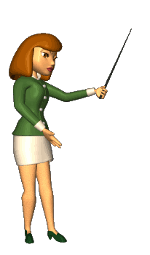
Utility Software
Optimizes, repairs, or safeguards the computer or its data.
Protection from malware
Virus
Spyware
Adware
Anti-spam software
Disk error correction
Disk optimization
File cleanup
Uninstallers
Registry cleanup
Notes:
Utility software performs a task (or set of tasks) that optimizes, repairs, or safeguards the computer or its data.
The difference between utility software and the operating system is sometimes not clear-cut, because most operating systems come with many utility programs built-in.
For example, Microsoft Windows comes with utilities for checking a disk for errors and optimizing the way files are stored on an HDD (hard disk drive).
Third-party utility software is also available, and may do a more thorough job at the task, combine multiple functions in a single interface, or have more advanced options for configuring how the tasks will run.
There are many types of utilities that protect the computer from attack by malware (harmful or maliciously created software). Antivirus programs find and remove viruses, for example, anti-spyware software finds and removes spyware and adware, firewall software blocks hackers from invading your system, and anti-spam software detects and segregates junk email. Some all-in-one protection suites such as Norton Security Suite protect against many types of threats at once.

Slide 8
Desktop and Notebook Operating Systems
Two main platforms: Apple and Intel (IBM)
Apple Macintosh platform supports only the Apple OS.
Mac OS: User-friendly, popular with graphic professionals. Many applications available
Notes:
There are two main hardware platforms for desktop and notebook computers: Apple and Intel (IBM-compatible). The Apple Macintosh platform supports only the Apple operating system: Mac OS X(pronounced Mac O-S-X, although the X technically is the Roman numeral 10). This operating system has an attractive GUI and is easy to understand and use. Apple assigns the versions of Mac OS X code names as well as version numbers. The most recent version at this writing is called Yosemite (version 10.10).
The Macintosh platform has been popular with graphics professionals for decades, and much of the best page layout and graphics editing software was originally developed for the Mac. However, in recent years, similar software has become available for both Windows and Mac, so there is no reason to choose a Mac based on software compatibility anymore. You can run Windows on a Mac with the Mac program Boot Camp. There is also a Mac version of Microsoft Office. Most Intel-based systems use Microsoft Windows. Like Mac OS X, Windows also has an attractive GUI and is easy to learn and use. Windows has the advantage of being the most popular OS, and therefore the one that more applications are written to run on.
Linux (pronounced LIN-ucks) is an operating system that looks and feels very similar to UNIX. It can run on a variety of platforms, including Intel-based desktops and notebooks, servers, and handheld devices. (Android, a popular OS for smartphones and tablets, is a variant of Linux.)
Linux was developed by Linus Torvalds. The name Linux is a combination of the words Linus and UNIX. Linux is open-source, which means that Mr. Torvalds retains ownership of his original code, but it is free to the public to use in any way they see fit. Users are free to modify the code, improve it, and redistribute it. Developers are not allowed to charge money for the Linux kernel itself (the main part of the operating system), but they can charge money for distributions(distros, for short), which are packaged collections of add-ons and utility programs for Linux. Some of the most popular distros include SUSE Linux, Ubuntu Linux, and Red Hat Linux.

Slide 9
Mac OS X Mavericks

Slide 10
Mac os versions
OS X 10.9 Mavericks (Cabernet) - 22 October 2013
OS X 10.10: Yosemite (Syrah) - 16 October 2014
OS X 10.11: El Capitan (Gala) - 30 September 2015
macOS 10.12: Sierra (Fuji) - 20 September 2016
macOS 10.13: High Sierra (Lobo) - 25 September 2017
macOS 10.14: Mojave (Liberty) - 24 September 2018
macOS 10.15: Catalina (Jazz) - 7 October 2019

Slide 11
Desktop and Notebook Operating Systems
Intel-based systems use Microsoft Windows
Windows: Best known, greatest selection of applications available
Notes:
There are two main hardware platforms for desktop and notebook computers: Apple and Intel (IBM-compatible). The Apple Macintosh platform supports only the Apple operating system: Mac OS X(pronounced Mac O-S-X, although the X technically is the Roman numeral 10). This operating system has an attractive GUI and is easy to understand and use. Apple assigns the versions of Mac OS X code names as well as version numbers. The most recent version at this writing is called Yosemite (version 10.10).
The Macintosh platform has been popular with graphics professionals for decades, and much of the best page layout and graphics editing software was originally developed for the Mac. However, in recent years, similar software has become available for both Windows and Mac, so there is no reason to choose a Mac based on software compatibility anymore. You can run Windows on a Mac with the Mac program Boot Camp. There is also a Mac version of Microsoft Office. Most Intel-based systems use Microsoft Windows. Like Mac OS X, Windows also has an attractive GUI and is easy to learn and use. Windows has the advantage of being the most popular OS, and therefore the one that more applications are written to run on.
Linux (pronounced LIN-ucks) is an operating system that looks and feels very similar to UNIX. It can run on a variety of platforms, including Intel-based desktops and notebooks, servers, and handheld devices. (Android, a popular OS for smartphones and tablets, is a variant of Linux.)
Linux was developed by Linus Torvalds. The name Linux is a combination of the words Linus and UNIX. Linux is open-source, which means that Mr. Torvalds retains ownership of his original code, but it is free to the public to use in any way they see fit. Users are free to modify the code, improve it, and redistribute it. Developers are not allowed to charge money for the Linux kernel itself (the main part of the operating system), but they can charge money for distributions(distros, for short), which are packaged collections of add-ons and utility programs for Linux. Some of the most popular distros include SUSE Linux, Ubuntu Linux, and Red Hat Linux.

Slide 12
Microsoft Windows 7

Slide 13
Microsoft Windows 8.1

Slide 14
Microsoft Windows 10

Slide 15
Desktop and Notebook Operating Systems
Linux: Free, but can be more challenging to configure
Can run on Intel-based desktops, notebooks, server, and handheld devices;
Few applications available
SUSE Linux, Ubuntu Linux and Red Hat Linux
Notes:
There are two main hardware platforms for desktop and notebook computers: Apple and Intel (IBM-compatible). The Apple Macintosh platform supports only the Apple operating system: Mac OS X(pronounced Mac O-S-X, although the X technically is the Roman numeral 10). This operating system has an attractive GUI and is easy to understand and use. Apple assigns the versions of Mac OS X code names as well as version numbers. The most recent version at this writing is called Yosemite (version 10.10).
The Macintosh platform has been popular with graphics professionals for decades, and much of the best page layout and graphics editing software was originally developed for the Mac. However, in recent years, similar software has become available for both Windows and Mac, so there is no reason to choose a Mac based on software compatibility anymore. You can run Windows on a Mac with the Mac program Boot Camp. There is also a Mac version of Microsoft Office. Most Intel-based systems use Microsoft Windows. Like Mac OS X, Windows also has an attractive GUI and is easy to learn and use. Windows has the advantage of being the most popular OS, and therefore the one that more applications are written to run on.
Linux (pronounced LIN-ucks) is an operating system that looks and feels very similar to UNIX. It can run on a variety of platforms, including Intel-based desktops and notebooks, servers, and handheld devices. (Android, a popular OS for smartphones and tablets, is a variant of Linux.)
Linux was developed by Linus Torvalds. The name Linux is a combination of the words Linus and UNIX. Linux is open-source, which means that Mr. Torvalds retains ownership of his original code, but it is free to the public to use in any way they see fit. Users are free to modify the code, improve it, and redistribute it. Developers are not allowed to charge money for the Linux kernel itself (the main part of the operating system), but they can charge money for distributions(distros, for short), which are packaged collections of add-ons and utility programs for Linux. Some of the most popular distros include SUSE Linux, Ubuntu Linux, and Red Hat Linux.

Slide 16
Ubuntu Linux

Slide 17
Desktop and Notebook Operating Systems
Thin client operating system: Chrome OS produced by Google
Doesn’t run most applications
Preinstalled on some thin clients: simple file manager and web browser
Notes:
There are two main hardware platforms for desktop and notebook computers: Apple and Intel (IBM-compatible). The Apple Macintosh platform supports only the Apple operating system: Mac OS X(pronounced Mac O-S-X, although the X technically is the Roman numeral 10). This operating system has an attractive GUI and is easy to understand and use. Apple assigns the versions of Mac OS X code names as well as version numbers. The most recent version at this writing is called Yosemite (version 10.10).
The Macintosh platform has been popular with graphics professionals for decades, and much of the best page layout and graphics editing software was originally developed for the Mac. However, in recent years, similar software has become available for both Windows and Mac, so there is no reason to choose a Mac based on software compatibility anymore. You can run Windows on a Mac with the Mac program Boot Camp. There is also a Mac version of Microsoft Office. Most Intel-based systems use Microsoft Windows. Like Mac OS X, Windows also has an attractive GUI and is easy to learn and use. Windows has the advantage of being the most popular OS, and therefore the one that more applications are written to run on.
Linux (pronounced LIN-ucks) is an operating system that looks and feels very similar to UNIX. It can run on a variety of platforms, including Intel-based desktops and notebooks, servers, and handheld devices. (Android, a popular OS for smartphones and tablets, is a variant of Linux.)
Linux was developed by Linus Torvalds. The name Linux is a combination of the words Linus and UNIX. Linux is open-source, which means that Mr. Torvalds retains ownership of his original code, but it is free to the public to use in any way they see fit. Users are free to modify the code, improve it, and redistribute it. Developers are not allowed to charge money for the Linux kernel itself (the main part of the operating system), but they can charge money for distributions(distros, for short), which are packaged collections of add-ons and utility programs for Linux. Some of the most popular distros include SUSE Linux, Ubuntu Linux, and Red Hat Linux.

Slide 18
Google Chrome OS

Slide 19
Server Operating Systems
Computers that share resources
UNIX
Command-line OS, very mature server capabilities, large user community, stable
Windows Server
Familiar GUI interface for those experienced with Windows, designed to help IT professionals control server activities
Linux
Free, customizable, many free services and utilities available

Slide 20
UNIX

Slide 21
Windows Server

Slide 22
Tablet and Phone Operating Systems
Use solid state storage
System-on-chip (SoC)
Downloadable applications (apps) from a Store app
Popular SoC operating systems:
- iOS: for iPad, iPhone
- Android: for a variety of tablets and phones
- Windows Phone: for Windows phones (Windows 8.1 pro, Windows 10)

Slide 23
iOS on the iPad

Slide 24
Windows Phone OS

Slide 25
Device Drivers
Translate the OS requests into the language of the device
Translates messages from the device back to the OS
Published by the device manufacturer for a specific operating system and device model
Updates are periodically released that fix bugs and improve performance

Slide 26
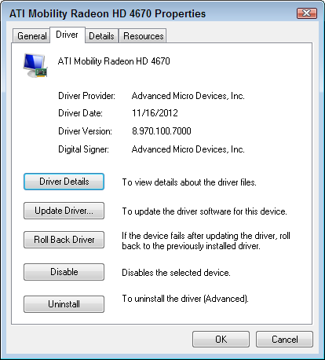
Device Manager
Access from the Control Panel (System section)
Shows the installed devices
Shows driver details and versions

Slide 27
Digital Storage Vocabulary
Drive: Physical storage device
Volume: A lettered section of a storage device (a logical drive)
Partition: To create logical volumes out of a single physical drive
Format: To create the file system on a volume

Slide 28
File Systems
File system: The storage system used to store and organize the files on a particular volume
Common file systems:
NTFS: Most Windows hard drives (Windows 2000 and higher)
HFS+: Hard drives for Mac OS X
ISO 9660 or UDF: CDs and DVDs
FAT32: Hard drives for Windows 95/98/Millennium Edition
Notes:
A drive is a physical storage unit, such as an HDD, a SSD, or a DVD drive. Some drives are separate from their discs, as a DVD drive is.
Other drives have the discs built-in, like in an HDD.
And some drives are not technically “drives” at all, in that they have no moving parts, but are called drives for consistency; solid-state drives are an example of that. The term hard drive generically refers to both HDD and SSHD storage in popular usage. Each drive has one or more volumes, which are logical divisions of storage areas.
Volumes are represented by letters, such as C:. A small-capacity, removable storage device like a DVD or a USB flash drive has a single volume letter. A large-capacity storage device like an HDD or SSHD may be divided into multiple volumes.
To prepare a hard drive for use, it must first be partitioned. Partitioning creates the logical divisions of the available space. A physical drive can logically be a single volume (one big partition with one volume letter assigned), or it can be split up into many pieces, each with its own volume letter. Each volume must then be formatted.
Formatting organizes the available space by creating a file system on it. The file system determines how the files will be stored and retrieved logically.
Depending on the operating system and the utility you are using to partition and format the drive, different file systems may be available. Modern versions of Windows prefer the New Technology File System (NTFS) for the system volume (that is, the volume on which Windows itself is installed), but can also support FAT32, a file system used in earlier Windows versions.
Mac OS X uses a file system called Hierarchical File System Plus (HFS+). Linux supports several different file systems, and the default file system installed depends on the distro.
CDs and DVDs commonly use the ISO 9660 (also called CD File System, or CDFS) or the Universal Disc Format (UDF) file system. Table 4.1 outlines the most popular file systems.
Different file systems offer different features and benefits. NTFS, for example, provides features like file encryption, file compression, support for long filenames (up to 255 characters), and support for large-capacity volumes (up to16 TB).

Slide 29
File Paths
Root directory = top-level folder
Path: the complete descriptor of a file’s location, including the volume and folders
Path is written like this:
E:\Budget\January.txt
Notes:
The top level of storage for a volume is its root directory. The root directory is like the lobby of a building. All other locations within the volume are accessed by going through it. The term root directory is a carryover from an earlier time when folders were called directories. Another name for the root directory is top-level folder.
A file's path is the complete descriptor of its location. A file named Budget.txt located in the root directory of the C: drive, for example, would have a path like this:
path The complete descriptor of a file's location, including the volume and folders.
The colon (:) in the preceding example path indicates that the letter preceding it is a volume letter.
The \ follows a folder (directory) name. The example has no name before the \ because the root directory has no name. Now suppose that file were in a folder called Personal.
Its path would look like this: C:\Personal\Budget.xlsx, a folder within a folder is called a subfolder.
Suppose that the Personal folder had a subfolder called Financial, and our example file was in that folder. The path would look like this: C:\Personal\Financial\Budget.xlsx A volume's folder hierarchy can be complicated. There can be hundreds of folders in the root directory, and each of them can contain many levels of subfolders. A file management utility, such as File Explorer in Windows 8.1, provides a visual picture of the structure that you can browse. For example, in Figure 4.12, the example file appears in the Financial folder. The folder tree in the navigation pane at the left shows the complete path taken to get to that file. folder tree A graphical representation of a volume's storage hierarchy, with subordinate branches for folders and subfolders.

Slide 30
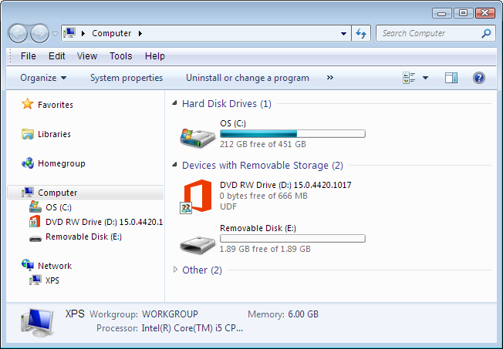
File Paths
Folder tree in navigation pane in Windows Explorer shows graphical representation of folder system

Slide 31
File Extensions and Types
Extension: characters after the period in a file name that indicate the file’s type
Extensions tell the OS which application to use to open a data file
Extensions tell the OS which files are executable (.exe or .com)

Slide 32
File Extensions and Types

Slide 33
File Compression
Can be made to take up less space by compressing them
NTFS has an optional compression feature built in.
Notes:
Files can be made to take up less space by compressing them. Compressing a file applies an algorithm to it that makes the file smaller by storing it using more efficient notation. For example, suppose a file contains 36 zeroes in a row. Each character occupies one byte of space, so that's 36 bytes. But a compression algorithm could rewrite that as 0x36, resulting in code that occupies only 4 bytes. When the file is needed, it is decompressed into its original form again, but when it is stored on disk, it is in the smaller form. JPEG is a common graphic file format that uses compression, for example. algorithm A step-by-step procedure for performing a calculation.
NTFS has an optional compression feature built in. You can enable or disable it for individual files and folders. The trade-off is that when a file or folder is compressed, it takes slightly longer to access it, because the internal compression algorithm must run before the decompressed file can be presented to you. compressed archive A compressed file that contains one or more other files. Another type of compression creates a compressed archive, which is a package file containing one or more files within a single compressed file. For example, files with a zip extension are compressed archives. Windows supports the zip archive format and treats zip files like folders. You can also use third-party utility programs such as WinZip to manage zipped archive files.

Slide 34
Backup Vocabulary
Archive attribute: File attribute that indicates whether or not a file has changed since its last backup
Full backup: Backs up all files and sets their archive attribute to Off
Differential backup: Backs up all files that have the archive attribute On but does not change that attribute
Incremental backup: Backs up all files that have the archive attribute On and then sets it to Off

Slide 37
Key Terms
adware
algorithm
Android
anti-spam software
app
archive attribute
backup set
backup software
BitLocker
Chrome OS
command-line interface
compressed archive
Device Manager
device driver
differential backup
disk checking program
distribution (distro)
encrypt
FAT32
file extension
file system
firewall software
folder tree
format
full backup
graphical user interface Hierarchical File System Plus (HFS+)
incremental backup
Intel platform
iOS
ISO 9660
Linux
Mac OS X
malware
Mavericks
Microsoft Windows
New Technology File System (NTFS)
partition
path
platform
Plug and Play
registry
registry cleanup program
roll back
root directory
server
shell
spyware
system-on-chip (SoC)
system software
system volume
thin client
uninstaller utility
Universal Disc Format (UDF)
UNIX
utility software
virus
Windows Phone
Windows RT
Windows Server
x64
x86

Slide 38
Summary
1 . List three types of system software.
2 . What is the difference between an OS and a platform?
3 . List five types of utility programs.
4 . List three operating systems that would run on an IBM-compatible desktop PC.
5 . Name three operating systems used on smartphones.
6 . Explain the purpose of Plug and Play technology.
7 . Explain the purpose of partitioning a drive.
8 . Give an example of a complete path to a file, and explain the parts of the path.

