Slide 1
Chapter 13: Networking and Internet Basics
Instructor: <Daw Khin Myat Thu>

Slide 2
Chapter 13: Networking and Internet Basics
Learning Objectives:
Identify communications networks in daily life
Distinguish between types of networks
Identify common types of network hardware
Understand the Internet and choose a connection method
Troubleshoot common network and Internet connectivity problems

Slide 3
Our Connected World
Networking is early everywhere
Withdraw funds
Buy an item with credit card
Inventory Management
Phone call
Notes:
Networking is nearly everywhere, and many of our everyday activities are enabled or assisted by computer networking, even the activities that might not on the surface seem to have anything to do with it.
For example, when you withdraw funds at your local bank branch, the bank verifies your account balance on the bank's main server at the home office.
When you buy an item at your local discount chain store and pay for your purchase with a credit card, the digital cash register's software checks a credit card verification server to make sure your card is valid before charging your purchase.
It then sends the information to the store's internal inventory management system via the local network.
The local server then sends an updated inventory report to the company's web server, so that someone ordering from the store's website will know that the item is no longer in stock.
When you call your mother on your cell phone on the way home to tell her about your purchase, your call goes through the wireless network for your cell phone provider

Slide 4
Public Telephone and Data Networks
First worldwide network is telephone network
Public switched telephone network (PSTN) is circuit-switched
- Point to point connection between locations
- Communication channel stays open the whole time
Notes:
The first worldwide network ever created was the telephone network, predating computers by many decades.
This network is an example of a circuit-switched network.
It works by creating a point-to-point circuit between the two locations, as shown in Figure 13.1.
The telephone network creates a pathway between the two points, and that pathway remains open for the duration of the phone call.
Networks can be public or private. The public telephone system—the whole of the world's circuit-switched telephone networks—is known as the public-switched telephone network (PSTN).

Slide 5
Packet-Switched Network
Computer networks are packet-switched
Communication channel does not remain open the whole time
Data is broken up at the sending end into small packets and routed individually to the receiver
Each packet may take a different route to the destination
Notes:
In contrast, computer networks are packet-switched networks.
A communication channel does not remain open between two points for an entire conversation; instead, the data is broken up at the sending end into small packets, each with an electronic envelope around it that states the source and the destination, and sent individually to the receiver.
Depending on the network traffic, each packet may take a different route to the destination, but when they arrive they are unpacked and reassembled into the original message, as in Figure 13.2.

Slide 6
The Internet
World’s largest computer network
Not owned or maintained by any one company
Multiple standards organizations manage the protocols (rules)
Packet-switched network with a worldwide addressing system
Internet uses various protocols that all participating computers have standardized on.
Based on TCP/IP protocol stack
- Common set of standards
- Use in most private networks too
- IP addressing identifies each device by a numeric value
- Eg. 192.168.0.254
Notes:
The Internet is the world's largest computer network. It is not owned or maintained by any one company; instead, it is a cooperative effort among many companies and governments, with multiple standards organizations managing the rules for its operation.
The Internet is a packet-switched network with a worldwide addressing system.
The Internet uses various protocols (rules) that all participating computers have standardized on, so that services like the web, email, and instant messaging work the same everywhere.
Most companies and individuals don't connect directly to the Internet; instead, they connect to an Internet service provider (ISP), which in turn connects to the Internet
The Internet is based on a protocol stack (a set of protocols) called Transmission Control Protocol/Internet Protocol (TCP/IP). TCP/IP provides a common set of standards by which data can be sent and received. It is used not only on the Internet, but in most private networks today as well. One of the key features of TCP/IP is IP addressing, which is a means of uniquely identifying each connected computer on the network by a numeric value

Slide 7
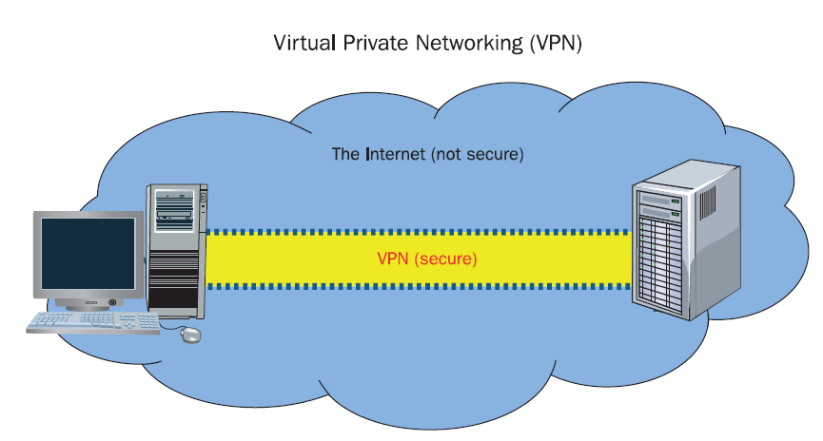
Private Digital Networks
Companies maintain their own high-speed connections between locations
Using the Internet is the most cost-effective method, but not the most reliable method, because the connection can be affected by Internet traffic problems and connections that other companies control and maintain
- Leased lines from the phone company
- virtual private network (VPN) through the Internet
VPN technology creates a secure, tamper-resistant data tunnel between two points on the Internet.
Notes:
Many companies maintain high-speed connections between their locations.
They can do so by leasing a line running their own, or using the existing pathways of the Internet.
Using the Internet is the most cost-effective method, but not the most reliable method, because the connection can be affected by Internet traffic problems and connections that other companies control and maintain.
Using the Internet is also not very secure; it's an open system, and data being sent and received can easily be snooped.
To tighten the security when using the Internet as a conduit (a pipe or passage through which water, gas passes), many companies use a software technology called virtual private networking (VPN). VPN technology creates a secure, tamper-resistant data tunnel between two points on the Internet, so that sensitive information can be exchanged securely, as in Figure 13.3.
A VPN allows an employee who is working outside of the company's main building to connect to any of the internal network resources, just as if he or she were in the building

Slide 8
Satellite Data Networks
Transmitter/receiver unit that orbits the Earth.
Satellites in geosynchronous orbit
Contains Transponders to send and receive data that communicate with stations on the ground.
Satellite radio and TV distribution
- DirecTV, Dish Network
- Sirius, XM radio
Satellite Internet services to consumers
- Internet service for those who cannot get other broadband because of location
Notes:
A satellite is a transmitter/receiver unit that orbits the Earth, more than 22,000 miles up.
Satellites are in geosynchronous orbit (that is, their orbit is synchronized with the Earth's orbit), so they do not appear to change in position compared to any location on Earth. A satellite contains transponders, which are two-way radios that communicate with stations on the ground. Satellites are used to quickly send information between two points on Earth that are physically separated by a great distance.
For example, when the Olympics are held in one country, satellites are used to broadcast the video of each competition nearly instantly to every other country. Satellites are also used for services like satellite radio (Sirius/XM, for example) and satellite TV broadcasts such as DirecTV and Dish Network (see Figure 13.4).
Some Internet services also use satellites to provide Internet access to areas where other high-speed connection technologies are not available.

Slide 9
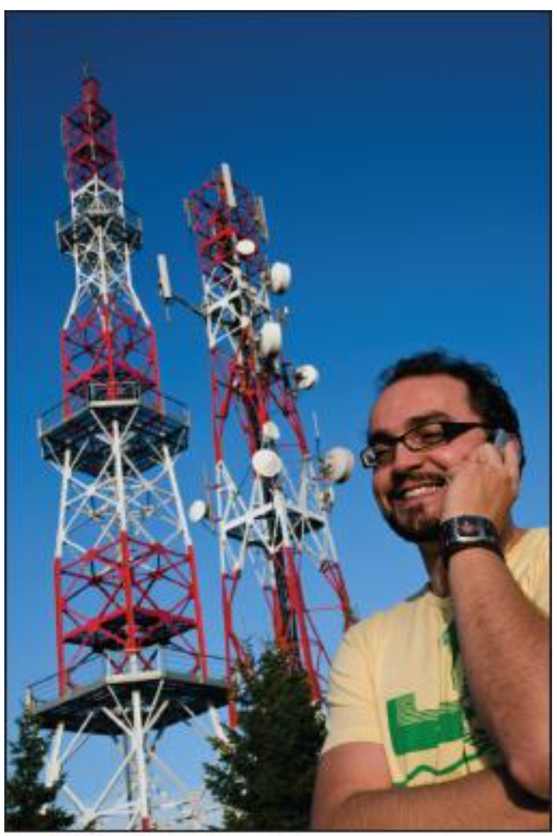
Cell Phone Networks
Cellular telephone companies have their own data networks using a combination of satellites, cables, and on-ground towers with transmitters and receivers
Calls connect to the tower closes to them
The tower then taps into the larger network
Cell networks (3G/4G) can access the Internet
You can tether (connect) a smartphone to a computer
Notes:
Cellular telephone companies have their own data networks, using a combination of satellites, cables, and on-ground towers with transmitters and receivers on them.
Calls connect to the cell tower that is closest to the phone's current location, and that cell tower then taps into the larger telecommunications network via satellites and cables.
smartphone A cellular phone that includes computer applications and Internet access capability.
tether To connect a smartphone to a computer so that the computer can use the smartphone's Internet access.
Some cell phone networks can also be used to access the Internet (see Figure 13.5). You can access the Internet on a smartphone (a cell phone that includes computer functionality), and you can tether (connect) a smartphone to a computer and use the phone as a modem to allow the computer Internet access.

Slide 10
Ways of Classifying Networks
Geographical Range
Peer-to-Peer and Client/Server
Intranets and Extranets
Ethernet
Wireless Technologies

Slide 11
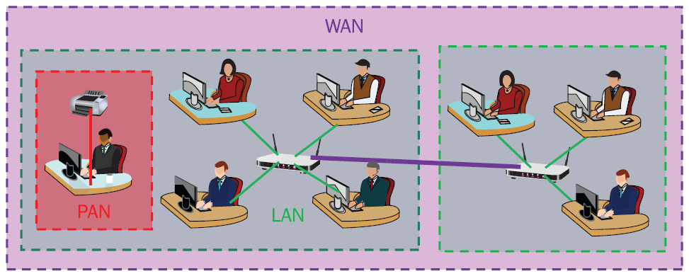
Geographical Range
Personal area network: single user
Local area network: in the same building or campus or a group of adjacent buildings
: key characteristic is that it is contained within a relatively small area.
Metropolitan area network: in the same city or town.
Wide area network: geographically dispersed network, at least two LANs connected together.
: Not managed by a single organization.
: Internet is a form of global WAN.
Notes:
One way to classify networks is according to the geographical range that they cover, from a few feet within a single person's office to a huge area that covers multiple countries or even multiple continents. Figure 13.6 provides a graphical explanation of some of these ranges
A personal area network (PAN) consists of devices that directly connect to a single computer. For example, if you are showing a presentation in a conference room during a business meeting, you might connect your notebook PC to the projector in the room. You might also form a PAN by connecting your smartphone to your computer.
A local area network (LAN) is a network in which all the devices are located within the same physical location, such as a single building or a group of adjacent buildings. A key characteristic of a LAN is that it is contained within a relatively small area. For example, your home network is a LAN, and so is the network at your school.
A metropolitan area network (MAN) is a network that spans an entire town or city— or, as the name implies, a metropolitan area that might span a major city and its suburbs. A city might invest in a network infrastructure, for example, and then businesses and individuals within that area might sign up to use the network.
A wide area network (WAN) is a geographically dispersed network, usually consisting of at least two LANs connected together by an external link. A business or college with multiple separate campuses might link all the individual LANs together to form a WAN, for example. A WAN is not necessarily managed by a single organization and may include architecture and communications hardware from several different service providers. In this sense, the Internet is a form of global WAN.

Slide 12
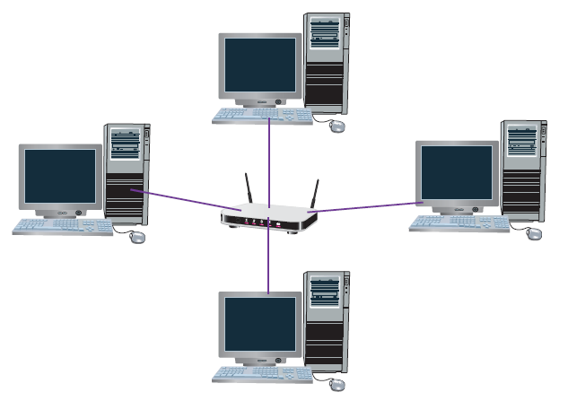
Peer to Peer Network
To look at whether or not a server is involved in their management
A server is a computer that is dedicated to providing network and sharing services to the other computers on the network
Very small networks (10 computers or fewer) can get by without a server by operating as P2P also called workgroup
A P2P network slows down each computer slightly because of the overhead involved in the network.
Good for small groups of computers
Notes:
Another way to classify networks is to look at whether or not a server is involved in their management.
As you learned in Chapter 1, a server is a computer that is dedicated to providing network and sharing services to the other computers on the network. Very small networks (10 computers or fewer) can get by without a server by operating as a peer-to-peer (P2P) network, also called a workgroup.
In a P2P network, each computer shares in the administrative burden of maintaining the network, as shown in Figure 13.7.
Each computer is responsible for authenticating other users who want to share its resources (files and printers) and for making those resources available. A P2P network slows down each computer slightly because of the overhead involved in the network. It is not usually noticeable with just a few computers, but the more computers there are, the greater the slowdown.

Slide 13
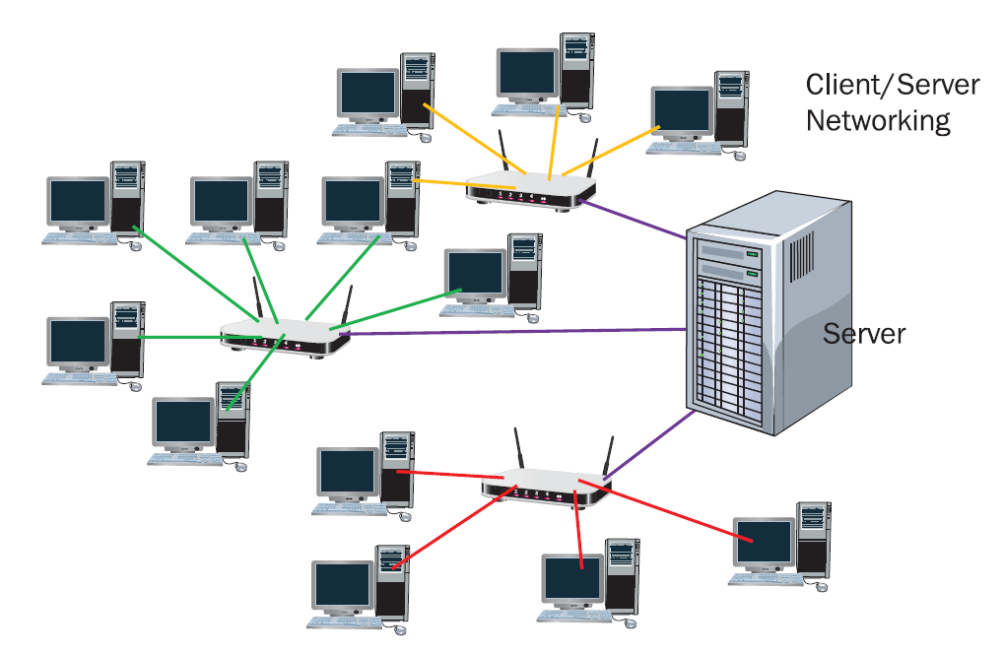
Client/Server Networks
Consists of one or more dedicated servers and client
Central management of security and identities
Each server may perform a different type of network task, such as a file server or a print server
Good for large groups of computers (>10)

Slide 14
Intranets and Extranets
Intranet: A secure network that only staff within the company can access, and only on-site
- The intranet cannot be accessed by anyone outside the organization and can't be accessed when staff are not physically located in the office unless they are given specific permission for remote access.
Extranet: A secure network that is available to both employees and outsiders
- An extranet may be used by the company's business partners, contract employees, or customers to get real-time information, such as about products they supply that might soon need restocking.
Notes:
Some organizations have a part of the network that can only be accessed from within the organization. This sub-network is known as an intranet.
The network administrator may enable intranet users to share message board items, link to external web pages, and comment on photos or news items that are posted.
The intranet cannot be accessed by anyone outside the organization and can't be accessed when staff are not physically located in the office unless they are given specific permission for remote access.
In contrast, a company may maintain an extranet, a separate network that is specifically intended for people outside the organization. An extranet may be used by the company's business partners, contract employees, or customers to get real-time information, such as about products they supply that might soon need restocking.

Slide 15
Ethernet
The current dominant standard for local area networking devices
Can be wired or wireless (refer only the wired type as Ethernet)
Wireless version is also called Wi-Fi or 802.11
Devices have a maximum speed, such as 1 Gbps
Twisted-pair copper cable is the most common medium
1000BaseT means 1000 Mbps (1 Gbps) and twisted pair cable (T for twisted)
Also allows fiber optic cable and very high rates of data transfer up to 10 Gbps.
Notes:
Over the years since networking began, there have been several popular networking technologies—that is, different sets of standards for networking hardware and software. Each of these technologies has involved different hardware and software installed in each computer, different connection hardware, and different types of cables.
Some of the early networking technologies included Token Ring, Banyan Vines, and Ethernet.
All of those technologies have become obsolete except Ethernet. Most network hardware that you buy in stores today can be assumed to be Ethernetcompatible unless it specifies otherwise.
Ethernet can technically be either wired or wireless, but it is becoming increasingly common to refer to only the wired type as Ethernet; wireless Ethernet is popularly called Wi-Fi. (See the following section for more information about Wi-Fi.)
Ethernet devices have a certain maximum speed. For example, 1000BaseT Ethernet, which is common in most residential and business networks, transfers data at up to 1000 Mbps (1 Gbps). The “T” in the name refers to the twisted-pair cables used; you will learn more about cables in the “Network Hardware” section later in this chapter. The Ethernet standard also allows fiber optic cable and very high rates of data transfer

Slide 16
Wireless Networking
Two main uses:
- Endpoints of connectivity: laptops, smart phones
- Source of transferring data between locations when using cables is not practical, such as with satellite and microwave systems.
Notes:
A network can connect devices using either wired or wireless connections. A wired connection runs a cable between the points, whereas wireless connects the two points via radio frequency (RF) or infrared. Wireless communications have two main uses. The first use is at the endpoints of network connectivity, where a device such as a smartphone or laptop computer connects wirelessly to a router or other device that provides network and/or Internet access. The second use is as a source of transferring data between locations when using cables is not practical, such as with satellite and microwave systems.

Slide 17
Wi-Fi
Wireless fidelity
The wireless version of Ethernet
IEEE 802.11 standard
Notes:
Wi-Fi is the common name for the wireless networking technology that's used for almost all home and business networks today, often referred to by its standard number: IEEE 802.11.
Whenever you use wireless networking to access the Internet at your home or workplace or in a public location such as a cafe or library, you are using Wi-Fi.
There have been different versions of the Wi-Fi standard since its original development. The popular version today is 802.11n, which can carry up to 600 Mbps of data over a range of up to 230 feet indoors or 840 feet outdoors.
An update to it called 802.11ac has recently been approved; it may already be incorporated into networking devices you can buy in stores by the time you read this. 802.11ac has a maximum throughput of 1.3 Gbps, more than doubling the capacity of 802.11n. Table 13.1 lists the different Wi-Fi standards and their speeds and distances.

Slide 18
Bluetooth
Short-range wireless networking
Most commonly used to connect a computer to an input or output device
Used to connect personal devices such as headsets or Bluetooth-enabled printer
Used to create personal area networks
Range limit of 20 feet
Notes:
Bluetooth is a wireless technology used to connect individual devices to one another in close proximity. It is most commonly used to connect a computer to an input or output device.
For example, you might have a Bluetooth headphone that you use with your smartphone, or you might have a Bluetooth-enabled printer that you can use with your notebook PC.
A personal area network (PAN) forms when the devices are within range of each other and they are paired (by using software to authenticate them to one another). When the devices are no longer in range of one another, the PAN stops.
Bluetooth is limited to about 20 feet in range, so it isn't a practical technology to use for wireless networking in general (such as to share an Internet connection with computers all over a home or office).

Slide 19
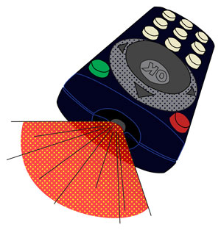
Infrared
Uses light waves to beam information between devices.
Older technology, mainly replaced by Bluetooth
Still used in TV remote controls
IrDA is the standard (Infrared Data Association)
The main drawback of infrared transmission is that it must have a clear line of sight between the two points.
Notes:
Infrared technology uses light waves to “beam” information from device to device.
Infrared was the method of choice for connecting wireless peripherals a decade or so ago, but Bluetooth has mainly superseded it today. However, infrared is still used for most remote controls for TVs and other home theater components.
The main drawback of infrared transmission is that it must have a clear line of sight between the two points. The standard for an infrared connection is IrDA (short for Infrared Data Association, the organization that created and manages the standard).

Slide 20
Microwave
High-frequency radio waves.
Much higher than that used for Wi-Fi or Bluetooth.
The points can be miles apart (up to about 25 miles)
Because line of sight is so critical for microwave communications, the transmitters are often placed high up on towers or buildings.
Microwave technology is not as widely used today but use in where security is critical.
A point-to-point microwave connection is more secure than a connection that goes through a satellite.

Slide 21
Network hardware
Network connectivity requires both hardware and software.
The software portion is handled by the operating system
Not all computers include networking hardware, and some network hardware is independent of any one computer
Network Installer position in IT

Slide 22
Network Adapter
Provides networking interface hardware needed for a computer to connect to a network
Each network client device (computer, tablet, printer, and so on) must have a network adapter.
Most desktop and notebook computers come with a wired Ethernet adapter built in, and notebook computers almost always include a built-in wireless adapter as well.
Can be built into motherboard or separate, it is called a network interface card (NIC)

Slide 23
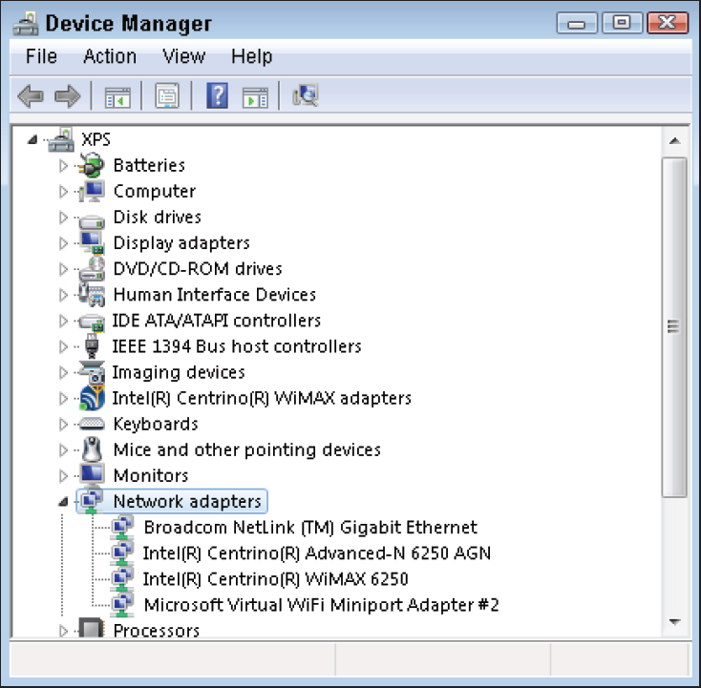
Network Adapter
Most portable computers (notebooks, tablets, smartphones) have a Wi-Fi network adapter built in.
A portable device may also have other built-in network adapters, such as a Bluetooth adapter.
Has a unique Media Access Control (MAC) address

Slide 24
MAC Address
Page 491 Step by Step

Slide 25
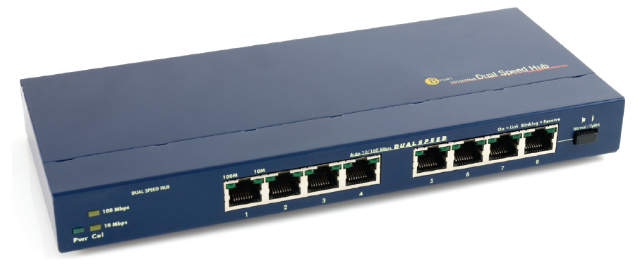
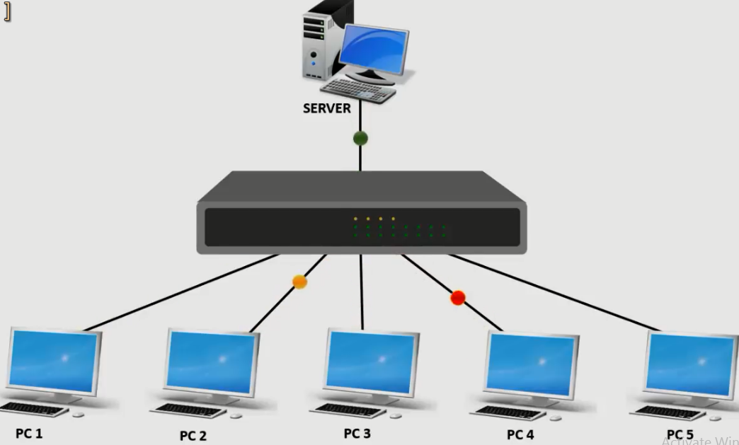
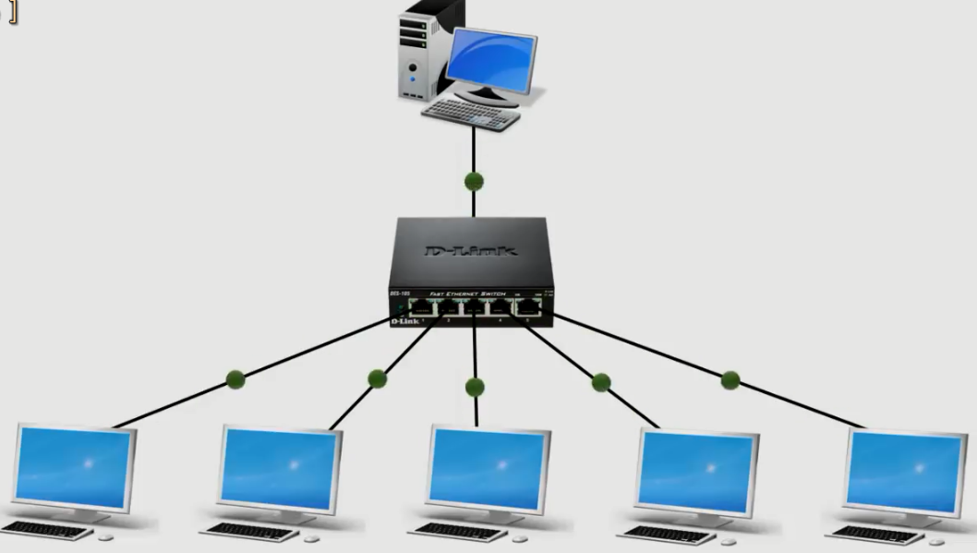
Switches and Hubs
Both are gathering points for computers in an Ethernet LAN
A switch manages data traffic between devices
A wireless switch is a wireless access point (WAP)
A hub is dumb, and sends all data to all ports

Slide 26
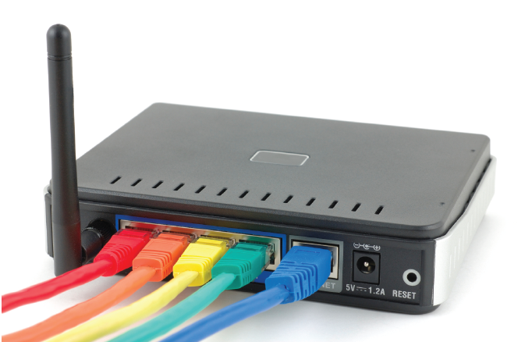
Router
Performs the same functions as a switch
Can also direct traffic into and out of your LAN
Is typically used to direct traffic to/from an Internet connection
The output port is the default gateway
Can include wireless connectivity or not
Also make the Internet possible.
The Internet consists of a mesh of interconnected commercial-grade routers that pass data back and forth between them.

Slide 27
Router

Slide 28
Other Devices
Gateway: Connects dissimilar networks
Bridge: Connects similar networks
Repeater: Receives and retransmits a network signal

Slide 29
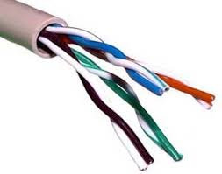
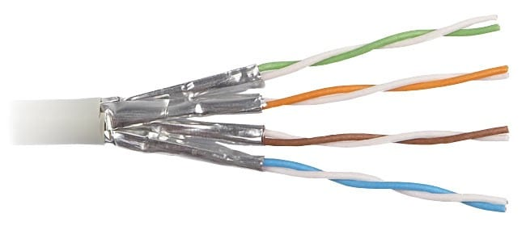
Twisted-Pair Cable
Transfers data with pairs of copper wires
Wires are twisted to reduce electromagnetic interference (EMI) within the cable
Standard cables are unshielded twisted pair (UTP)
Shielded twisted pair (STP) is more expensive and protects against EMI from outside the cable

Slide 30
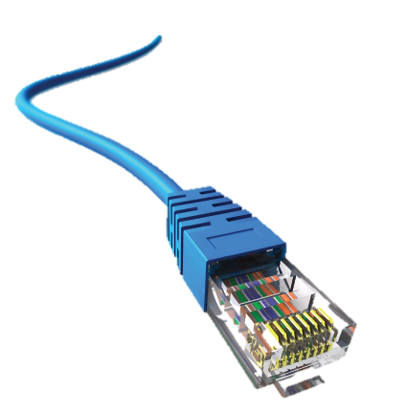
UTP Categories and Connectors
Cables:
- Category 3: Used in telephone systems
- Category 5: Data at up to 100 Mbps
- Category 5e: Data at up to 1000 Mbps (1 Gbps)
Connectors:
- RJ-11: Phone connector with two wires
- RJ-14: Phone connector with four wires
- RJ-45: Ethernet connector with eight wires

Slide 31
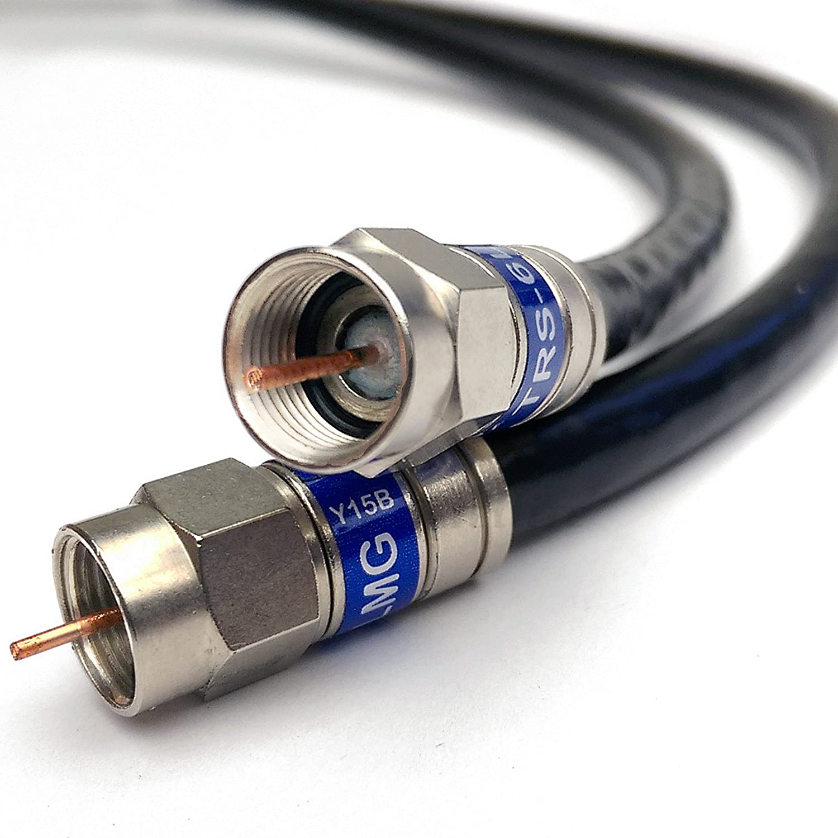
Coaxial Cable
Used for cable TV connections
Connects cable TV service or satellite dish to broadband modem
Carries data through a single copper core in electrical signals
Carries data faster than UTP but is more expensive

Slide 32
Fiber Optic Cable
Carries data with light pulses
Each fiber is about the width of a human hair
Each cable contains hundreds of fibers
Often used as the backbone of a network
Expensive and difficult to install
Fast, secure, and not subject to EMI

Slide 33
Understanding and connecting to the internet

Slide 34
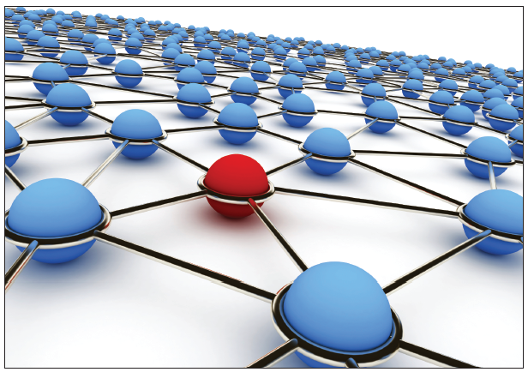
Internet Structure
Mesh of interconnected routers and servers
If any single router or server goes down, network traffic is simply routed around the point of failure.
Data may take any available path to its destination

Slide 35
Internet Structure
The Internet is a packet-switched network; each message sent is broken up into multiple data packets; each packet is sent individually.
When the packets arrive at the destination computer, the data is reassembled into the original message.
The term message refer to any data sent or received (the request to display a web page, the information you enter in an online form, or an email you send).

Slide 36
Internet Speed
Internet does not have a fixed speed
Throughput depends on the capabilities of the segment the data is passing through
At the heart of the Internet are high-capacity, high-speed data pathways.
Backbone (main roads) of the internet are high-speed lines
The backbone is made up mainly of fiber optic cables that can carry data very fast.

Slide 37
Internet Speed
Large ISPs have entire buildings full of servers that are connected directly to the Internet off of this main backbone.
From the ISP's servers to the individual, the connection speeds are lower because the cheaper copper-based cables used in those areas carry data at a lower rate.
Some ISPs charge different prices for different speeds of Internet connection.
Individual service speed has a theoretical maximum and an actual speed

Slide 38
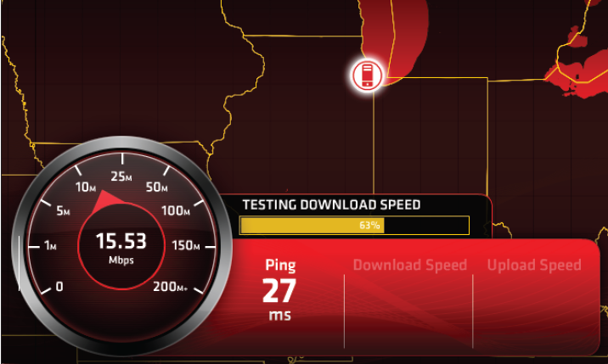
Factors that Affect Internet Speed
Internet traffic: When more people are using the Internet, overall speeds may be slower.
Local traffic: Share bandwidth cable internet with your neighbors. If someone is using a lot of bandwidth, your connection's performance may suffer.
Server issues: Individual websites that has a slow connection to the Internet or is located in an area where Internet traffic is currently heavy, or the server may be experiencing problems such as overloading .
Throttling: used more data than Internet service provider allows you to use, the ISP may temporarily throttle the speed of your connection for a certain amount of time (usually 24 hours) as a penalty.

Slide 39
Types of Internet Connections
There are a variety of factors to consider.
Speed is important, faster is better.
Faster may also be more expensive.
Important to look at availability, and evaluate any package deals you may be able to get with other services such as cable TV or phone service.
All of these types except dial-up are always on broadband connections.
The word broadband literally means wide path, but when referring to Internet connectivity it refers to a connection with a speed higher than 256 Kbps.
Many of today's broadband Internet options are much faster than that.

Slide 40
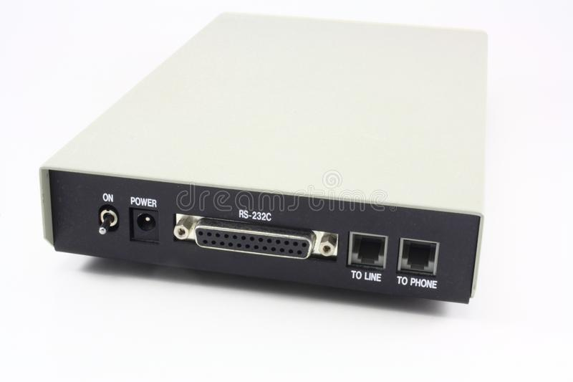
Types of Internet Connections
Dial-up
- Oldest, slowest
- Tops out at around 44.8 Kbps
- Ties up a phone line (cannot use the phone line for telephone calls while you are connected to the Internet)
- Internet is not always on (less than 1/100th of a more modern connection)
- Uses a dial-up modem (modulator/demodulator)
- The modem A device that converts between analog and digital data so computer data can be sent over analog phone lines.
- A dial-up modem can either be internal or external.

Slide 41
Types of Internet Connections
Cable Internet
- Comes through cable TV cable (coaxial cable )
- More than 100 Mbps (although most connections top out at around 30 Mbps)
- Uses a cable modem
- Fast speed
- Can be optionally shared throughout the home or business
- You can connect one computer directly to the cable modem via an Ethernet cable to receive high-speed Internet on that computer.
- Share the Internet connection with other computers by using a broadband router.
- Some cable modems are dual-purpose units, with a router built in.

Slide 42
Types of Internet Connections
Digital Subscriber Line (DSL)
- Comes through telephone land line cable with moderately fast speed
- asynchronous DSL (ADSL); download speeds are higher than the upload speeds, synchronous DSL (SDSL)upload and download speeds are the same.
- Ordinary DSL uses the same twisted-pair cable (can use them both at once. )
- Has a speed ranging from 256 Kbps to 20 Mbps depending on the distance between the service address and the phone company's connection box.

Slide 43
Types of Internet Connections
Digital Subscriber Line (DSL)
- Also deliver high-definition TV and phone service, all on a single line.
- The main drawback is geographically limited within 1,000 meters of a phone company service box.
- Newer kind, Very High Bit Rate DSL (VDSL), rivals cable Internet in speed
- up to 52 Mbps download and16 Mbps upload on copper wires and up to 85 Mbps (both download and upload) on coaxial cable.

Slide 44
Types of Internet Connections
Satellite
- involves using a satellite dish for receiving and a satellite transmitter for sending data.
- Available in places where other broadband is unavailable
- Requires professional installation of satellite transmitter (transmitter positioning is important )

Slide 45
Types of Internet Connections
Satellite
- Slower than cable or DSL (around 1 Mbps) and suffers from significant latency (delay) issues (video conferencing and playing action-based games)
- Bandwidth may be throttled
- satellite is available just about anywhere, even in the most rural of areas, as long as there is a clear view
- When faced with the choice of dial-up modem connection or satellite, people who need a broadband connection will go with satellite.

Slide 46
Internet over Cell Phone Networks
Available anywhere 3G or 4G cell phone service is available
Phone can be connected to a computer (tethered) to provide the computer an Internet connection such as tablets, notebooks, and even desktops to get Internet access in situations where Wi-Fi
Other Internet connection methods are not available such as when riding in an automobile.
There have been many different cell phone standards and technologies
3G, which stands for 3rd Generation, supports download speeds of up to 14 Mbps.
Newer and faster technology, 4G, can support up to 100 Mbps downloads.
Can be expensive on a limited data plan; beware of overages

Slide 47
Networking Issues

Slide 48
Internet Issues

Slide 49
Summary
1 . List three types of wireless connection.
2 . How do a switch and a router differ?
3 . Explain the difference between STP and UTP cable.
4 . What kind of cable would you need for a 1000BaseT network?
5 . What is TCP/IP?
6 . List four ways to connect to the Internet.
7 . List two things to try if your computer is connected to a network but can’t access the
Internet.
8 . Why is satellite Internet not more popular?

